Slide 1
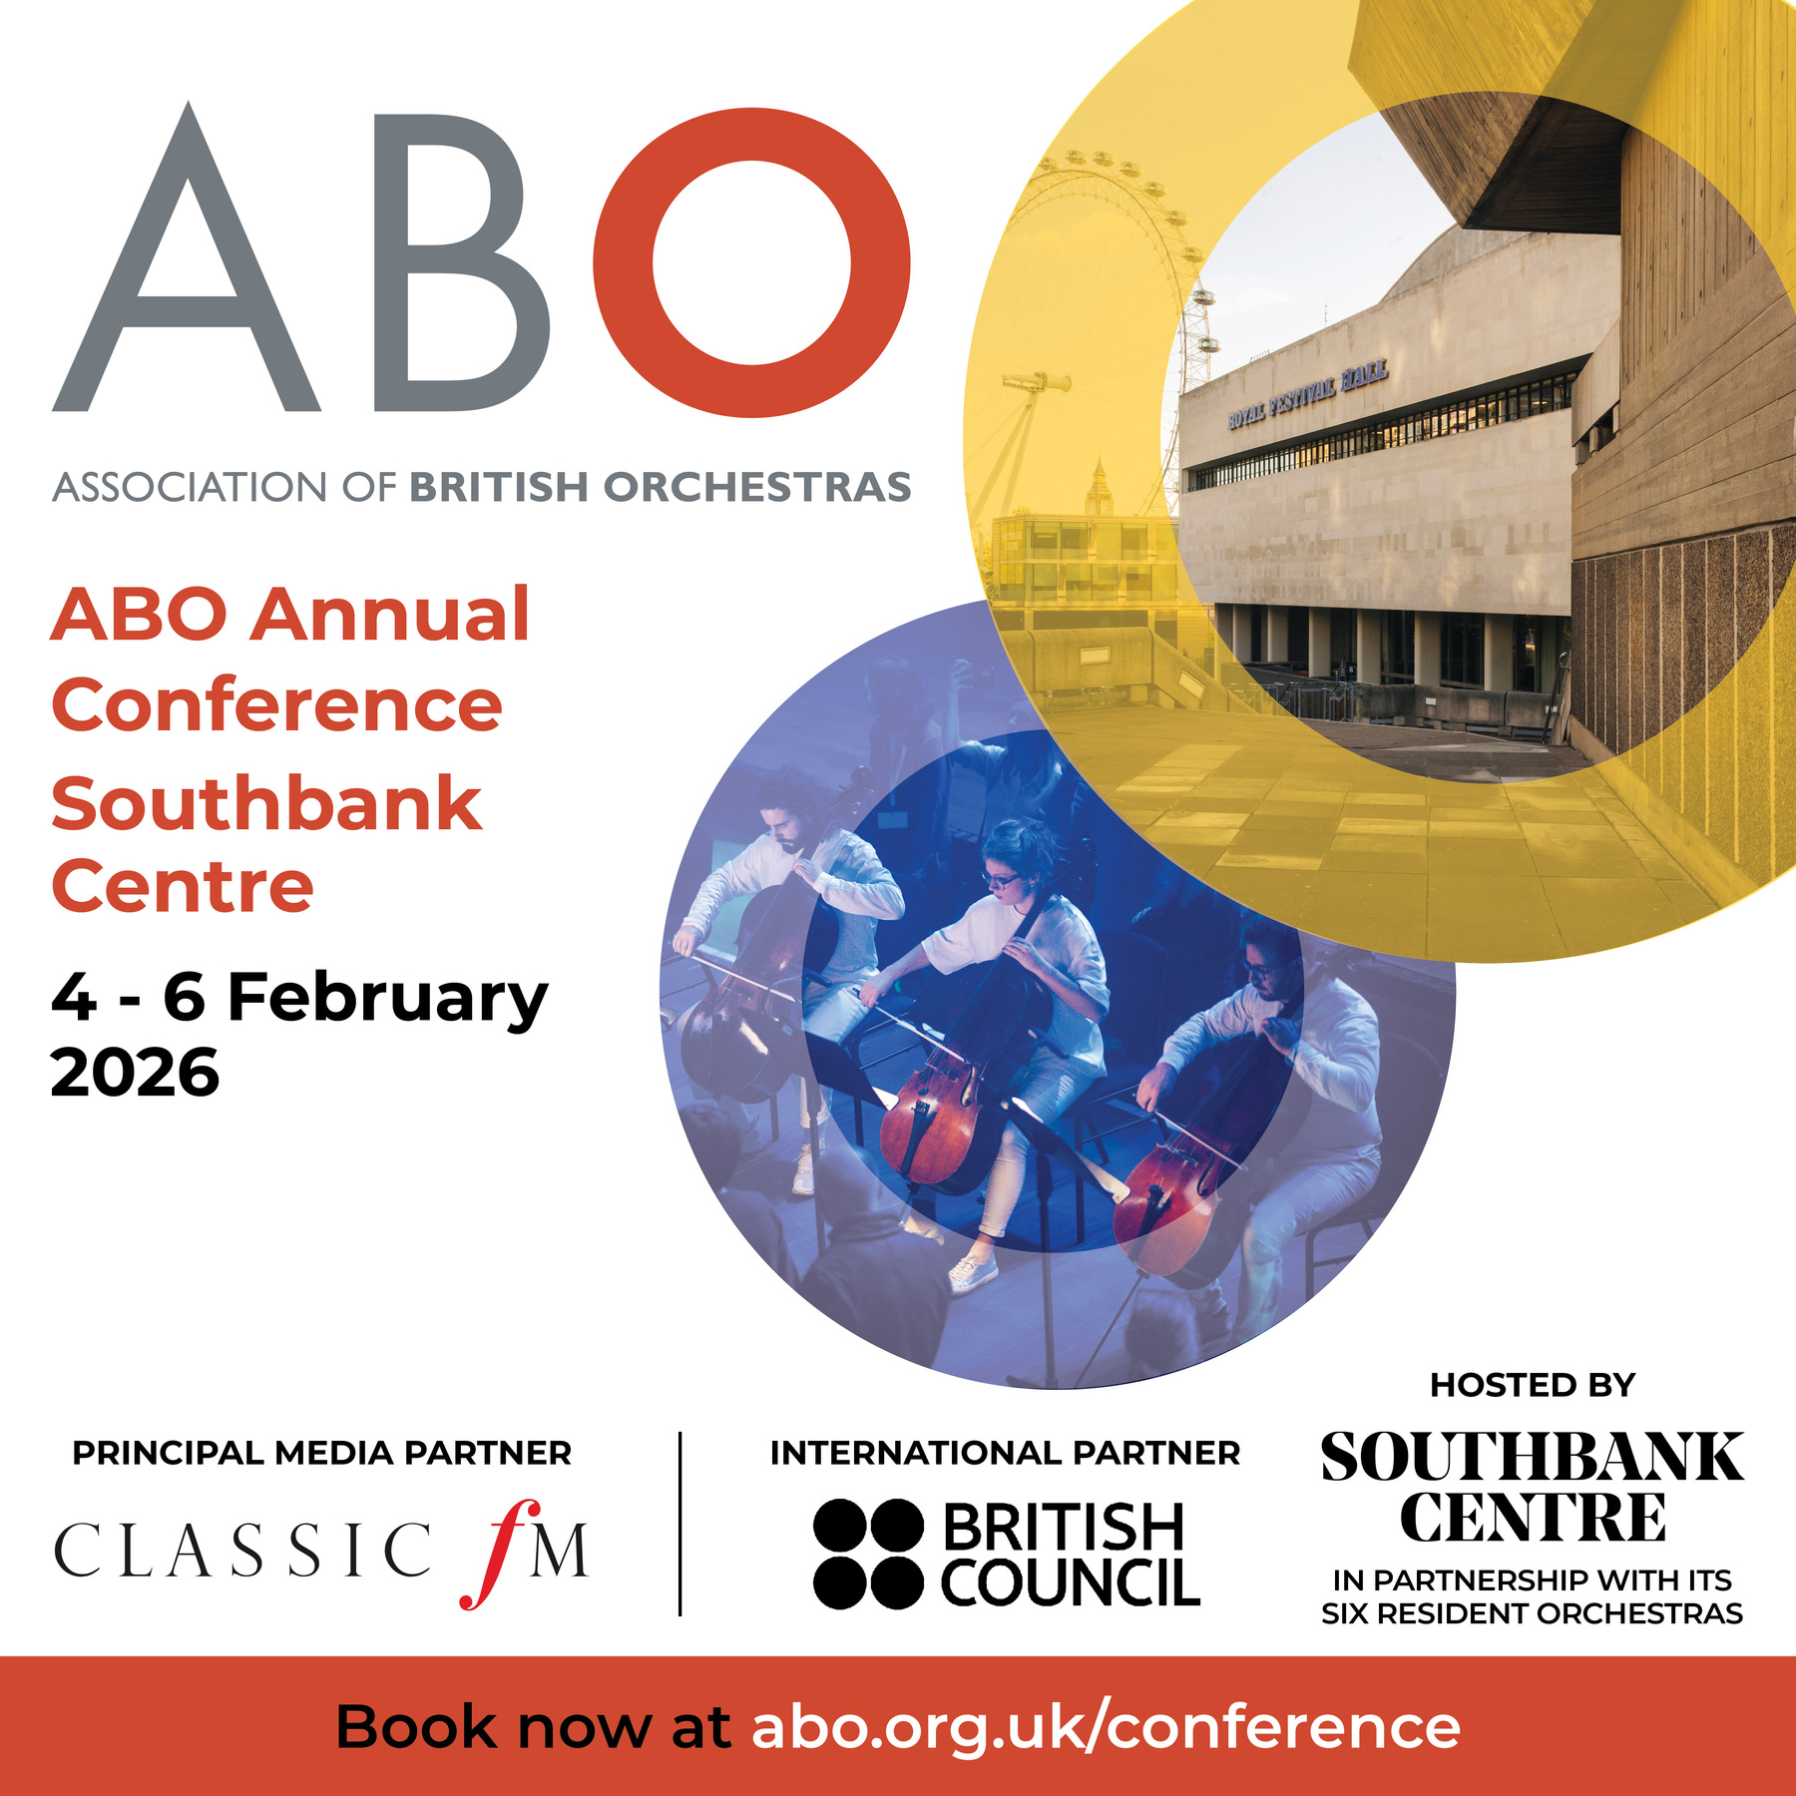





HOSTED BY
INTERNATIONAL PARTNER
PRINCIPAL MEDIA PARTNER
IN PARTNERSHIP WITH ITS SIX RESIDENT ORCHESTRAS
ABO Annual Conference
DEVOLUTION
2pm – 3.30pm
Katy Shaw
Fran Heygi
Claire Mera- Nelson
Dougie Scarfe
Mat Flynn
Join the conversation!
@aborchestras #abo2026

Slide 2



Transforming the UK’s Music Innovation Ecosystem
Dr Mathew Flynn – Co-Director
matf73@liverpool.ac.uk
ABO Conference 2026
Notes:
v

Slide 3




Liverpool: Shaping the Future of Music Innovation
MusicFutures: a five-year research and innovation programme led by the University of Liverpool in partnership with Liverpool John Moores University. Funded by the Arts and Humanities Research Council (AHRC) through UKRI’s Creative Industries Clusters Programme, it will position the Liverpool City Region as the UK’s leading hub for music research, development and innovation (R&D&I).

Slide 4
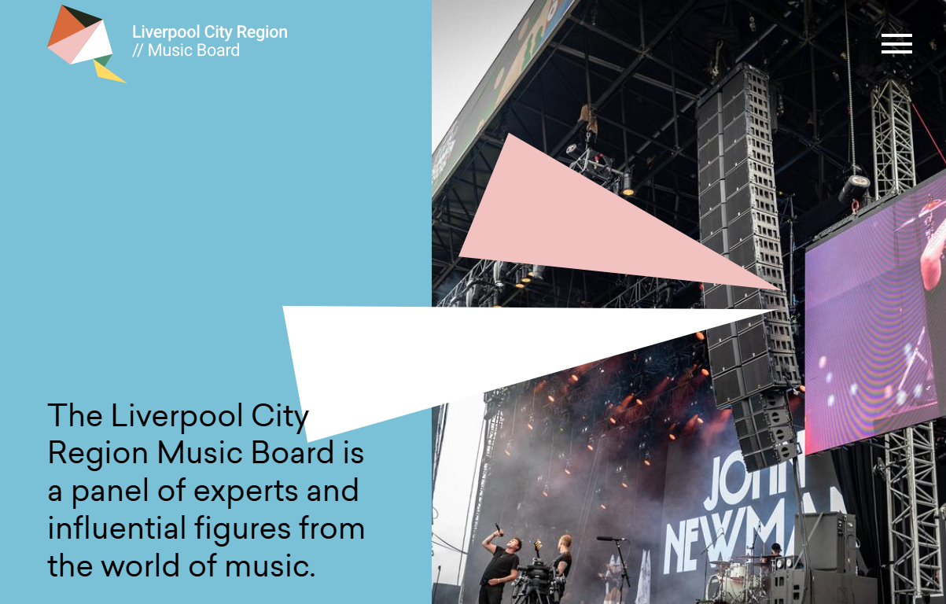
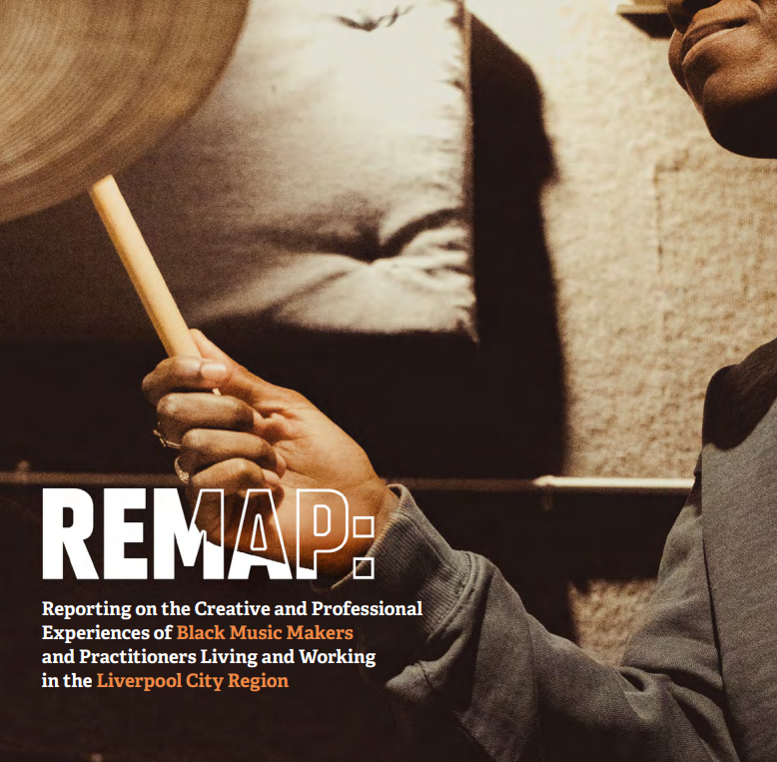


https://lcrmusicboard.co.uk/

Slide 5
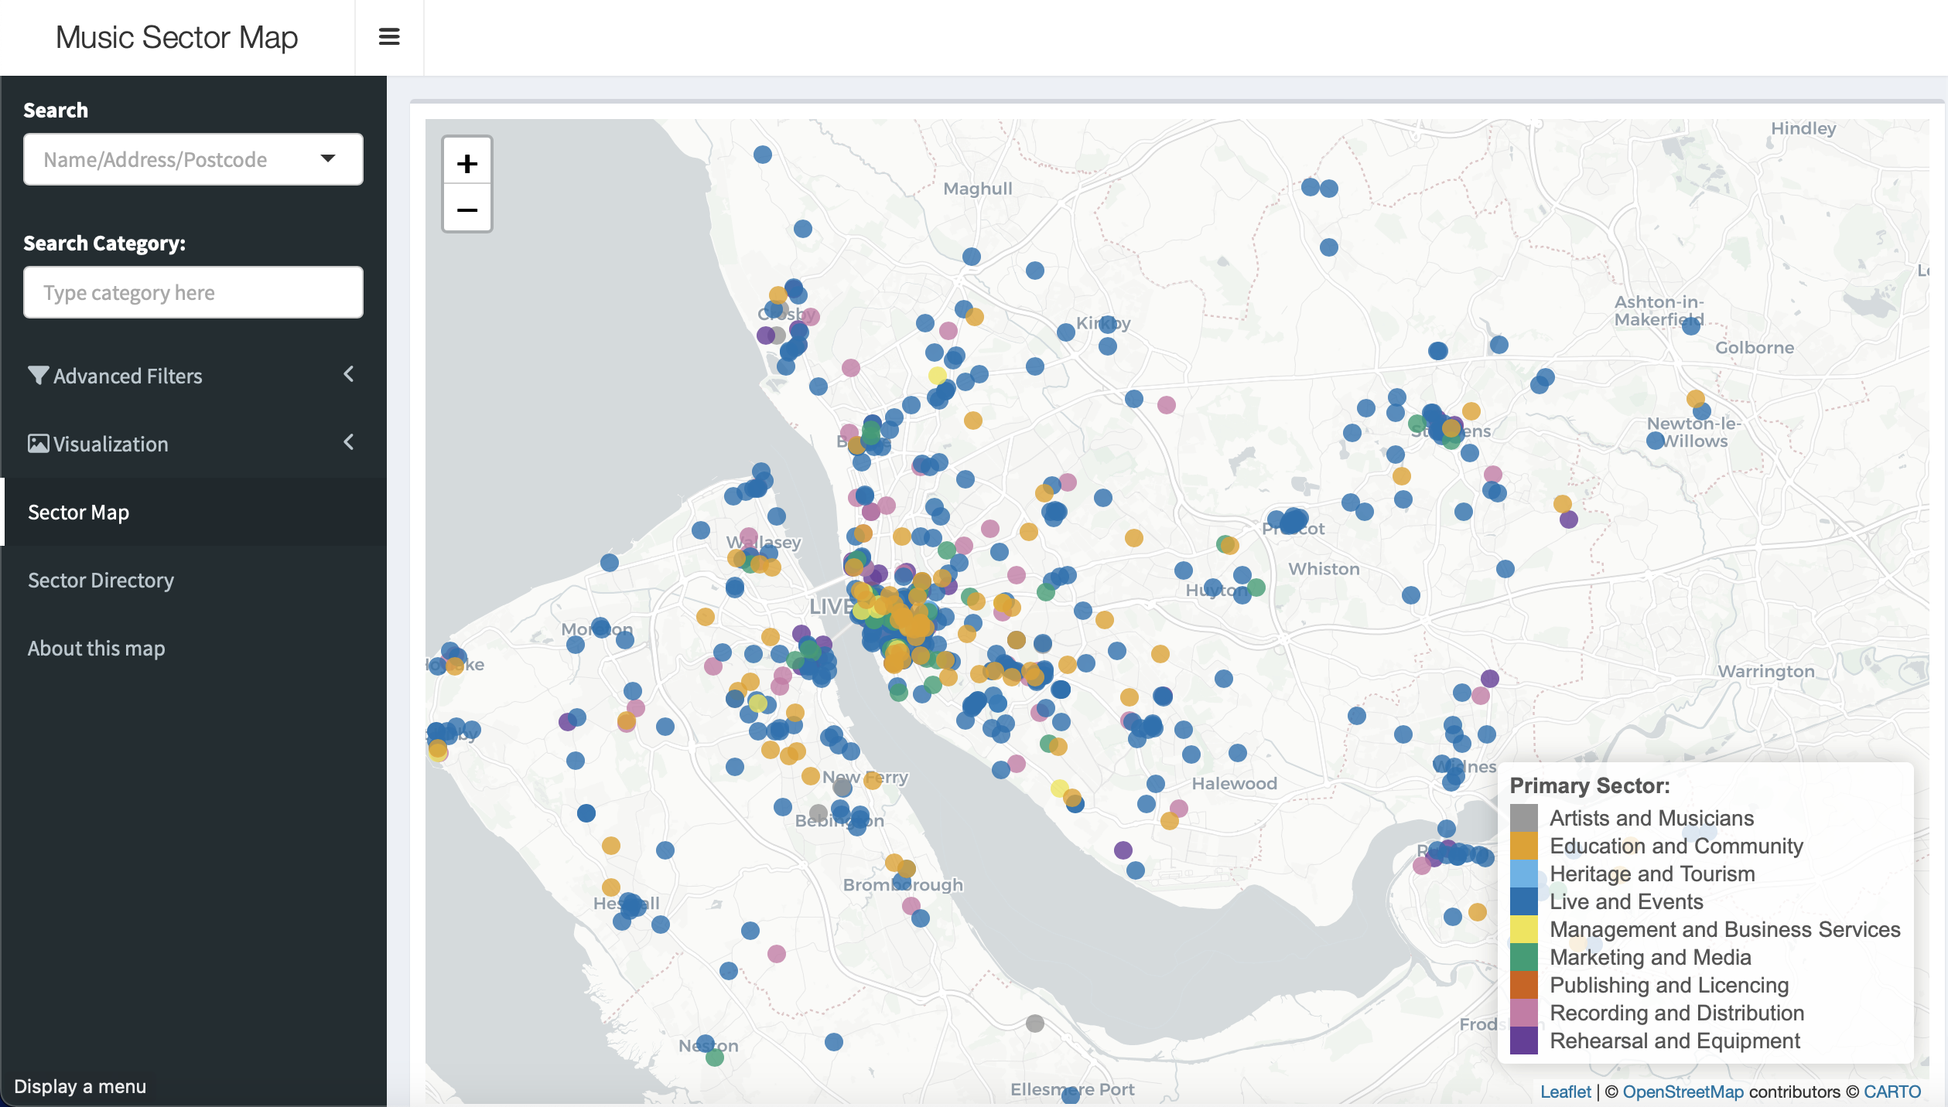
An existing music cluster
02 Sector Geography
// regional to national/global context

Slide 6
MUSIC SECTOR economic impact
Scenario | Definition & Logic | Direct FTE | Direct GVA | Total Regional Impact
Case 1: “Hard” Base | Evidence of employment, workforce and GVA from ONS, Datacity and LinkedIn + IPM/LMMP sector mapping + evidence of IG/Spotify accounts (provided by MusicSeen) | 6,780 | £277.3m | £532.4m
Case 2: Base Case | “Hard Base” + "Invisible Freelancers" community of Artists & Musicians. | 8,495 | £307.5m | £590.4m
Case 3: Integrated Case | Base Case + “Invisible Freelancers" gap in Live/Recording/Promotion across both “shared utility” of smaller venues and regional mega-assets (Stadiums, Media). | 9,570 | £373.7m | £717.5m

Slide 7
Full extent of music workforce
Sub-sector | Registered businesses (Tiers 1+2) | Visible Freelancers (Tier 3) | Invisible freelancers (Tier 4) | Total FTE | Direct GVA
Artists & Musicians | 252 | 3,033 | 1,715 | 5,000 | £88.0m
Live & Events | 620 | 450 | 750 | 1,820 | £99.4m
Rehearsals & Equipment | 465 | 320 | 150 | 935 | £70.3m
Recording & Distribution | 420 | 305 | 100 | 825 | £60.1m
Publishing & Licensing | 350 | 15 | - | 365 | £34.7 M
Management & Business Services | 115 | 115 | 75 | 305 | £12.9m
Marketing & Media | 135 | 185 | - | 320 | £8.8m
TOTAL INTEGRATED CASE | 2,357 | 4,423 | 2,790 | 9,570 | £373.7m

Slide 8
The Future of LCR Music…
Opportunities
MusicFutures – Investment into Innovative R&D & Business Growth
Creative Place Growth Fund – Bid into ringfenced funding
One Creative North – Stronger Collective Regional Voice
Music Export: Northern England?
Transmedia and convergence -
Challenges
Music is just one sub-sector of the CI and harder to quantify
Pace of politics of CAs
LA and CA relationships

Slide 9



Thank You

Slide 10


CrowdComms
Scan to download the conference app:
Or visit
crowdcomms.com/abo2026
Event code: abo2026

