Slide 1
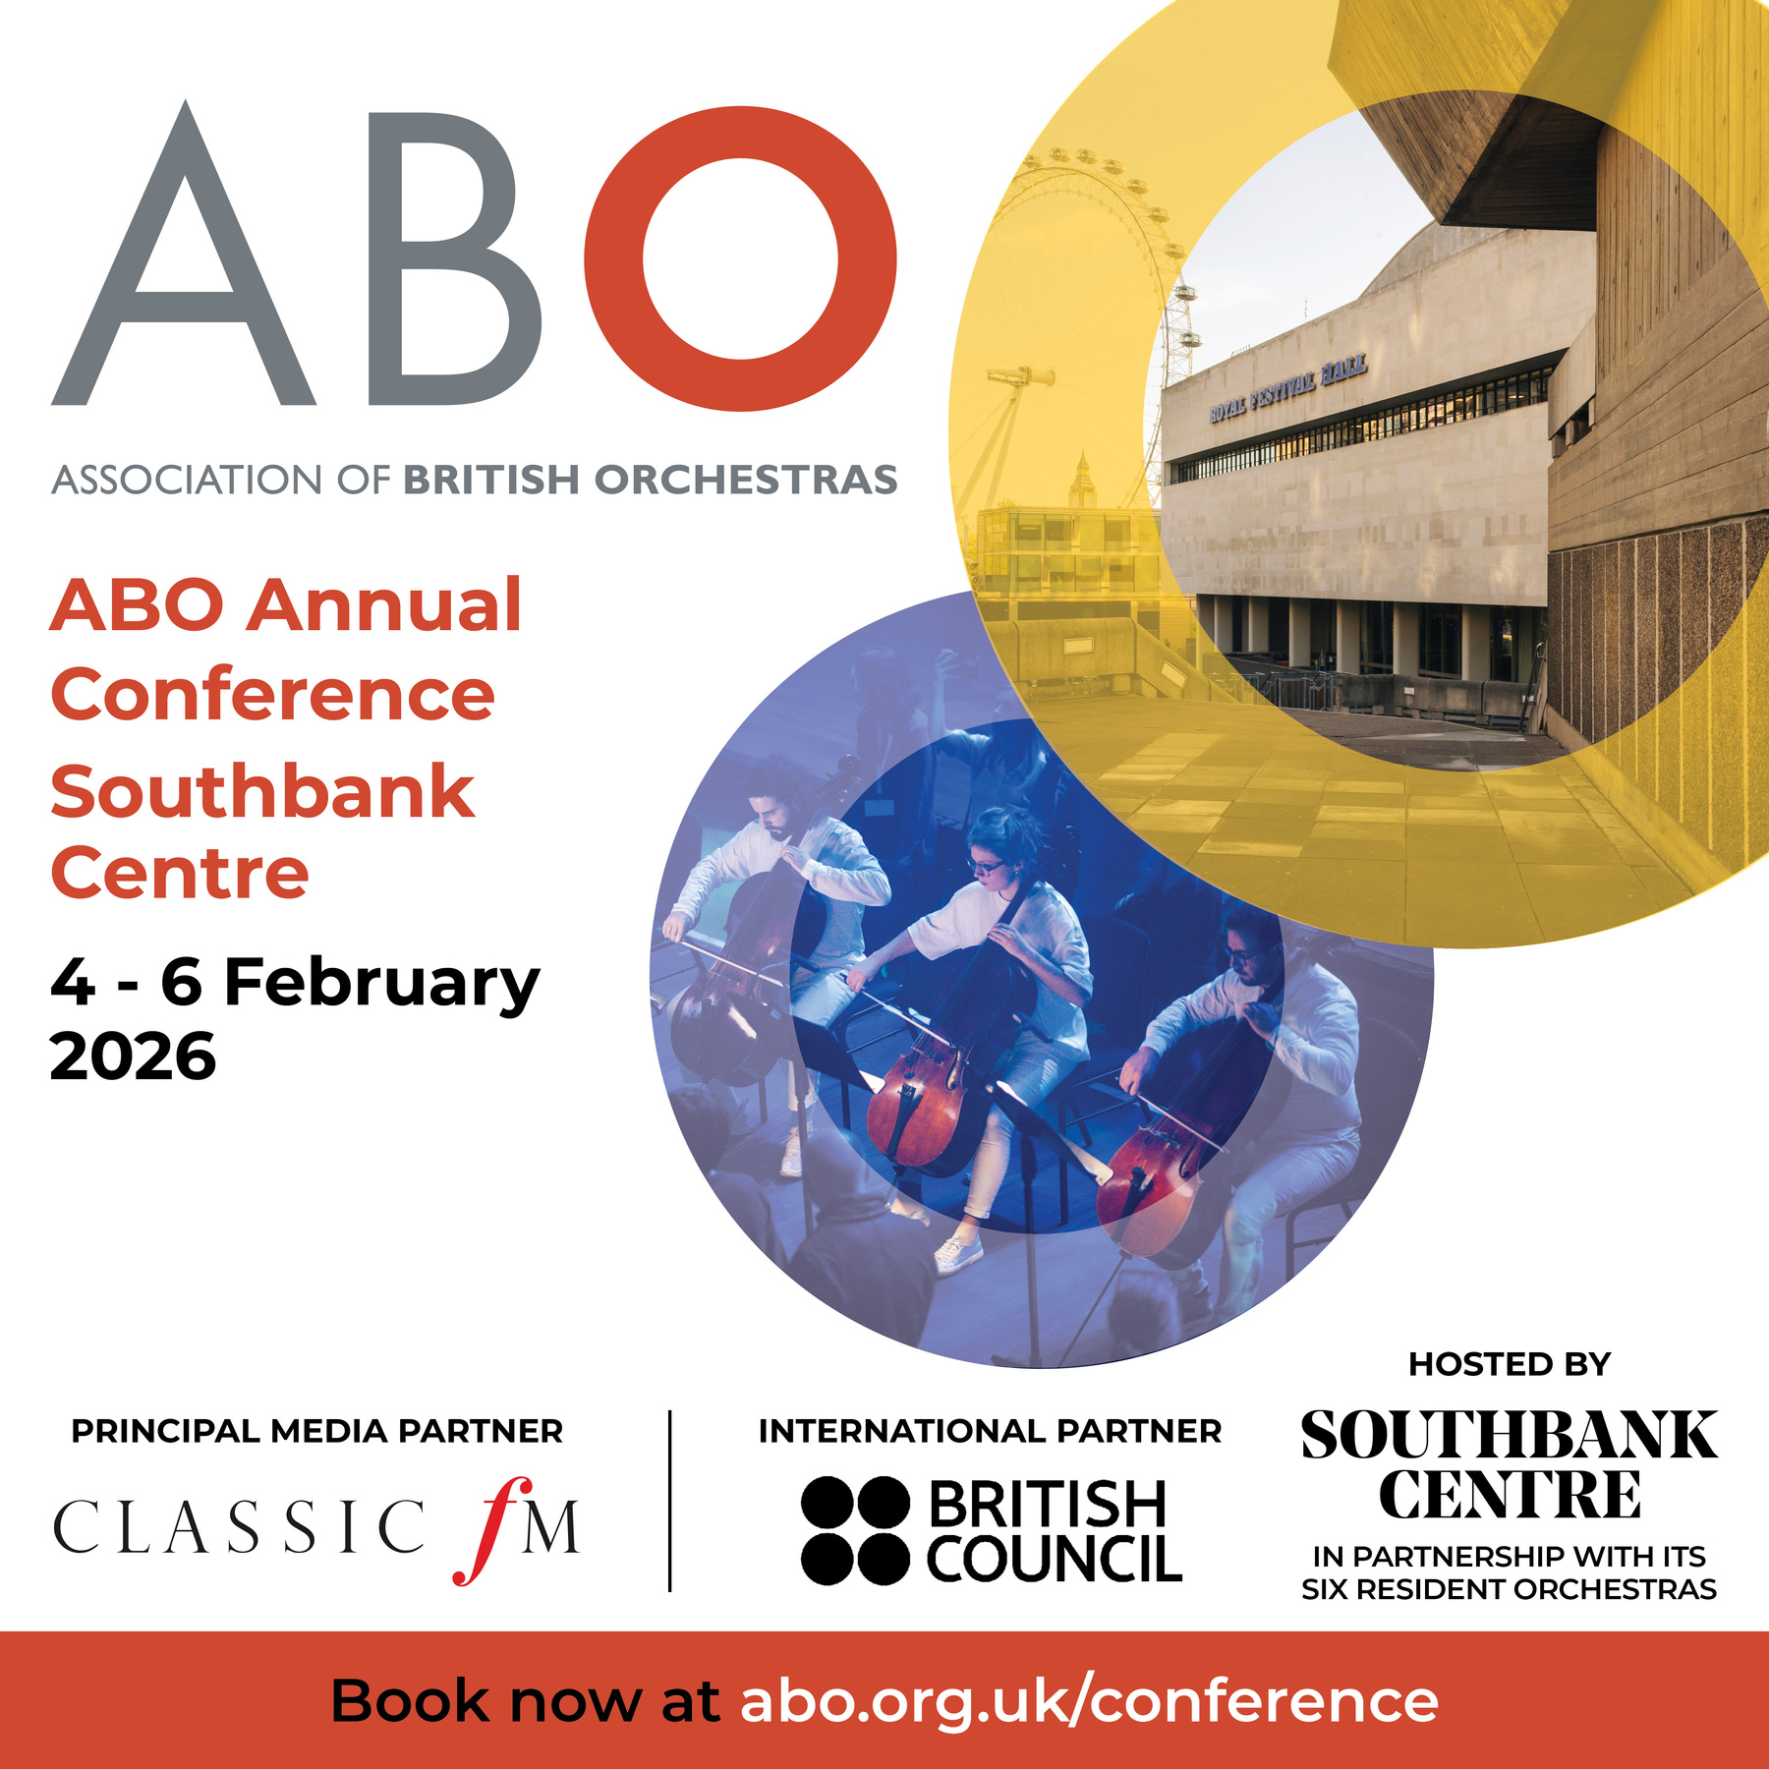






HOSTED BY
INTERNATIONAL PARTNER
PRINCIPAL MEDIA PARTNER
IN PARTNERSHIP WITH ITS SIX RESIDENT ORCHESTRAS
ABO Annual Conference
speakers
Join the conversation!
@aborchestras #abo2026

Slide 2
HOSTED BY
INTERNATIONAL PARTNER
PRINCIPAL MEDIA PARTNER
IN PARTNERSHIP WITH ITS SIX RESIDENT ORCHESTRAS
ABO Annual Conference
ENVIRONMENTAL SUSTAINABILITY
10am – 11.15am
Nick Jackman (Chair)
James Hardie
Katy Raines
Katie Sterland
Join the conversation!
@aborchestras #abo2026

Slide 3
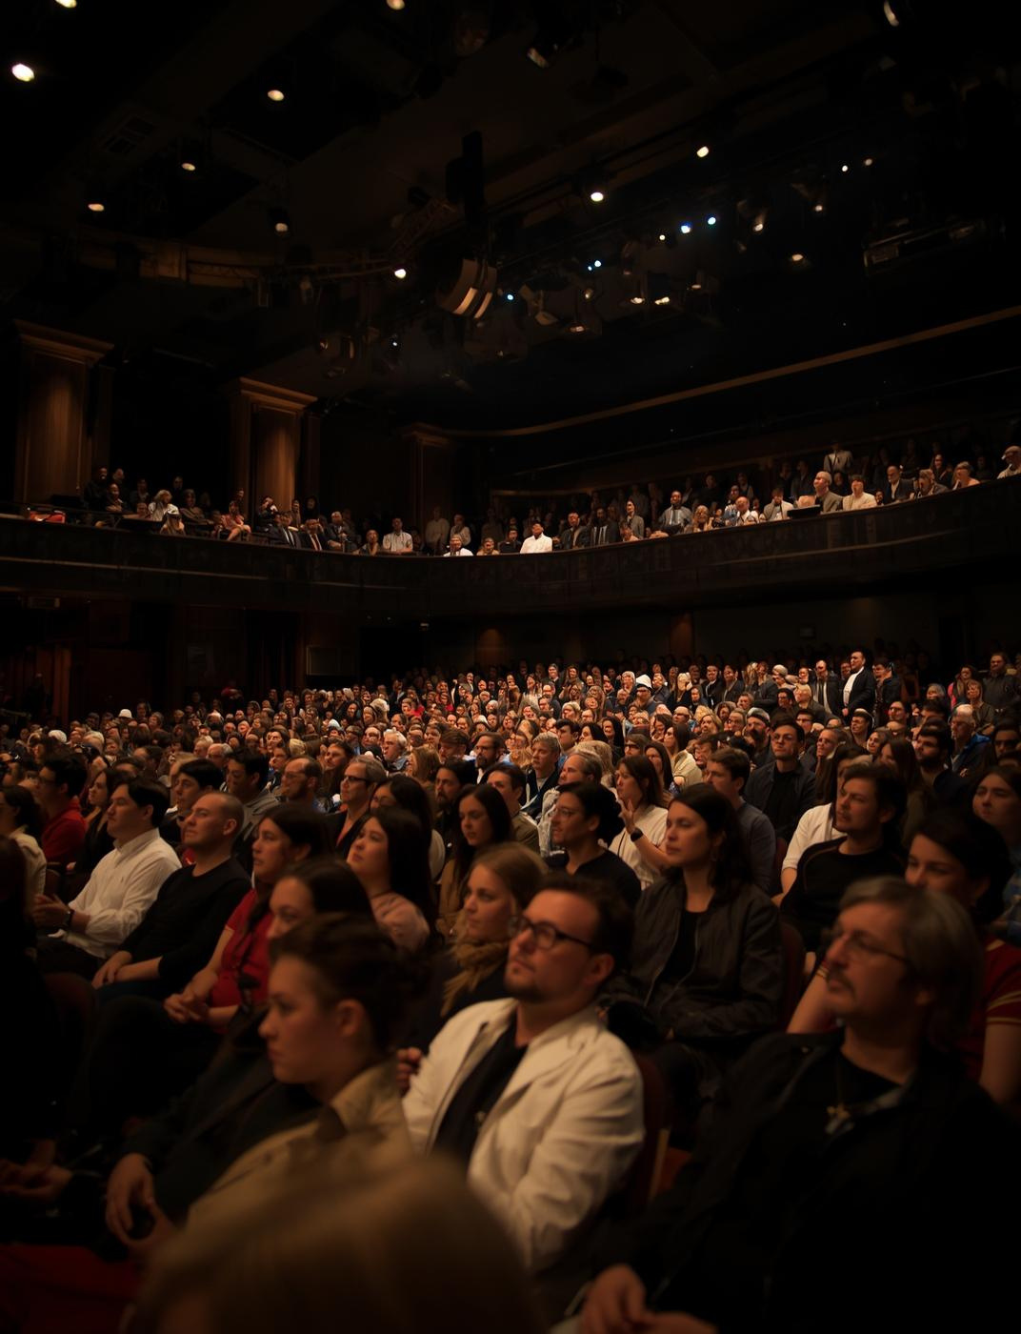

Why bother?
Katy Raines
CEO, Indigo

Slide 4

Audiences Care About Climate Crisis
“Worried/Very worried about the Impact of Climate Change”
86%
76%
Cultural Audiences
UK General Population

Slide 5
Audiences Care About Climate Crisis
Cultural audiences show strong concern levels
86%
85%
76%
Classical Audiences
Cultural Audiences
UK General Population

Slide 6
The Industry cares too...
81%
80%
Orchestras
Concert Halls

Slide 7
The Industry cares too...
Artists less so
81%
58%
80%
Artists
Orchestras
Concert Halls

Slide 8


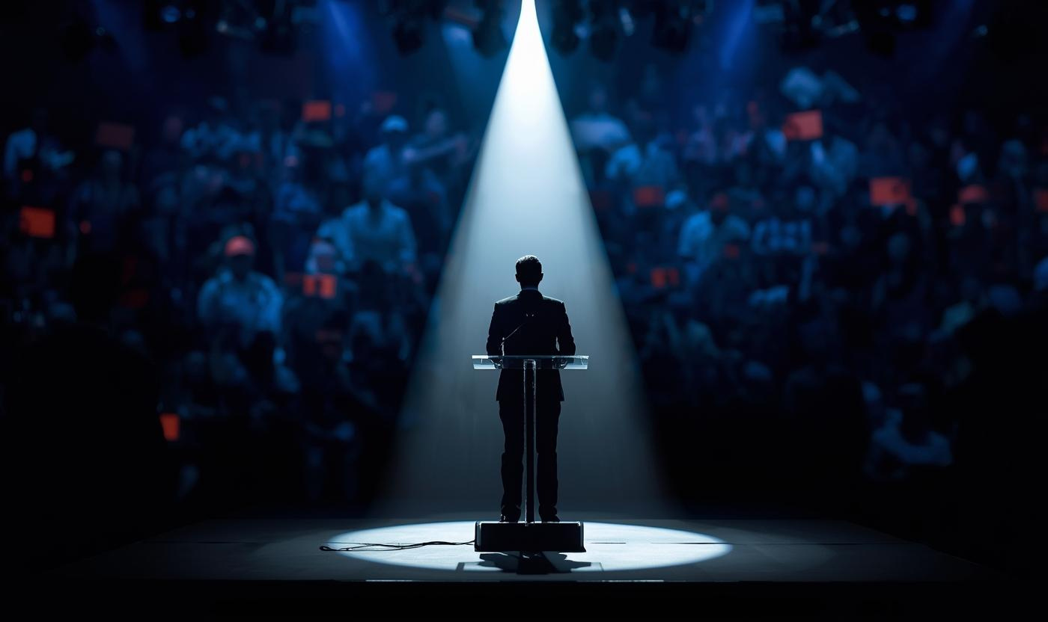
Leadership Expectations of Audiences
72%
“Cultural organisations have a responsibility to influence society to make radical change to address the climate emergency”

Slide 9

Visibility of Action
13%
of Classical Audiences think cultural organisations place great importance on playing an active role in tackling climate change

Slide 10
Visibility of Action
13%
14%
Classical Audiences
Industry professionals

Slide 11
Visibility of Action
13%
14%
Classical Audiences
3%
Industry professionals
Artists

Slide 12

Silence has consequences
25%
of audiences don’t know how much importance that organisation is placing on sustainability

Slide 13
Silence has consequences
22%
of audiences have stopped attending or attended less
if they see an organisation showing a lack of commitment to sustainability

Slide 14


Why bother?

Slide 15
HOSTED BY
INTERNATIONAL PARTNER
PRINCIPAL MEDIA PARTNER
IN PARTNERSHIP WITH ITS SIX RESIDENT ORCHESTRAS
ABO Annual Conference
ENVIRONMENTAL SUSTAINABILITY
10am – 11.15am
Nick Jackman (Chair)
James Hardie
Katy Raines
Katie Sterland
Join the conversation!
@aborchestras #abo2026

Slide 16

Small organisation: 4 - 21 freelance musicians based in Scotland and around the UK, 8 staff based in Glasgow
Agile, relationship-driven: deliver work with venues, festivals and partners around Scotland plus UK and international touring
Co-founders of Scottish Classical Sustainability Group

Slide 17
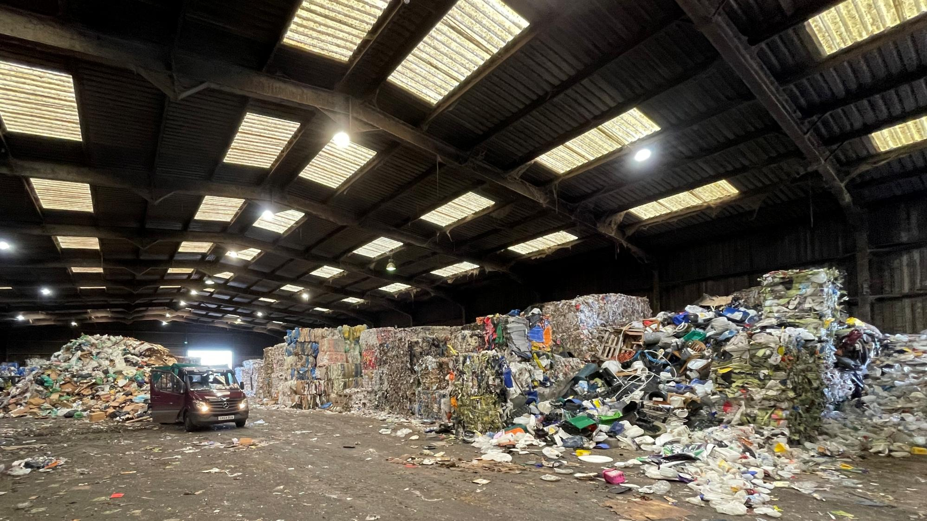

Slide 18
Measuring, Understanding, Reducing
Measuring and reporting carbon data since 2015, working with Culture for Climate Scotland to interpret and identify reductions.
Identifying areas for reduction in our operations across touring, travel, production, office and digital
Biggest impacts often outside our direct activity: freelance travel

Slide 19
Advocacy & Collaboration
Scottish Classical Sustainability Group includes 30 organisations
Regular meetings to share best practice and current challenges, and contribute to national policy conversation
Two major research pieces: ‘Scottish Classical Music Green Guide’ and ‘Classical Music & Train Travel in Scotland’
Code of conduct with international agents
Green Riders for Scotland, UK, and international partners, reducing road miles, food waste, and other environmental impacts.

Slide 20
Looking Ahead
Build internal carbon literacy: embed awareness across staff and artists, shared responsibility across team
Extend advocacy: strengthen relationships with agents, venues, and the wider sector
Embed sustainability early: integrate into planning, touring and promoter conversations; prioritise sustainable travel
Explore sustainability artistically: new commission on place, landscape, and cultural heritage to engage audiences

Slide 21
Challenges
Wanting to move quickly, but broader systems not keeping pace, for example: player terms and conditions while existing structures don’t always allow for this.
Year-on-year reporting pressure: as a small organisation, our touring footprint can fluctuate significantly, yet there’s an implicit expectation to show continual reductions aligned with 2030 and 2045 net zero targets.
Competing priorities from funders, particularly balancing internationalism with environmental sustainability, often without clear guidance on how those tensions should be navigated.

Slide 22
HOSTED BY
INTERNATIONAL PARTNER
PRINCIPAL MEDIA PARTNER
IN PARTNERSHIP WITH ITS SIX RESIDENT ORCHESTRAS
ABO Annual Conference
ENVIRONMENTAL SUSTAINABILITY
10am – 11.15am
Nick Jackman (Chair)
James Hardie
Katy Raines
Katie Sterland
Join the conversation!
@aborchestras #abo2026

Slide 23
Environmental Sustainability:
How to get started
Association of British Orchestras Annual Conference
February 2026

Slide 24
Don’t let perfect be the enemy of the good
Start measuring your carbon footprint
Set a roadmap with realistic targets
Implement key decarbonisation levers
Contextualise environmental within wider sustainability strategy

Slide 25
1. Measuring your carbon footprint

Slide 26
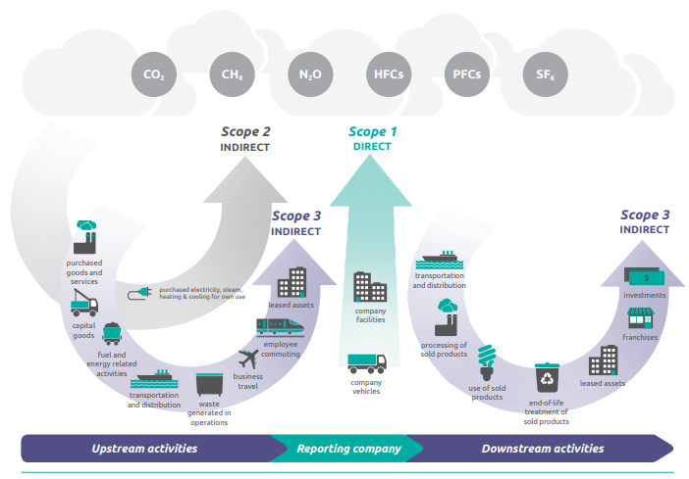
Greenhouse Gas Emissions
Scope 1
Direct emissions
Use of fuels including natural gas, petrol, diesel, and refrigerants
owned or controlled source
Scope 2
Emissions from purchased indirect energy Use of electricity, heat, steam & cooling
Scope 3
All other value chain emissions, both upstream (suppliers) and downstream (customers/audiences)

Slide 27
GHG Emissions Calculations
Data (Energy Consumption)
Emission Factor
Emissions
x
=
Example: London to Manchester
Emissions factors quantify the amount of GHG emissions produced per unit of activity. Most GHG inventories use emissions factors from public datasets such as DESNZ or IEA.
Mode | Distance | Emission Factor (DESNZ) | CO₂e Emissions
Train | 262 km | 0.03546 kg CO₂e/passenger-km | 9.3 kg CO₂e
Car (Medium-Sized, Petrol, 2 passengers) | 339 km | 0.17174 kg CO₂e/km | 29.1 kg CO₂e
Plane | 243 km | 0.22928 kg CO₂e/passenger-km | 55.7 kg CO₂e
  Utilise free online tools that can make these calculations:
    e.g. Julie’s Bicycle, REVERB, Atmosfair

Slide 28
Carbon Footprint
Example emissions breakdown for an orchestra
Your Scope 1 & 2 emissions are where you have direct control.
It is likely the majority of your emissions will sit in Scope 3:
  The vast majority of which will be Business Travel (touring) and Audience Travel.
Example emissions breakdown for an orchestra highlighting key Scope 3 categories

Slide 29
Guidance for Measurement
It is best practise to report carbon emissions using Greenhouse Gas Protocol, splitting data by Scope 1, 2 and 3.
Depending on the location of touring in a given year, an orchestra’s footprint may fluctuate significantly.
  If this is the case, we suggest you use a rolling average (e.g. three years) to more clearly see a general trend line.

Slide 30
2. Setting Targets

Slide 31
Set realistic targets
Identify and prioritise your decarbonisation levers
  Largest emissions sources
  Most controllable
  Are there any co-benefits? e.g. cost savings, reputation, creative opportunities
Define strategic ambition
  How much change is possible based on resources and ambition?
Example Targets:
Reduce emissions from domestic touring by 20% by 2028
Increase the % of trips taken by rail vs. air

Slide 32


‘Carbon Neutral’ vs. ‘Net Zero’
Carbon Neutral
Pay to compensate for your emissions
Balance carbon emissions by offsetting them through carbon avoidance or removal. No defined emissions Scopes or boundary to include.
Net Zero
Reduce the majority of your emissions
Long-term decarbonisation (90-95%) aligned to 1.5 degrees of Scope 1,2 & 3 emissions and balancing residual emissions with carbon removals.

Slide 33
3. Decarbonisation Levers

Slide 34
Buildings: Performance & Rehearsal Venues, Offices
1. Reduce energy demand
2. Electrify
3. Switch to renewables
Your first step is to reduce energy demand through energy efficiency measures like: LEDs Insulation Behavioural change | Once your energy demand is as low as possible, you should begin electrifying your fossil fuels. This can be done by switching from natural gas boilers to heat pumps or switching your fleet to EVs. | The final step is to switch to renewable energy like: installing onsite renewables like solar PV procuring renewable energy.

Slide 35
Operations & Procurement
Update supplier code of conduct
Use local suppliers where possible
Reduced waste
  Ban single use plastics
Lower-carbon catering (meat-free)
Reduction in print
  FSC or PEFC accredited paper supplier
  Digital programmes
  Digital ticketing
Beyond Carbon
Water
Pollution
Waste
Nature & Biodiversity

Slide 36
The needle-mover: Travel & Touring
Efficiency in programming
  Fewer but longer tours
  Multi-date residencies/more performances per venue
  More cities within one country
Mode of transport
  Replace flights with rail where possible
  Avoid internal flights
  Direct flights where possible
Hiring equipment locally to avoid freight travel
Introduce travel policies for guest musicians/conductors
  Economy vs. business class
Transparent touring carbon budgets

Slide 37
Audience Travel
Combine live and streamed concerts
Encourage green transport via ticketing websites
Offer shuttle bus/coach transport to nearby rail stations
Enable active travel:
  Bike parking and clear signage
  Well-list pedestrian paths
Green ticketing incentives
  Partnering with local public transportation

Slide 38
4. Embed into wider sustainability strategy

Slide 39
Consider wider sustainability strategy
While this session is focussed on environmental topics, these sit within a broader sustainability strategy that also includes social and governance aspects.
Consider the broader purpose of your orchestra
  Do you have education, outreach or community programmes?
Power of content: Use your artistic programming to inspire audiences and engage with sustainability topics.
Holistic strategy helps orchestras look beyond carbon reduction to recognise and amplify their wider positive impact.

Slide 40
Key Takeaways
Progress > perfection
  Start where you are, use what you have, share what you learn
Set realistic targets
Link environmental progress to wider sustainability strategy

Slide 41
HOSTED BY
INTERNATIONAL PARTNER
PRINCIPAL MEDIA PARTNER
IN PARTNERSHIP WITH ITS SIX RESIDENT ORCHESTRAS
ABO Annual Conference
ENVIRONMENTAL SUSTAINABILITY
10am – 11.15am
Nick Jackman (Chair)
James Hardie
Katy Raines
Katie Sterland
Join the conversation!
@aborchestras #abo2026

Slide 42


CrowdComms
Scan to download the conference app:
Or visit
crowdcomms.com/abo2026
Event code: abo2026

Slide 43
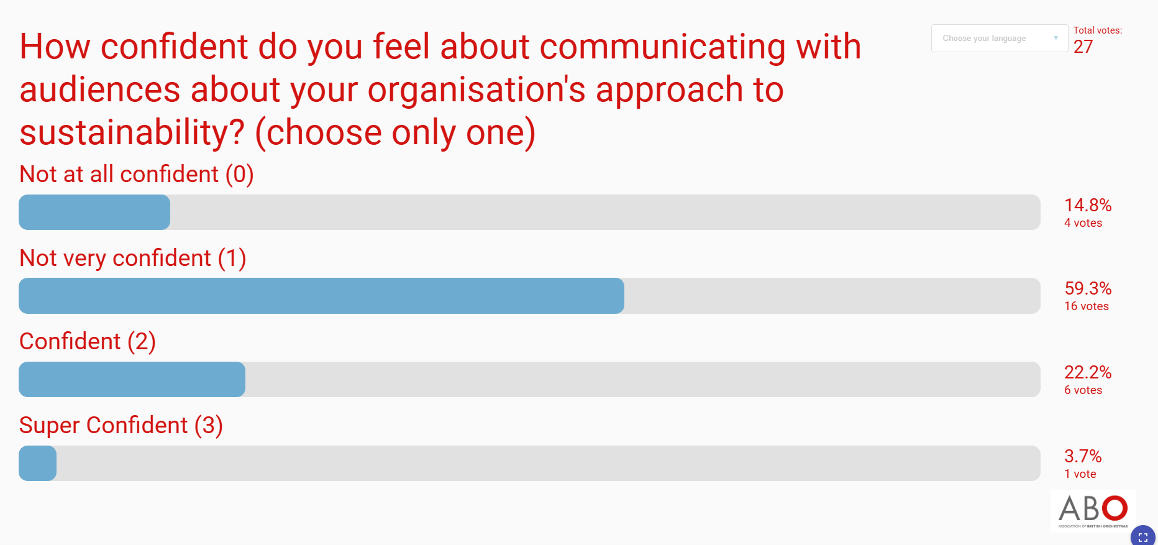

Slide 44
What Audiences Reject
01
02
03
Preaching
Guilt
Vague claims
Audiences dislike being lectured or scolded.
Guilt-based messaging alienates and disheartens audiences.
Ambiguous statements lead to distrust and confusion.

Slide 45
What audiences value
01
02
03
Clarity
Honesty
Relevance
Clear messages resonate with audiences deeply.
Sincere communication builds essential trust.
Pertinent content captures audience engagement effectively.

Slide 46

Building Trust
Imagining a
Positive Future
Creative work and
new narratives
Positively Challenging
Inviting audiences to
act
Leading by Example
Specific projects and
decisions
Doing What's Expected
Basic operations and
consistency

Slide 47




Talking Sustainability toolkit 2026
Act Green Research 2026
Sustainable Classical 2024
Indigo-ltd.com

Slide 48
HOSTED BY
INTERNATIONAL PARTNER
PRINCIPAL MEDIA PARTNER
IN PARTNERSHIP WITH ITS SIX RESIDENT ORCHESTRAS
ABO Annual Conference
ENVIRONMENTAL SUSTAINABILITY
10am – 11.15am
Nick Jackman (Chair)
James Hardie
Katy Raines
Katie Sterland
Join the conversation!
@aborchestras #abo2026

Slide 49
HOSTED BY
INTERNATIONAL PARTNER
PRINCIPAL MEDIA PARTNER
IN PARTNERSHIP WITH ITS SIX RESIDENT ORCHESTRAS
ABO Annual Conference
speakers
Join the conversation!
@aborchestras #abo2026

