Slide 1
Sir Vernon Ellis
Arts Philanthropy

Slide 2
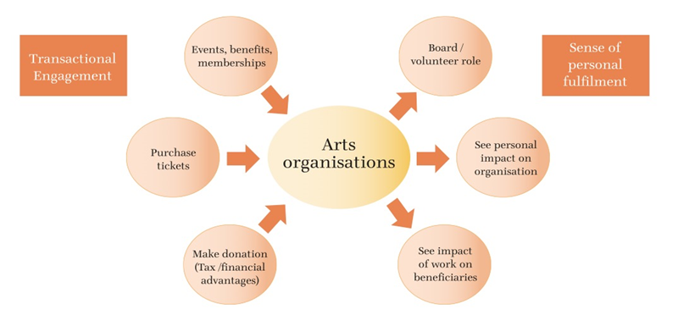
Turning patrons into donors

Slide 3
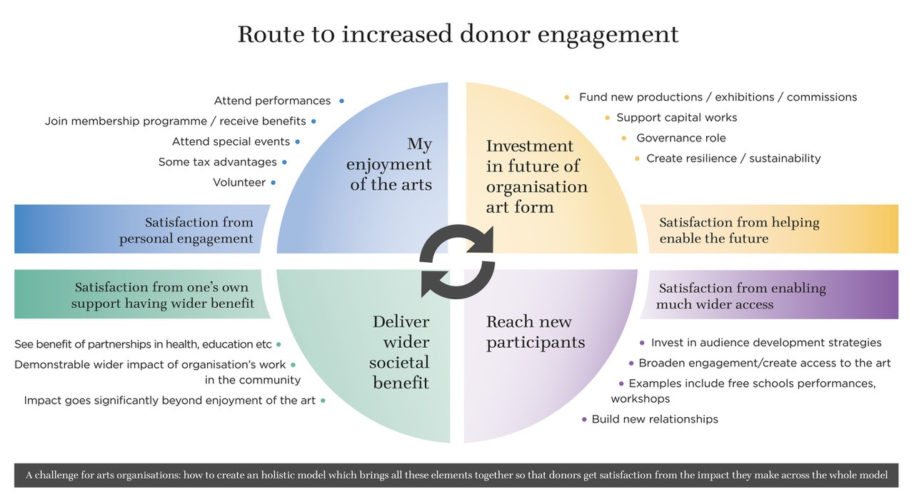
Route to increased donor participation

Slide 4
The case for support for the sector
“Why should philanthropists support cultural causes? What makes the arts deserving of their donations? The answer to these questions is practical and straightforward – the arts, culture and creativity change lives. They promote wellbeing, ease loneliness, and enable individuals and communities to tell their stories, among many other benefits.”
Sir Nicholas Serota, Chair Arts Council England
March 2020
New Philanthropy for
Arts & Culture

Slide 5
Anna Rowe
New Philanthropy for Arts & Culture
ABO Conference
Leeds, 2 Feb 2023

Slide 6
NPAC Background - Understanding arts philanthropy
Develop a new arts focused cause-related network:
  Provide a case study into best practice for engaging and supporting philanthropists
  Create a framework for operation, and explore different membership models
Understand philanthropists’ motivations and barriers to giving
  Research existing philanthropists’ routes to philanthropy
  Beacon research into barriers for giving
  Philanthropists’ response to COVID-19 pandemic: what can we learn?
Beacon surveyed 1,300 HNW individuals in summer 2019
  20% of respondents identified arts and culture as one of 3 preferred areas of interest
  Both education and health attracted a higher %
  This suggests that ‘arts in education’ and ‘arts in health’ might attract additional support
  Research also confirmed the importance to donors of the impact of their philanthropy
New Philanthropy for Arts & Culture

Slide 7
Impact as a unifying cause and driver of support
  Understanding the impact of the Arts
    Initial hypothesis was that sector impact on community, wellbeing, health and education could be driver of support
    But… impact defined differently by each organisation
    40 case studies compiled from database of 150
    Clear that significant resource required to scale up activity nationally
    We believe that the most effective way of leveraging a powerful narrative of the value of arts and culture is through more focused common cause networks
Creating a Cause
    Increased importance of a local focus (beneficiaries, supporters)
    Common cause to be created around the vital role of the arts and impact on creativity, economic activity, education, wellbeing, health and the community
    Particularly challenging for smaller, under-resourced arts companies in regions where the levelling up agenda is most urgent and philanthropy is very limited
We concluded that there is potential to create a unifying cause in specific places to drive new philanthropy to support the sector in each location

Slide 8
NPAC current work - mobilising philanthropy
Creating cause related place-based networks
  Core Cities Leadership presentation opened up conversations across England
  Discussions in Sunderland, Birmingham, Stoke, Hastings, Leeds, Newcastle
  Different models for operation emerging, around impact of the arts in each place
Developing a framework for attracting the next generation of arts trustees and philanthropists
New funding models to drive philanthropy
  NPAC work focused on development of a matched funding model for the sector
  Developed a theory of change around place-based matched funding
  BCG research into international case studies included several successful models
Toolkit for arts organisations new to philanthropy
  artsphilanthropy.org.uk
New Philanthropy for Arts & Culture

Slide 9
Local partnership model - Sunderland
Local cultural partnership
MAC Trust,
Sunderland University,
Sunderland City Council
Increased funding for Arts & Cultural organisations
Fundraising and philanthropy network created by fundraiser
Local delivery vehicle
Sunderland Culture
Opera Sunderland; Young Asian Voices; The Cultural Spring etc.
NPAC support

Slide 10
Cultural compact led model - Stoke
Events in Stoke and London
Increased individual support for Arts & Cultural organisations
Existing local partners and philanthropists
Local delivery vehicle to receive contributions
Create Stoke wide narrative
Enlarged group of Stoke philanthropists
(local and other)
Stoke Creates
Made in Stoke
Optional stage
NPAC partnership, enabling and support

Slide 11
Local government led model - Birmingham
Launch event in Birmingham
Networks of grassroots organisation chairs and pan region arts trustees
Increased individual support for Arts & Cultural organisations
Initial conversations with arts organisations and their trustees
Local Government and cultural partners
Local delivery vehicle to receive contributions
NPAC advocacy as catalyst
Optional stage
Mayor of the West Midlands
Birmingham City Council
Culture Central

Slide 12
A place-based approach – key learnings
Personal connections: fledgling groups have come about due to the use of personal connections and, usually, a peer to peer ask
Future recruitment: in time recruitment to be broader
Partnership: the broader the range and scale of the partners involved, the greater the impact of any work that's delivered
Good governance is key and particularly having a strong Chair will provide the greatest likelihood of success
Management of different agendas in each location can be challenging
Brokerage is attractive to some philanthropists
Locally based leadership / administrative support is required
Time: the time to set up a new network should not be underestimated
Next steps: aim to develop four new locations per year.

Slide 13
Nurturing the next generation?
Several have expressed concern about identifying the
next generation of arts supporters
Starting to develop a model to attract young professional
trustees
Focus on creating diverse pool of trustees
Some NPAC members have already expressed interest in mentoring
Young professional trustees will in time mentor their successors
Recruitment ideas
  Partner with major employers
  Link with leadership training programmes
  Professional development such as the Forward Institute Fellowship

Slide 14
A next gen model?
Responsible Influence in Arts & Culture or ‘RIAC’ to create new network of young trustees: riac-uk.org
Mentorship of RIAC trustees to be provided by NPAC members and their contacts
Partner arts organisations to be identified with board needs, primarily smaller organisations
In time partnerships to be created with employers to identify next gen trustees

