Slide 1
Is there a seat for someone like me?
Examining orchestral culture and its impact on diversity through the lens of a student musician
Nick Burdett he/him
Mica Sefia she/her

Slide 2
Session Objectives
Look at what we mean by Equality, Diversity and Inclusion.
Hear some real life challenges faced by those in the orchestral talent pipeline.
Discuss what benefits there are to Orchestras in nurturing a diverse talent pool, and the problems faced by a lack of inclusivity.
Consider if the sector is doing enough to embed inclusive practice in its work to welcome diversity throughout the talent pipeline?
Share ideas and good practice.

Slide 3
Ground Rules, Trust and Brave Spaces
What is important to us?
Notes:
Timings: 0:00 – 0:10
To set the atmosphere and tone, open the conversation up to participants and find out what is important for them in their space for the remainder of this session. Possible examples include:
Openness
Lack of Judgement
Engagement in discussions
Curiosity, freedom to ask questions
Confidentiality (remembering confidentiality can be broken in certain contexts)

Slide 4
According to Black Lives in Music, what percentage of black music creators feel there are barriers to progression?
According to recent EDI reports, what percentage of UK conservatoire students are white?
According to Arts Council England, what percentage of the artistic workforce in NPO’s disability status was unknown to them?
86%
89%
75%
According to Arts Council England, amongst musicians in the workforce, what percentage more likely are men to work with an orchestra or large music ensemble than women?
What percentage of Leeds Conservatoire staff have disclosed that they belong to the LGBT+ community?
What number of Leeds Conservatoire learners are from areas with high levels of deprivation?
12%
5%
41% have not disclosed to us
401 (25%)
https://www.artscouncil.org.uk/sites/default/files/download-file/Executive_Summary.pdf
https://blim.org.uk/
https://www.leedsconservatoire.ac.uk/about-us/about-leeds-conservatoire/corporate/edi-documents/
Notes:
5 Minutes
[Ask participants to answer each question as best as they can. Go through answers after five minutes, taking suggestions from the participants
Each box will reveal sequentially on click]
Staff LGBT+ - 14% increase in staff not sharing this data
Staff Gender – roughly matches student gender in terms of percentage split
Q: Did any of this surprise you?
You’ll hopefully be aware of our ambitions for EDI at the conservatoire and that starts with all staff understanding the current diversity of the institutions. Things are changing but we still have a lot of work to do

Slide 5
The Equality Act 2010
Protected Characteristics
Protected Characteristics
Age
Race
Sex
Sexual Orientation
Gender Reassignment
Religion or Faith
Disability
Marriage or Civil Partnership
Pregnancy and Maternity
It is against the law to discriminate against someone because of a protected characteristic.
There are 9 protected characteristics…
Notes:
Timings 0:50 – 1:05
This part of the training is led by you – which of these do you feel you need to know more about?
[Reminder of the ground rules they set earlier – this is a brave space so all questions are welcome]
PROMPTS:
Are there any of these characteristics they are unsure about?
Do you know what is meant by sex in comparison to sexual orientation?
Are you comfortable with the concept of gender?
Is there anything you would add to this list?
NOTES:
LC has a gender identity policy for students and we recognise a students disclosed gender not just those on a reassignment journey – whilst there is not a similar policy for staff

Slide 6
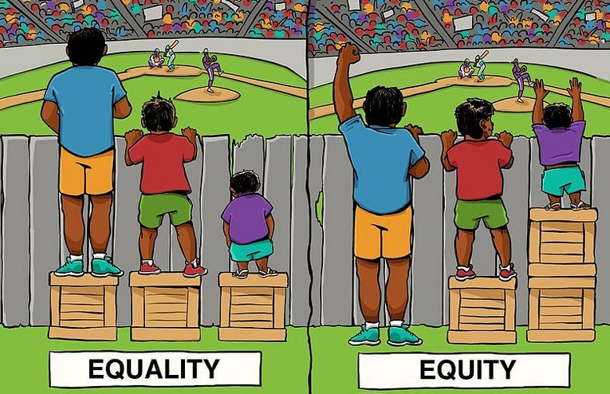
Equity, Equality & Inclusion
Equality
The term Equality refers to the principle of fairness, it
encompasses a wide variety of modules, programmes
and strategies that may be considered fair, but not
necessarily equal.
Equity
Being able to access and gain equal opportunities to
education and learning.
Inclusion
The culture in which the mix of people feel comfortable and confident to be themselves, work or learn in a way that suits them, and aligns with organisational values. Inclusion will ensure that everyone feels valued and can contribute.

Slide 7
Student Scenarios
What examples are there of inclusion or exclusion?
What is the impact of any inclusion or exclusion? (to either the student, or the organisation)
Have you encountered a similar situation?
Are you surprised by this situation?
What could be done to improve these circumstances?
Trigger Warning:
Some of these scenarios may include sensitive issues, please feel free to excuse yourself if you need some space.
Notes:
Time to look at some real-life examples of EDI, in a minute, I’ll share with you some case studies on both student and staff experiences. Each of these are based on things that have happened either within our organisation or elsewhere. In groups, you'll discuss one of these case studies and answer the questions on the slide

Slide 8
Scenario 1
Daniela and Manjit play viola in their student symphony orchestra. For this terms performance, the orchestra has brought in a guest conductor from a professional orchestra, alongside a number of professional orchestral musicians to fill the gaps in the orchestra.
The conductor regularly gives performance directions to the viola section, however Daniela and Manjit notice that they are constantly being overlooked by the conductor, who is seemingly only giving direction to the male performers.
They discuss this together, but don’t feel comfortable mentioning it to the conductor, as they are only student musicians.

Slide 9
Scenario 2
Bethany, a musician of colour, overhears some of her white colleagues talking irreverently about music programmed for a concert by a composer of Black heritage. Their inference being that the music was not good enough to be programmed and that its inclusion was in fact part of a box ticking exercise.
Though she doesn’t believe this to be true, she begins to question whether she was given her seat in the orchestra due to talent, or whether this too was a box ticking exercise.

Slide 10
Scenario 3
Adam has dyspraxia and ADHD. He has been invited to audition for an opera programme and has been asked to submit any reasonable adjustments that may improve his audition experience.
Adam asks for the audition material to be sent in advance, and this adjustment is granted.
When preparing the material for the audition, Adam highlights some cuts in the score for the accompanist in sections where he has no vocal part.
During the audition the accompanist continues through the cut section, stopping after a few bars to ask why Adam has stopped singing.
Already nervous, Adam begins to explain the cuts once more. The audition panel, upon recognising the requested adjustments, interject, telling Adam ‘it’s fine, it’s fine, we can all make mistakes’ asking whether Adam would like to slow it down to make it easier for him.
Adam continues with the audition, but leaves feeling patronized, feeling as though the mistakes in the audition were not his own and that his requested adjustments were not communicated well to the panel.
*Dyspraxia – a neurological condition that can cause difficulty in performing coordinated movements.
**ADHD (Attention Deficit Hyperactivity Disorder) – a neurological condition that can cause difficulty with concentration/focus and organisation/time management which can be heightened in stressful situations.

Slide 11
Affirmative Action and Impact
Affirmative Action
This involves policies and processes within an organisation seeking to include particular groups based on their underrepresentation, helping to bridge the gap of inequality in education and employment increasing access to education, promoting diversity and readdressing past wrongs, harms or hindrance.
Intention
Impact
Notes:
5 Minutes for Key Definitions

Slide 12
A Call for Action
What benefits would there be to an Orchestra in nurturing a diverse talent pool?
Is the sector already doing enough to embed inclusive practice to welcome under-represented talent into the sector?
Are there challenges to being inclusive whilst ensuring musical excellence?
What affirmative action(s) would you like to see the ABO take forward to develop inclusive practice, and tackle systemic inequalities?

Slide 13
equality@leedsconservatoire.ac.uk

