Slide 1


UNITED: SUPPORTING NEW MUSIC
Sam Rigby
Major Gifts Manager, National Theatre
Harriet Wybor
General Manager, Royal Philharmonic Society
Joe Frankland
CEO, PRS Foundation
Samantha Fernando
Composer
Sonia Stevenson
Head of Music Patron, Sound and Music
ANNUAL CONFERENCE
Leeds | 2023
@aborchestras​
#abo2023​

Slide 2


Slide 3


Slide 4
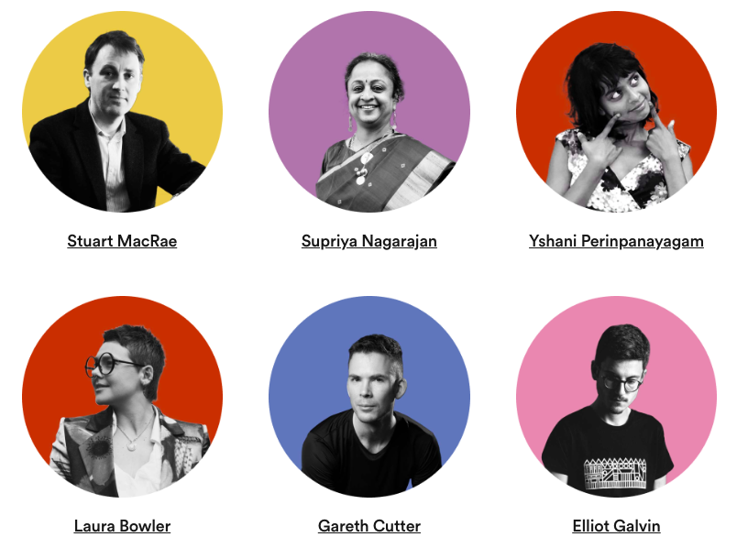
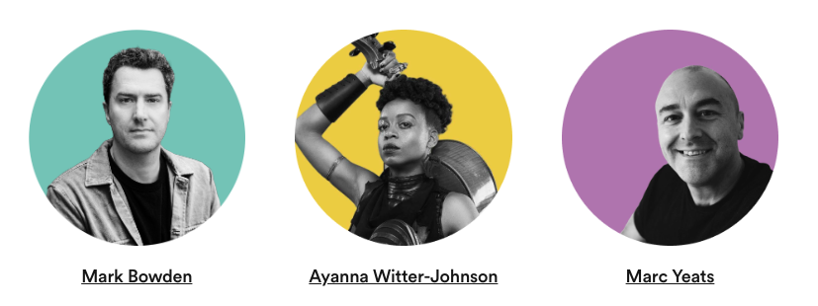

Slide 5
1
Give £10 for free to a composer
www.musicpatron.com/abo
We’ll design a 30 day, bespoke,
digital experience for your audience
hello@musicpatron.com
2

