Slide 1


Diversity and inclusion in action:
NOYO report from the front line

Slide 2


Doug Bott - Artistic Director, NOYO
Holli Pandit - NOYO member
Oliver Cross - NOYO alumnus
Abigail D'Amore - external evaluator, Sound Connections
Lisa Tregale - Director, BBC NOW
Notes:
Panel introduce selves, with visual descriptions

Slide 3

Download the full report from:
www.noyo.org.uk/report

Slide 4
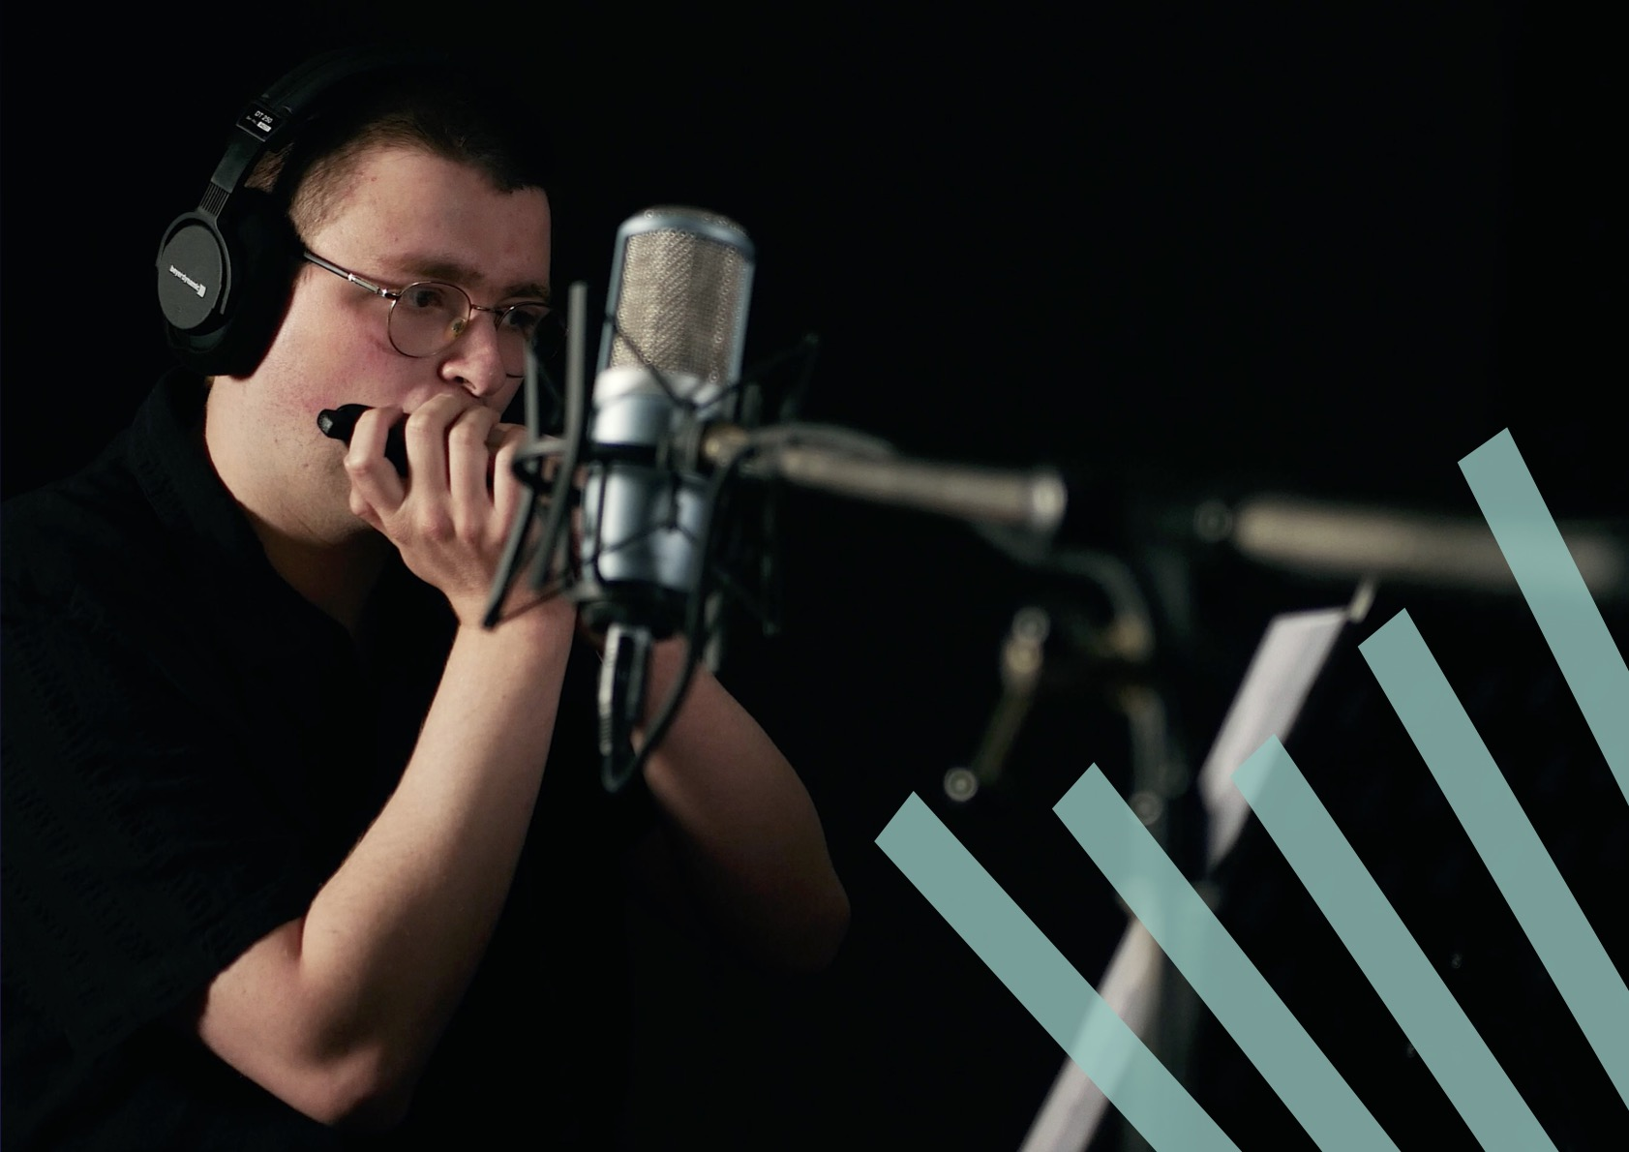

Slide 5
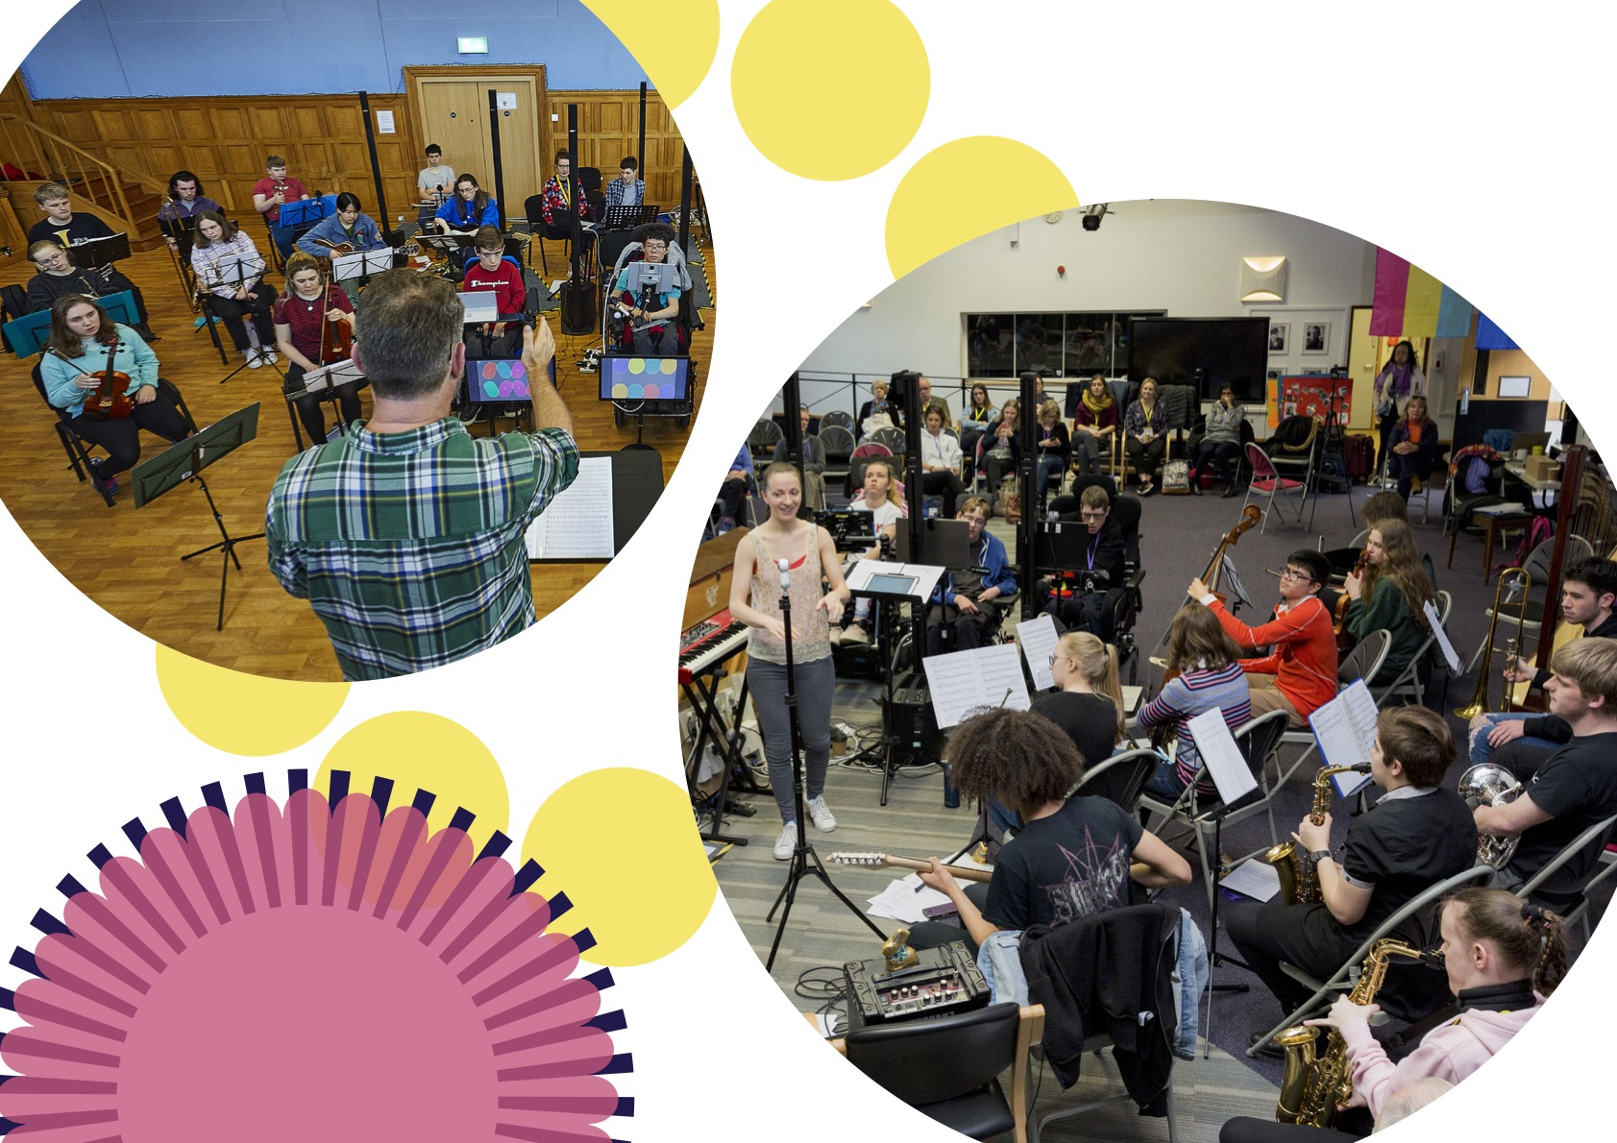

Slide 6
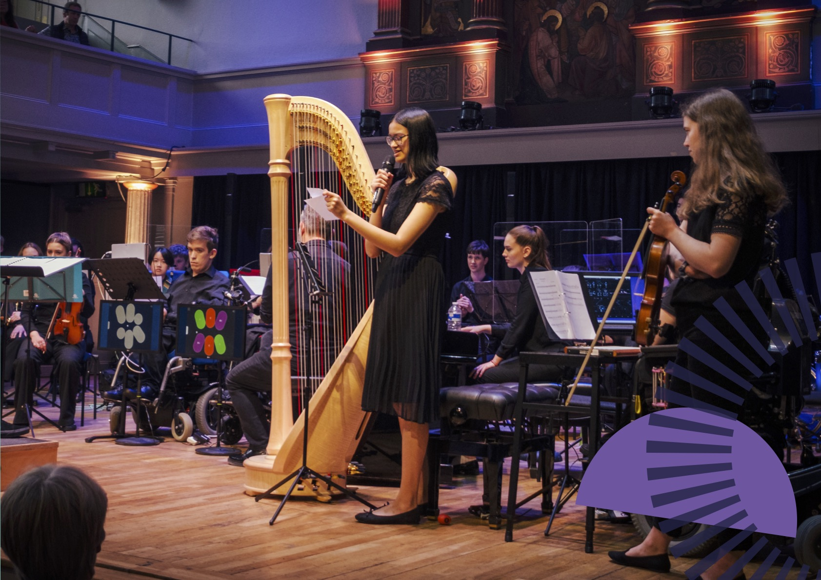

Slide 7
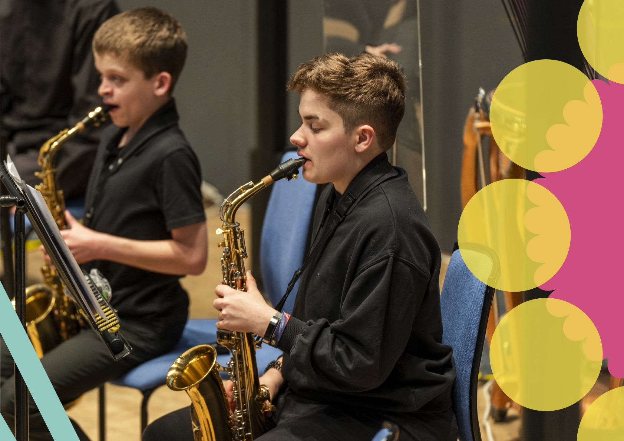

Slide 8
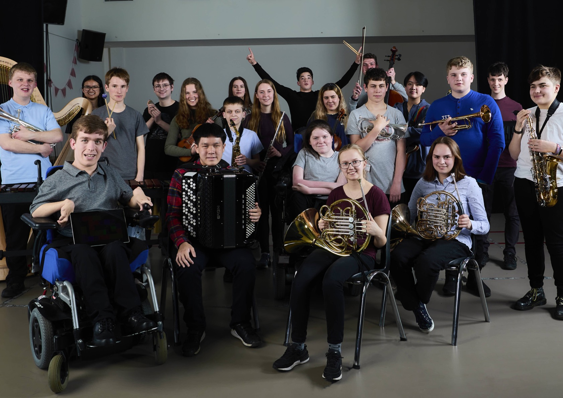

Slide 9
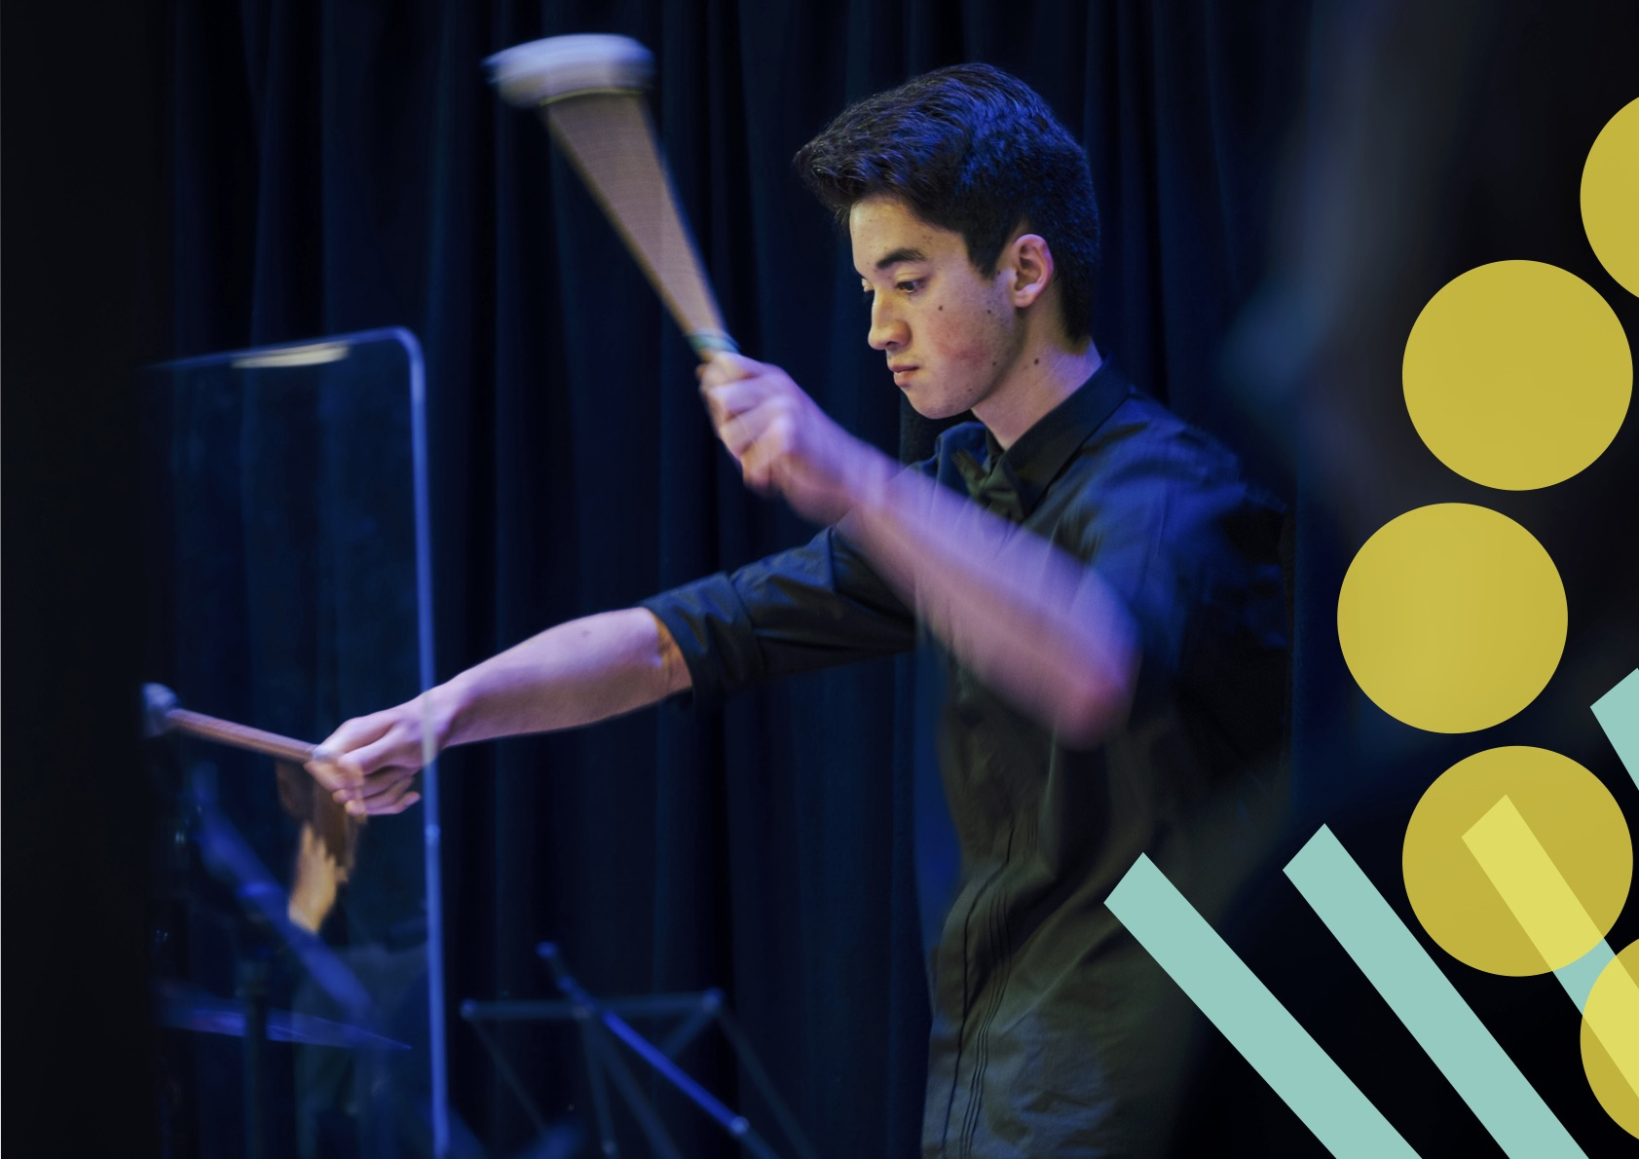

Slide 10
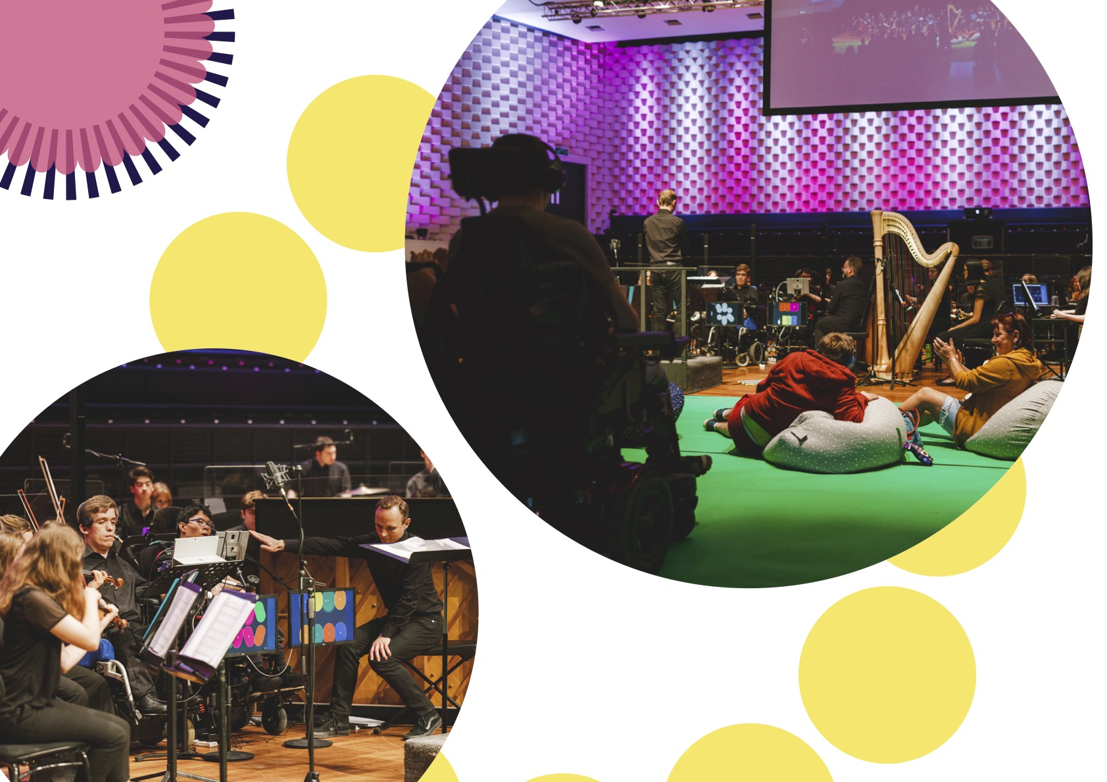

Slide 11
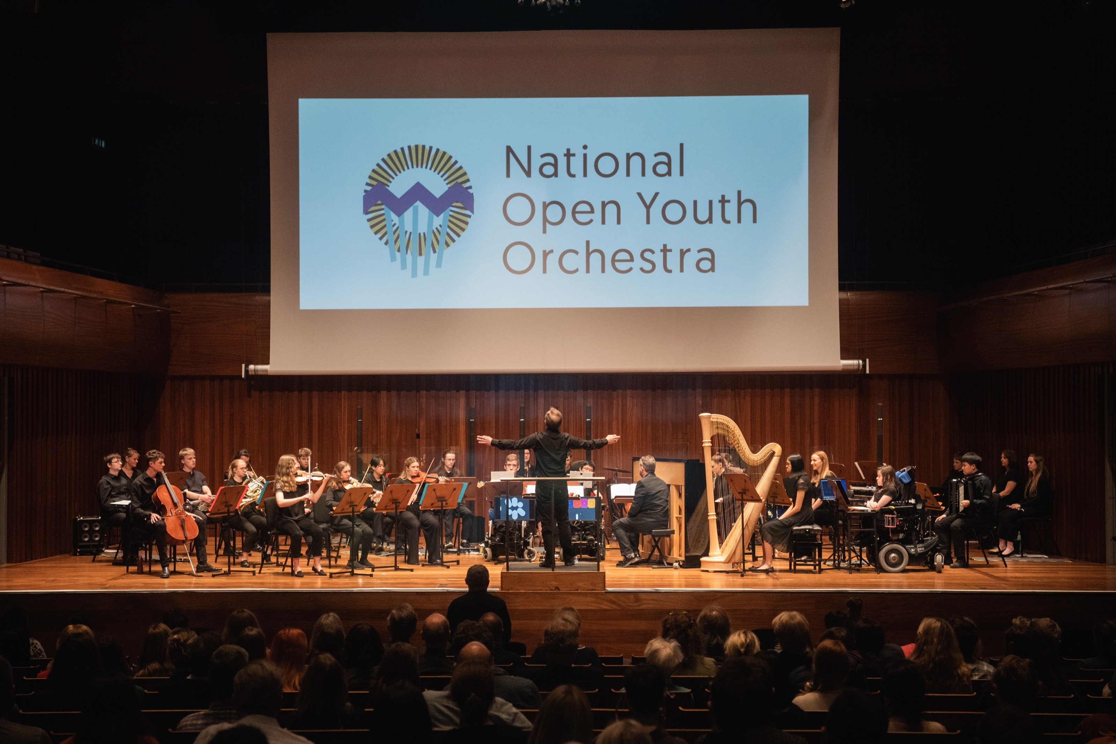

Slide 12

This report captures the learnings of NOYO through the voices that have shaped it. We hope that NOYO musicians’ desire to share their experiences will encourage you to take it further... Because NOYO doesn’t hold all the answers. We’ve known from the start that NOYO could only ever be one piece of the puzzle. These young musicians who bring with them a bounty of talent, creativity, and opportunities for wider audience engagement, are counting on you to lay down the next piece.
Notes:
DB, quote from intro to report

Slide 13
1. You can successfully combine inclusion with high musical expectations
Notes:
14:10 – 14:18
Oliver

Slide 14



2. Being more musician-centred can unlock the creative power of diversity
Notes:
14:18 – 14:26
Oliver & Holli

Slide 15
3. Diversity and inclusion can fuel the creation of exciting new music
Notes:
14:26 – 14:34
Holli

Slide 16

4. Find a new audience through being more diverse and relaxed
Notes:
14:34 – 14:42
Lisa

Slide 17
5. Radical empathy is critical for change
Notes:
14:42 – 14:50
Abi

Slide 18

6. We’ve got to learn from each other, and fast track inclusion

Slide 19
Download the full report from:
www.noyo.org.uk/report

