Slide 1


Capturing the value and impact of culture
ABO Conference, Leeds
Ben Walmsley, Director

Slide 2
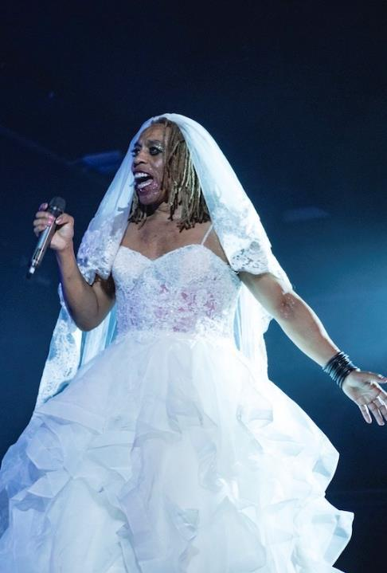
Understanding the difference culture makes
We are building a shared understanding of the differences that arts, culture, heritage and screen make to people’s lives and to society.
We want policy and practice to be based on rigorous research and evaluation.
Vogue Ball, Contact Theatre. Photo: Drew Forsyth
Notes:
We want cultural policy and practice to be based on rigorous research and evaluation of what works and what needs to change to build a more diverse, equitable and regenerative cultural sector.

Slide 3
40 sector affiliate partners
Aesop, Arts Marketing Association, Arts Fundraising & Philanthropy, Association of British Orchestras, BBC Research & Development, BFI, Bradford 2025, British Library, Campaign for the Arts, Chief Cultural and Leisure Officers Association, Contemporary Visual Arts Network, Coventry 2021, Creative Ageing Development Agency, Creative & Cultural Skills, Creative Lives, Cultural Learning Alliance, Culture Counts, Culture Forum North, Culture Health & Wellbeing Alliance, Eden Court Theatre, Galway 2020 & NUI Galway, Happy Museum, Historic England, Imperial War Museum, Leeds 2023, Leeds City Council
(Culture & Sport), Museums Association, National Centre for Creative Health, National Theatre, National Theatre Scotland, National Theatre Wales, Natural History Museum, OneDance UK, Opera North / DARE, Royal Society of Arts, Scottish Contemporary Art Network, Science Museum, Tate, Thrive, Visitor Studies Group.

Slide 4
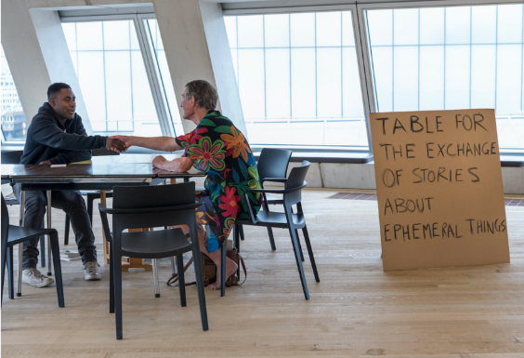

Evaluation
    Dedicated events programme
    A free massive online open course (MOOC)
    in 2023
    Cultural Evaluation Network LinkedIn group
    Our co-developed Evaluation Principles
Who Are Ya? Tate Exchange. Dan Weill Photography
46 sector leaders have joined our evaluation working group
Notes:
We work with the cultural sector and funders to support skills development in evaluation and to promote the value of a purposeful and proportional approach to evaluation.
- Events programme to support a more confident and collaborative sector: practical application + theoretical debate
- A free massive online open course (MOOC) in 2023: free professional development and learning
- Our dedicated LinkedIn group, the Cultural Evaluation Network, for sector-wide discussion and exploration of experiences in evaluation.
- We co-developed a set of cultural evaluation principles that can be adopted across sector…

Slide 5
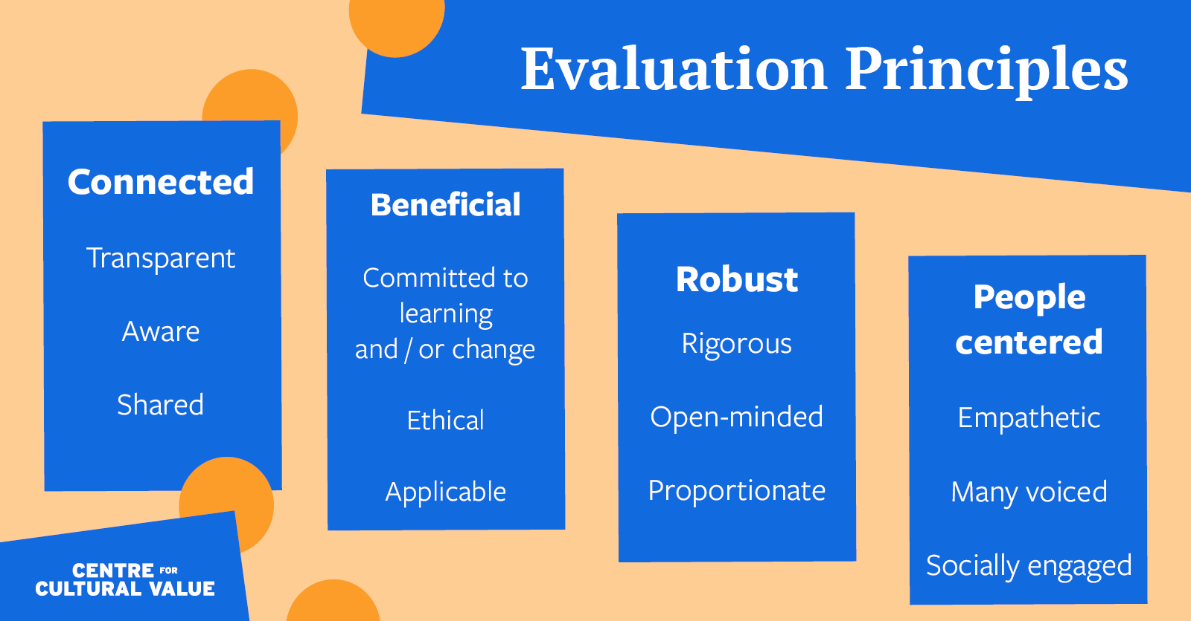
Notes:
These collaboratively produced evaluation principles are a sharing of ideas to inform how evaluation is carried out and used in the cultural sector

Slide 6
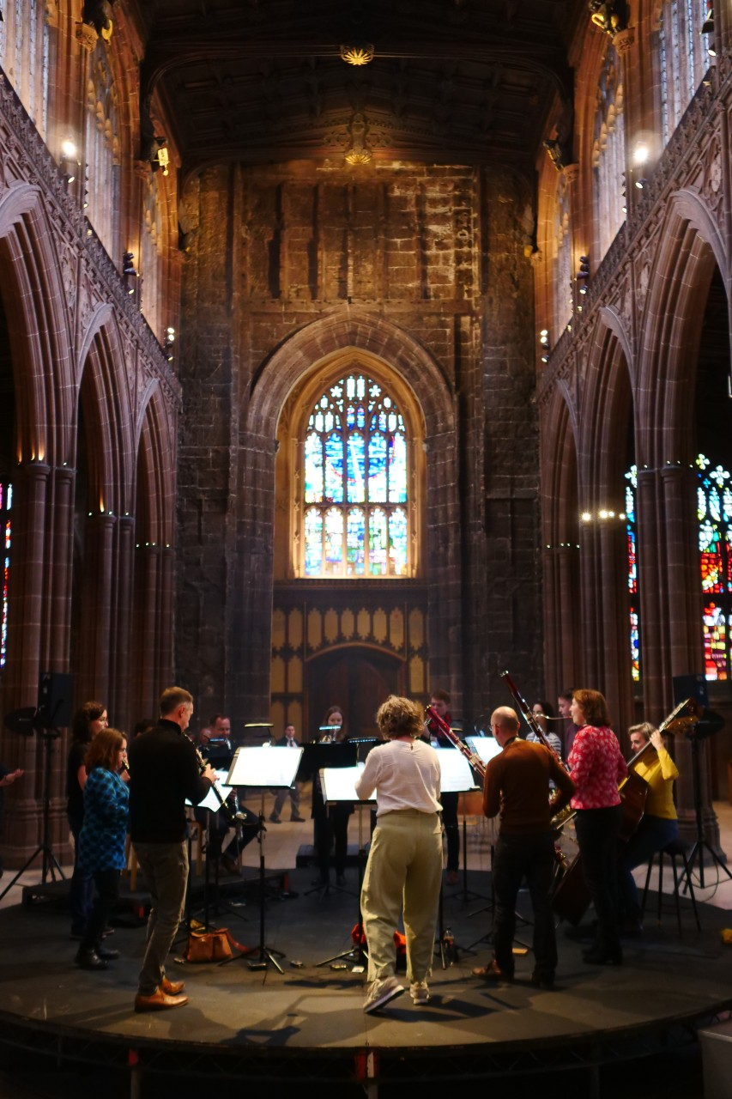
Collaborate
Our open-call funding programme
Supporting collaborative research projects between cultural sector partners and academic researchers
Investigating under-explored, sector-driven questions of cultural value
Collaborate offers £200,000 in overall funding
Manchester Camerata, photo by Alex Barnes
Notes:
Collaborate is our open-call funding programme.
The fund offers £200,000 to support the development of collaborative research projects between cultural sector partners and academic researchers investigating under-explored, sector-driven questions of cultural value.

Slide 7
Collaborate
EVIDENCE
Pilot partnership between Manchester Camerata and Royal Northern College of Music
5 additional partnerships in 2022
Plan to fund at least 5 more projects in 2023
INNOVATION
AND APPLICATION
AMPLIFICATION
Notes:
The pilot partnership between Manchester Camerata and Royal Northern College of Music has repeatedly proved the value of both the fund and model.
Following this success, we have funded 5 additional partnerships in 2022 and plan to fund at least 5 more in 2023.

Slide 8
Aims of Collaborate
INNOVATION
&
APPLICATION
EVIDENCE
AMPLIFICATION
Understanding why cultural activity matters
Rooted in real-world questions
Relevant and freely accessible
Research insights understood and applied
Innovative research methodologies developed
Collaborative and reflective research practice
Stimulate dialogue
Better understanding of developing mutually beneficial partnerships
Long-term partnerships
Notes:
EVIDENCE:
Understanding of why cultural activity matters and how we capture the effects that they have
Rooted in real world questions of cultural sector and communities
Shared in a way that is relevant and freely accessible
INNOVATION AND APPLICATION
Research insights understood and applied more widely
Innovative research methodologies developed
Developing collaborative and reflective research practice
AMPLIFICATION
Stimulate dialogue and widen
perspectives around what cultural
value looks like
Better understanding of developing effective, sustainable and mutually beneficial partnerships between the cultural and academic sectors
Potential for longer-term partnerships
or activity.

Slide 9
Hear
Sign up to our newsletter to hear more about the Collaborate projects and our events, courses and research
www.culturalvalue.org.uk

Slide 10
ABO Conference
UNITED: Cultural Value
Max Thomas – Creative Producer
2nd February 2023
Notes:
Introductions
Myself:
Joined Creative Manchester & Manchester Camerata as their Creative Producer in June 2022 as maternity cover, working between Camerata’s concerts team and the University of Manchester’s Arts Management and Music courses to undertake research, knowledge exchange and some teaching, while also supporting the everyday delivery of the Concerts Team at Camerata.
Recently graduated with an MA in Arts Management, Policy & Practice at the University of Manchester, where much of my research focus was on digital strategies for classical arts organisations.
Manchester Camerata:
Chamber orchestra from Manchester, founded in 1972, so recently celebrated our 50th year. Celebrate collaboration, experimentation, research – part of this includes a long history of partnering with academic institutions like University of Manchester, Creative Manchester, and researchers to discover new directions & ways of redefining what orchestras do.
Here to discuss Camerata’s involvement with CCV as a project partner & the research and experiment we embarked on.

Slide 11
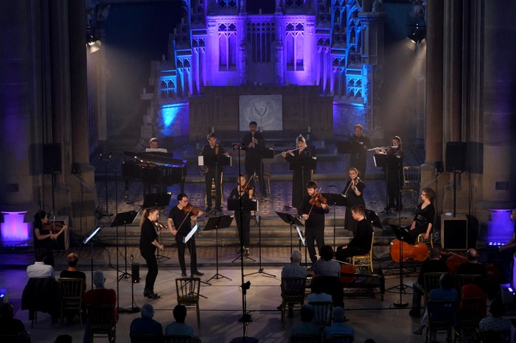
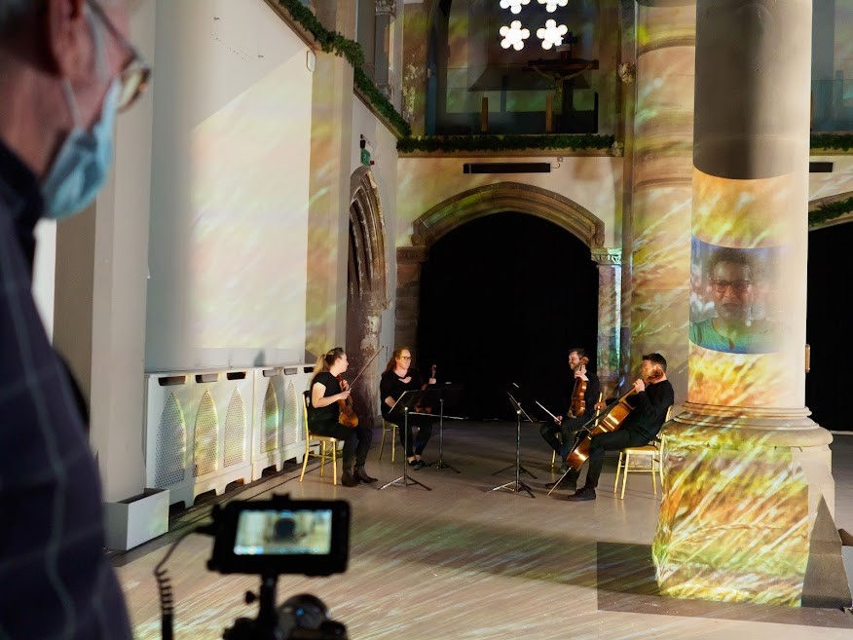
Experiment Influences and Contexts
COVID-19 Pandemic – Impacting delivery and relationship with audiences.
Developing Digital Strategy – Reaching audiences online with new performances and content.
Considering Audiences – How do they engage? What impact does live or recorded music have on audiences?
Notes:
Background context to design of the experiment
Around the start of 2021 we found ourselves in a similar situation to the rest of the sector, who had endured around a year of challenges faced from the pandemic.
One of the key shifts emerging from the pandemic had been finding ways of continuing to connect with and reach audiences, resulting in organisations meeting audiences where many of them already were – ONLINE.
Camerata engaged in creating recordings of concerts and other material to release online, while also creating more bespoke pieces of digital storytelling like our UNTOLD project, which tell the stories of various members of our Camerata community through music and spoken word – including our orchestra leader Caroline, our conductor Gabor, and of Keith – a local bus driver with a love for music and was living with dementia.
Whilst shaping, recording, and delivering these digital projects it struck the team that we had limited knowledge around how audiences actually engage with digital material…
This threw up many questions… how do audiences prefer to watch and listen to digital classical music? Do different audiences prefer live or digital performance? Do audiences expect the high quality of a concert hall when watching online?
As well as how audiences engage, it threw up questions around the impact of music on people when audiences listen online and in person, resulting in another set of questions…
Can digital recordings produce strong emotional responses in audiences? Do audiences feel a shared sense of connection with one another when watching live and digital performances? Do audiences feel connected to musicians when watching digital performances?
There were many questions, and there were not many places to turn to for answers.
In order for the music industry to decide how best to encourage, welcome, and sustain audiences of the future, the team felt it was imperative to gain some answers.
So what we did, was partner with the Royal Northern College of music and the fantastic Michelle here to make an application to the centre for cultural value to try and answer some of these questions.

Slide 12
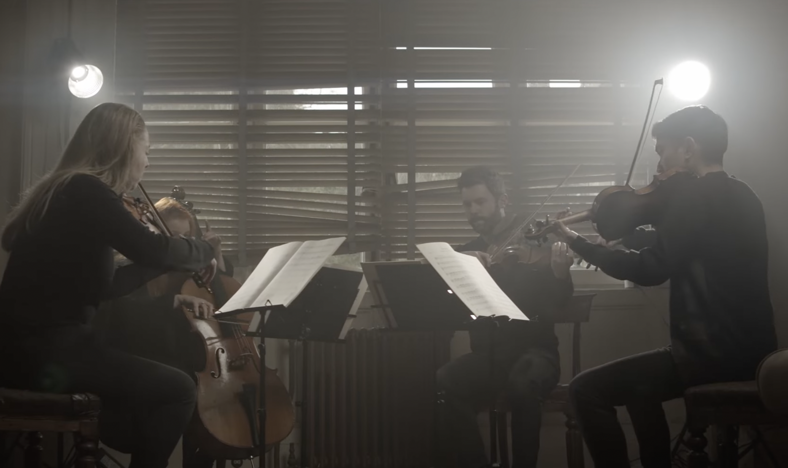
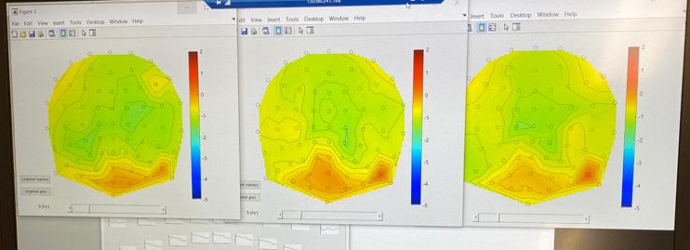
Methods and Research Questions
How do listeners respond neurologically, behaviourally, and physiologically to different styles of music and how does this differ during live versus recorded performance?
EEG Measurements – brain activity
Galvanic Skin Responses – emotional activity
Notes:
Overview of method & research question that we decided on and why
Before applying to the Centre for cultural value, but after much discussion and planning with Michelle, all these questions we had one boiled down to one central research question:
How do listeners respond neurologically, behaviourally, and physiologically to different styles of music and how does this differ during live versus recorded performance?
The purpose of answering this question was to gain an understanding of audiences responses when listening to music in both live and digital contexts - specifically, we planned to look at their levels of arousal, levels of enjoyment, and levels of surprise.
How we would go about doing this was by recruiting a small number of audience members who engage with music at varying levels of frequency - from people who attend tonnes of concerts to people, with high levels of cultural capital, through to people who might attend concerts infrequently or not at all.
They would listen to different extracts of Manchester Camerata performance, both in a live setting and in a digitally recorded setting. This ended up being extracts of Haydn – Seven Last Words from the Cross, Beethoven’s 15th String Quartet, which had featured in our UNTOLD digital series. They would watch the higher quality of recordings done for UNTOLD, lower budget recordings, taken on a static camera with low quality sound, as well as a performance from a live string quartet.
When watching these, we would gather two different types of data:
1 - participants of the experiment would wear electroencephalogram caps or EEG caps which record levels of brain activity.
2 - participants would also wear a galvanic skin response device which measure levels of excitement and arousal from your sweat glands, and via your heartbeat.
We later decided to additionally collect qualitative interview data to compare how people perceived their experience compared to what the EEG & Galvanic responses said.
The data would then be analysed to see how responses vary between the stimuli of live and recorded performance. In actual delivery some changes had to be made which Michelle will address in due course.

Slide 13
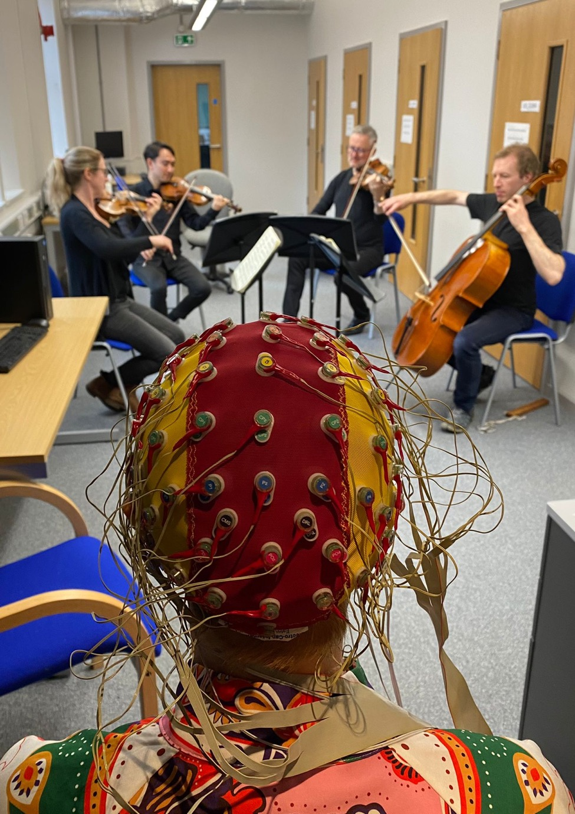
Challenges in Experiment Delivery
Research Partnerships – Complexity, availability, ethics.
Timeframes – Methodology delays, laboratory usage, recruitment.
Equipment – Restrictions in usage, size, capacity.
Notes:
Michelle and discussed in advance how it would likely be useful to hear some of the challenges we ran into as well as some of the initial findings.
1st challenge was…
RESEARCH PARTNERS
As you might imagine the delivery & complexity of a project like this requires various research partners to be recruited, and in the end, this project ended up being a collaboration between the Centre for Cultural Value, RNCM, Salford University, the University of Manchester, and Manchester Camerata.
Beyond academic institutions, we would be partnering with the general public as listeners, with Camerata players to form a string quartet to perform as part of the experiment, technicians to record various digital performances, amongst many others along the way.
Delivering across so many partners was at times a double-edged sword - fantastic to involve the expertise, knowledge and resources of these organisations from across Manchester, yet challenging to find shared availability or while gaining ethical approval from all institutions involved.
2nd challenge was…
TIMEFRAME
Initially we gave this experiment the timeframe a year with it right up being completed in May 2022. There were various reasons for a delay in terms of methodology, lab usage, identification of research partners, as well as a couple of babies along the way too.
As such, participant recruitment took place in July and August 2022, data collection period took place in September 2022, initial findings being analysed towards the start of 2023 and further findings analysis ongoing – overall the project delivery period has nearly doubled.
Originally:
June-August 2021 – meetings with research team and Camerata to confirm the music extracts / pieces to be used as stimuli
August-September 2021 – audience group recruitment
October-December 2021 – live concert/digital and data capture period [NB. This may have to be slightly later depending on social distancing regulation around live performance]
Jan-March 2022 – data analysis
Apr-May 2022 – reflection, write-up, and dissemination
3rd challenge was…
EQUIPMENT
One of the largest challenges was making use of the equipment and laboratories of the University of Manchester. Where the galvanic skin response devices are mobile and able to be moved around, the EEG caps used are immobile and required us to run the experiment in a laboratory outside of concert or more informal performance settings. The size of this kind of laboratory space also proved challenging in terms of how many people we could fit inside, meaning we could measure the activity of two participants, 3 researchers & 4 musicians at a time.

Slide 14
Notes:
Thank you for listening to this section. I’ve spoken to…
Experiment influences and contexts: Covid-19, creating a more developed digital strategy at Camerata, & our consideration of audiences.
Methods and Research Questions we initially pursued when approaching Centre for Cultural Value.
Challenges in Experiment Delivery around research partnerships, timeframes, & equipment.
Now onto Michelle to discuss more methodology and the beginnings of findings.

Slide 15

Context
There is previous evidence to support the value of ‘liveness’ in music performance (Tsangaris, 2020)
COVID-19 pandemic opened up new ways of engaging with performance in an online environment (Rendell, 2021 - ‘pandemic media’)
‘Connectedness’ may be facilitated during livestreamed performances by feeling of physical and social presence (Onderdijk, 2021)
Social experiences in the concert hall may impact on overall enjoyment (O’Neill & Egermann, 2022)
Motivations to attend live music performance may be different to livestreamed, and include opportunities for social interaction (Phillips & Krause, forthcoming)

Slide 16
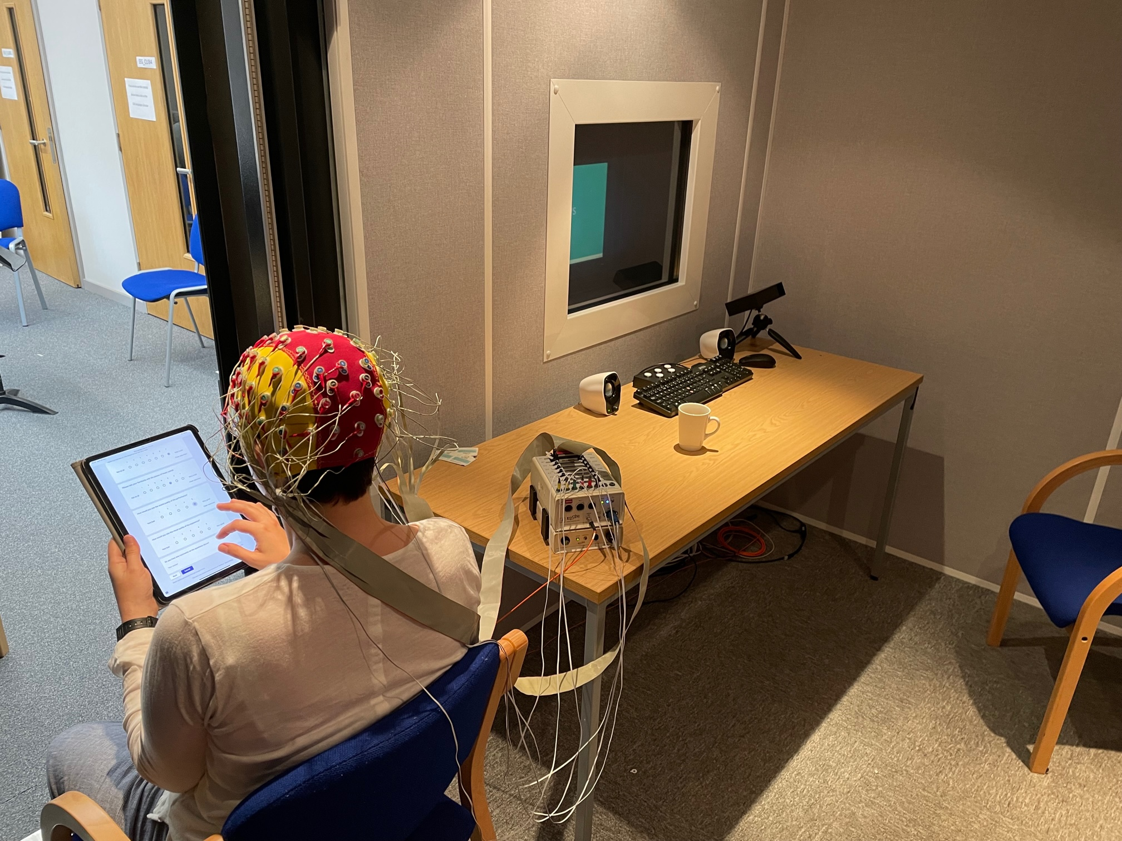
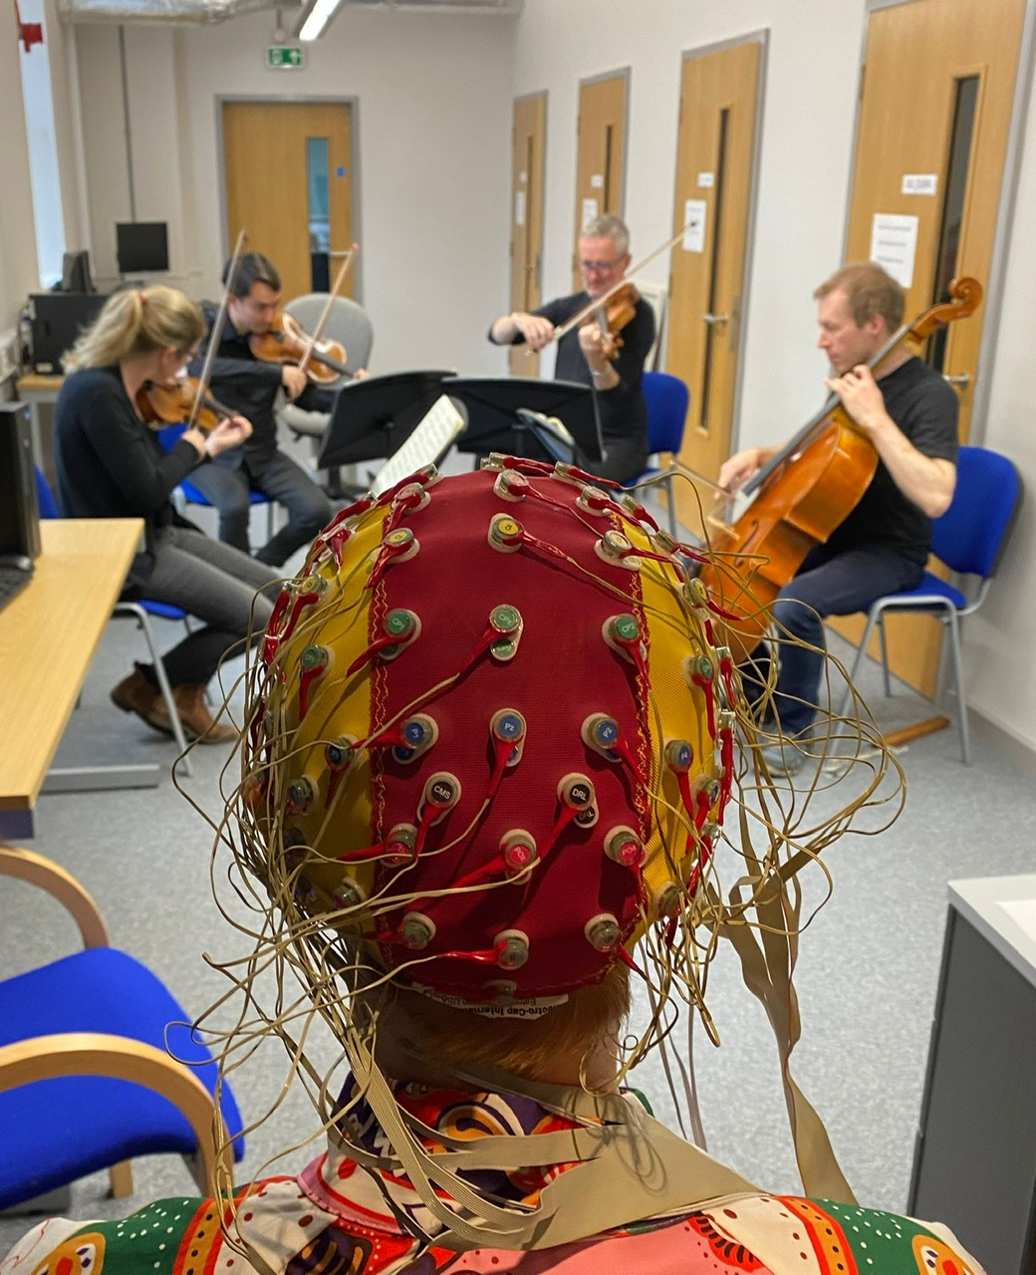
Method
22 participants – recruited via Manchester Camerata mailing list
3 types of data : behavioural (survey), neurological (EEG), physiological (galvanic skin response)
Tested in pairs (one EEG, one GSR)
Each pair heard 3 stimuli (order was counterbalanced for each pair):
  Live performance by Manchester Camerata string quartet
  Recording of the performance in 1. above
  High quality, professionally produced, video of the same extracts of music

Slide 17
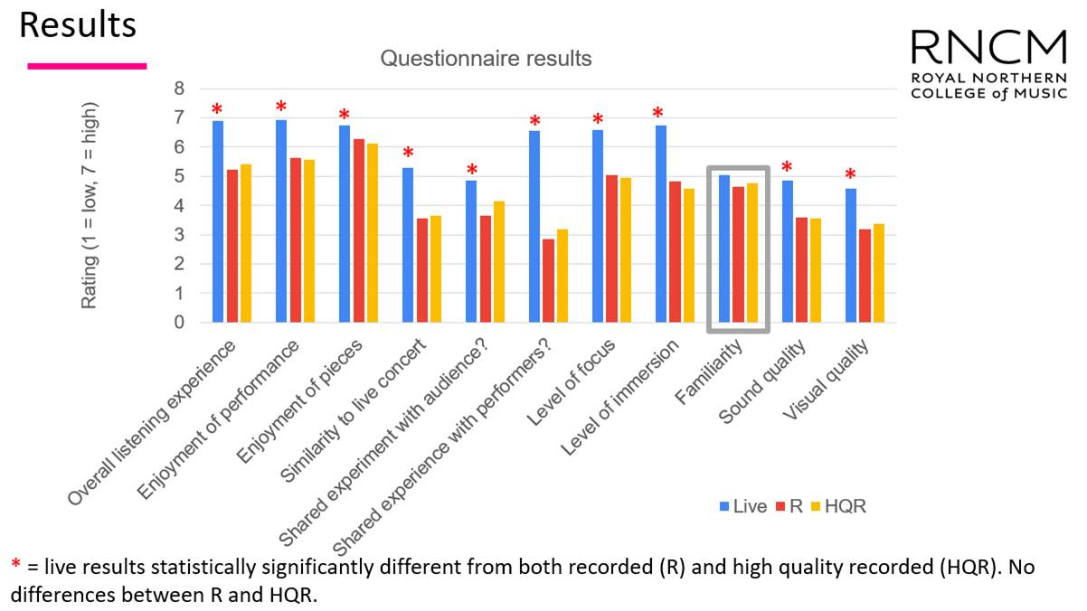

Slide 18
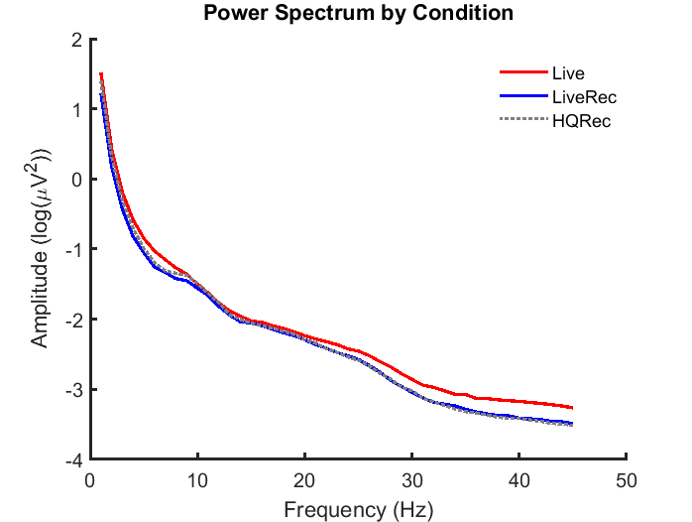
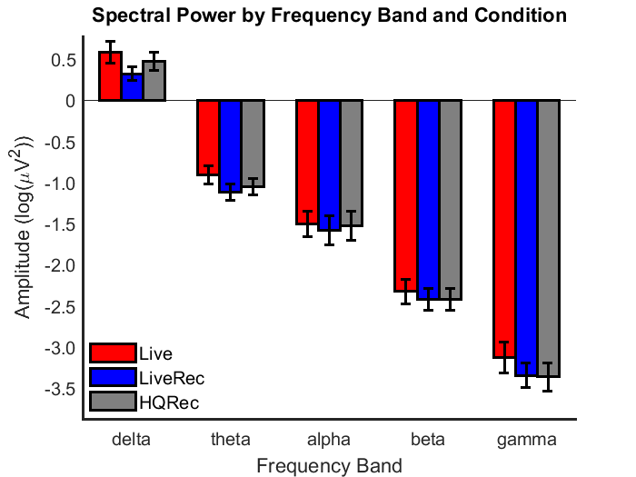
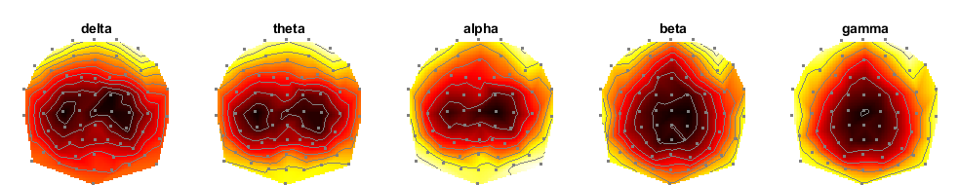
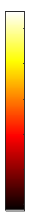
Results
Spectral Power by Condition
Spectral Power by Frequency Band and Condition
*
*
**
*
*
max
min

Slide 19
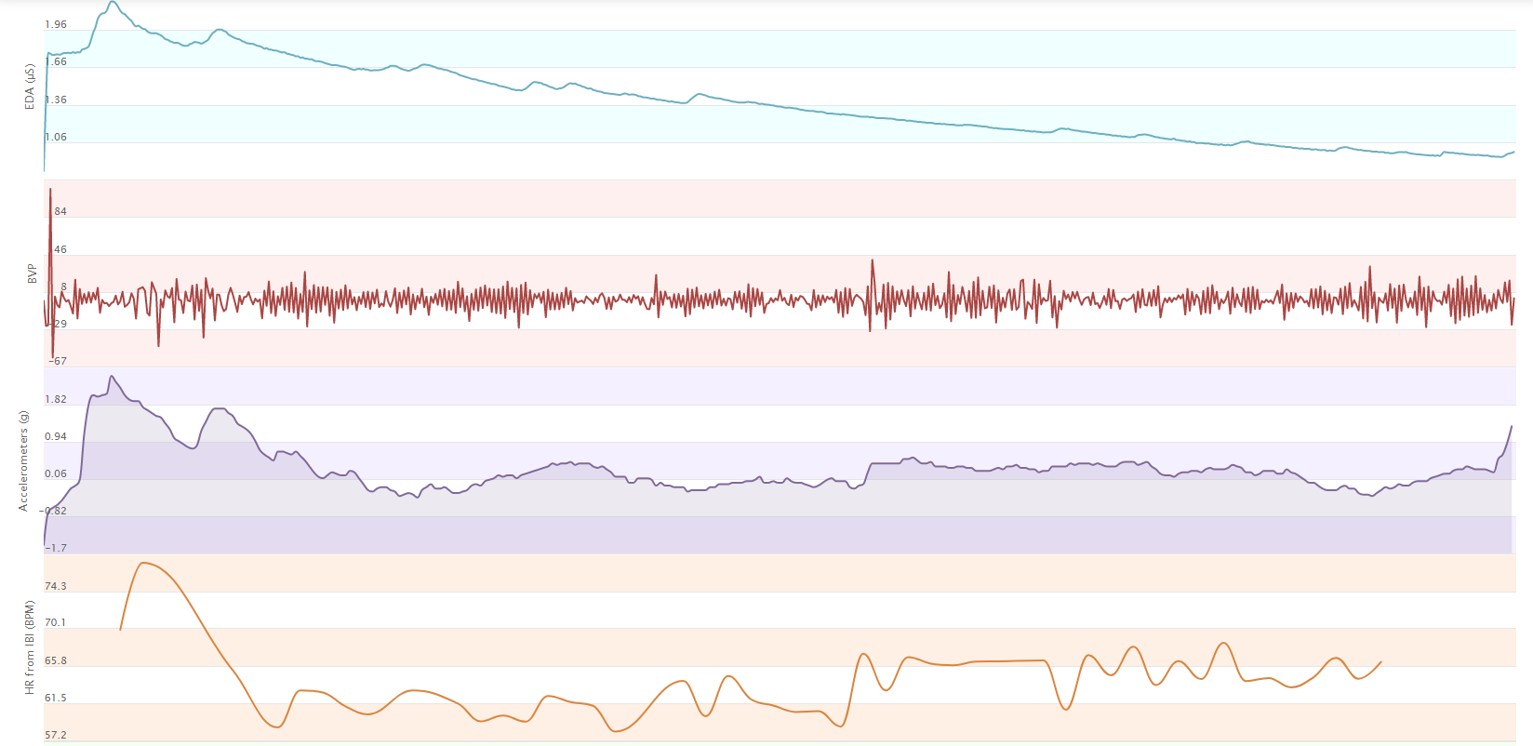
Results

Slide 20
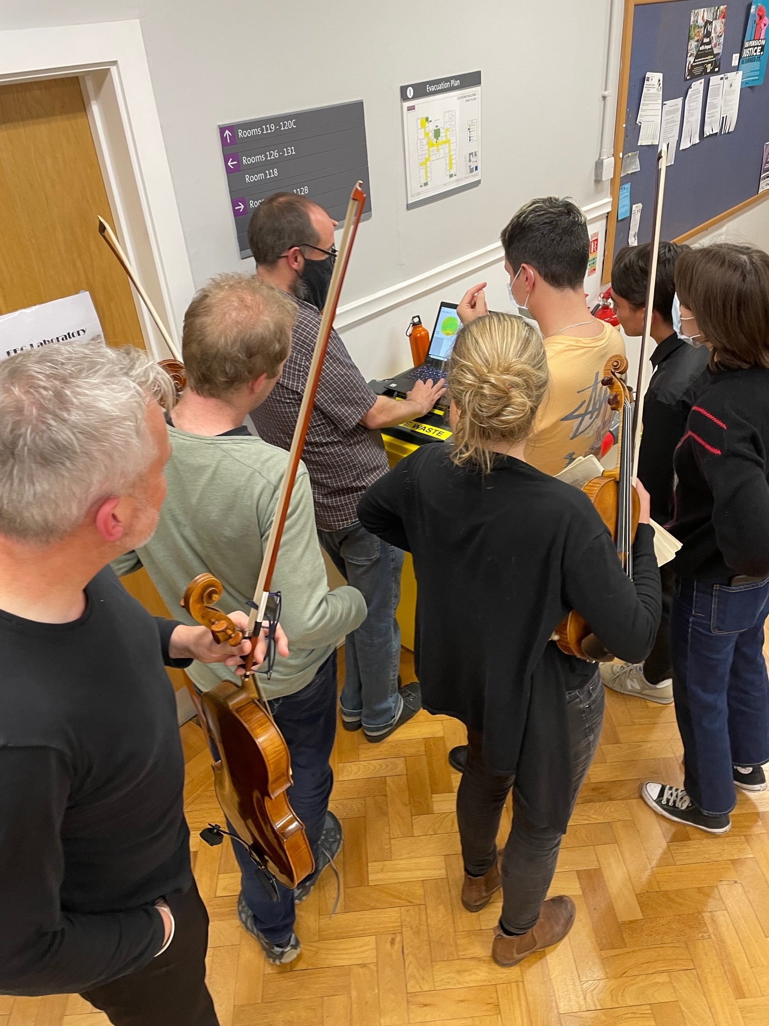
Overall conclusions
Established method to examine audience response
Evidence that the live music experience is different to recorded performance
More work needed on responses to different recorded / livestreamed formats
Live music is essentially a shared experience, can this be recreated online?
Should digital engagement replicate live experience, or is this a different medium, to be conceived and delivered and engaged with differently, fundamentally?

Slide 21
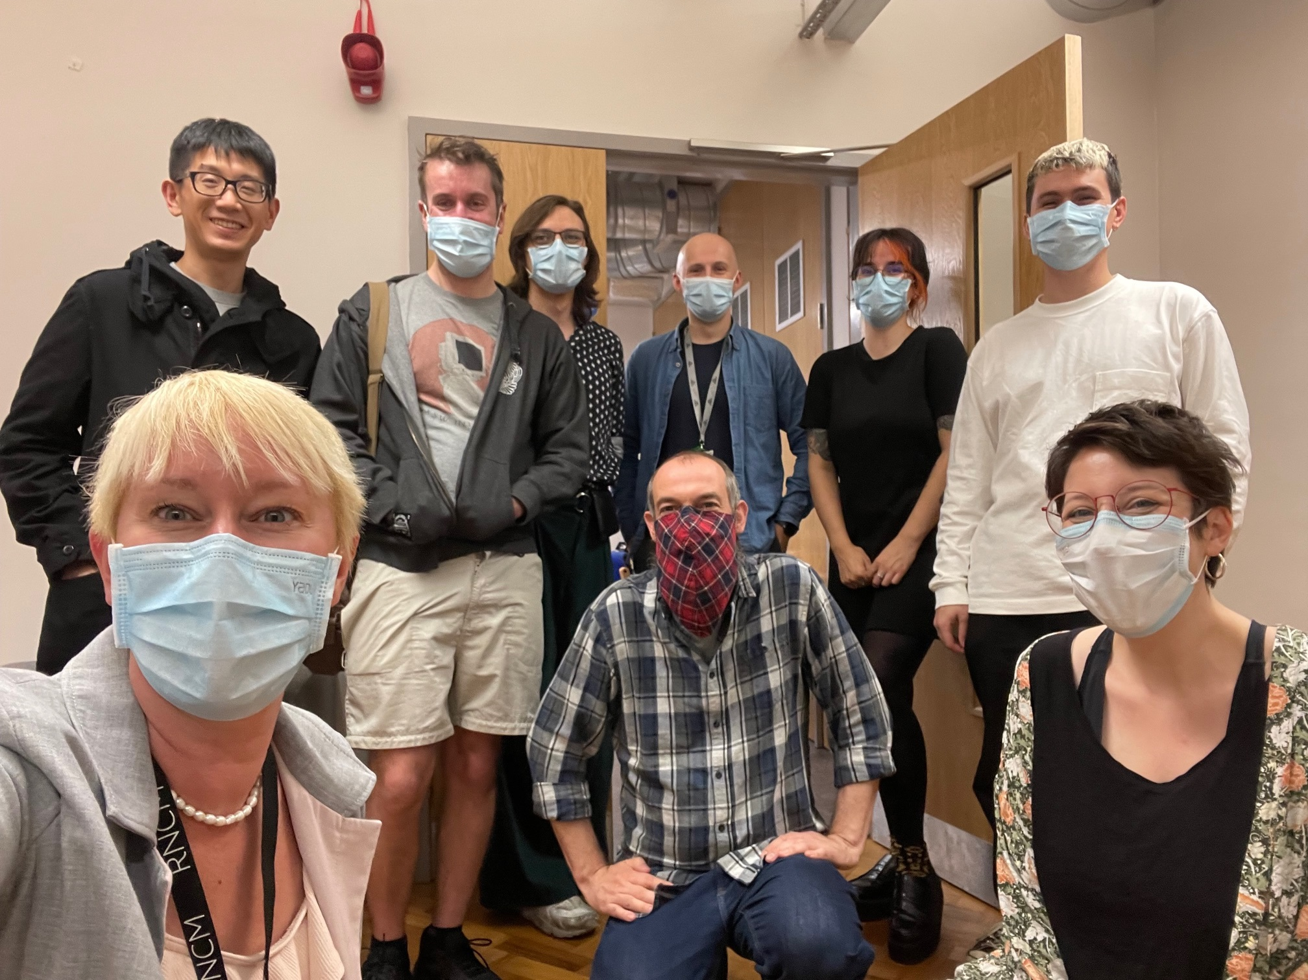
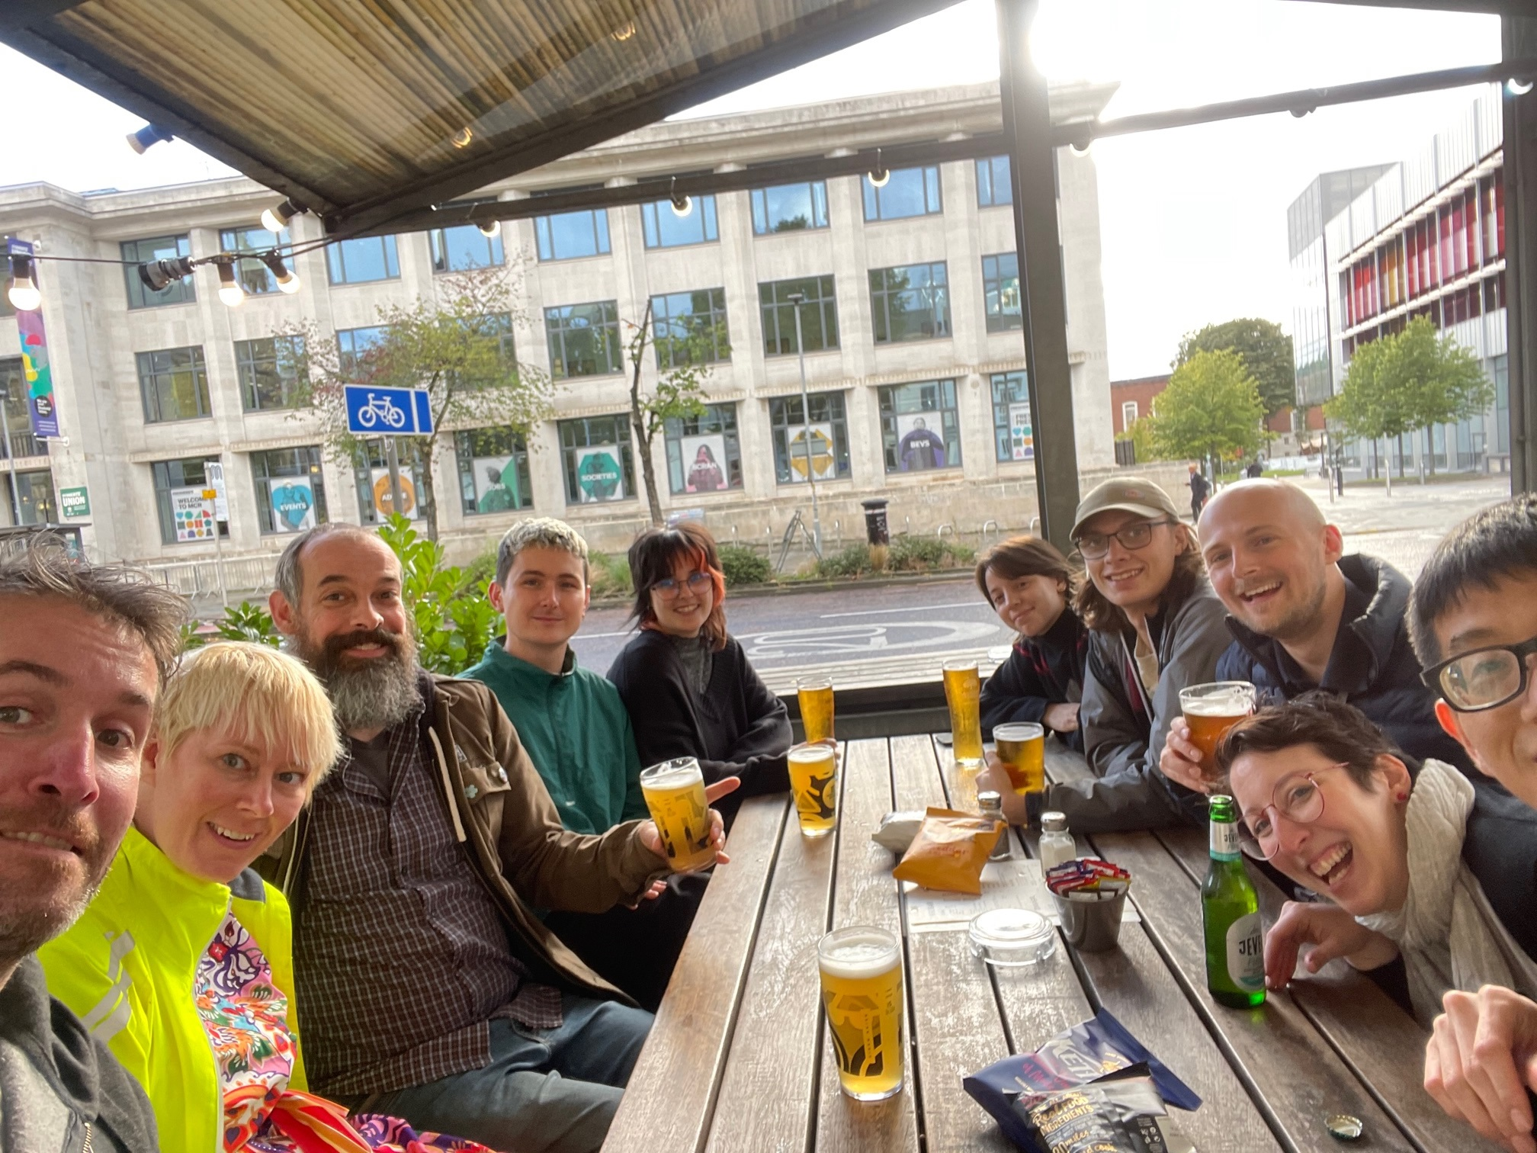
Thank you!
B.Walmsley@leeds.ac.uk
MThomas@manchestercamerata.com
Michelle.Phillips@rncm.ac.uk
Thanks to collaborators: Jason Taylor, Duncan Williams, Bruno Fazenda, Ioanna Filippidi, Josie Kearney, Stephen Ball, Sam Roberts, Xie He and to all participants

Slide 22
References
O’Neill, K., & Egermann, H. (2022). Development of the Social Experience of a Concert Scales (SECS): The Social Experience of a Live Western Art Music Concert Influences People's Overall Enjoyment of an Event but not Their Emotional Response to the Music. Music & Science, 5.
Onderdijk, K. E., Swarbrick, D., Van Kerrebroeck, B., Mantei, M., Vuoskoski, J. K., Maes, P. J., and Leman, M. (2021). Livestream experiments: the role of COVID-19, agency, presence, and social context in facilitating social connectedness. Frontiers in psychology, 12, 1741.
Phillips, M., and Krause, A., Audiences of the future – how can streamed music performance replicate the live music experience? MCICM Futuring Classical Music edited collection, forthcoming.
Rendell, J. (2021). Staying in, rocking out: Online live music portal shows during the coronavirus pandemic. Convergence, 27(4), 1092-1111.
Tsangaris, M. (2020). The eternal course of live music: Views and experiences of an audience. The Future of Live Music (New York, Bloomsbury)

