Slide 1
UNITED: AUDIENCES - PERCEPTIONS AND PERSPECTIVES
ABO Conference
February 3 2023

Slide 2
About LIVE
LIVE is the voice of the UK’s live music business
LIVE is a federation of leading live music industry associations representing 3,150 businesses, 4,000+ artists & 2,000 backstage workers
Workstreams include:
LIVE Green: sustainability across live music
LIVE Venues: costs, audience, safety
LIVE Workforce: inclusivity, talent pipeline
LIVE Touring: EU & beyond
LIVE Festivals: costs, audience, safety
LIVE Talks: monthly, free online workshops
LIVE members are:
Association of British Orchestras (ABO)
Association for Electronic Music (AFEM)
Association of Festival Organisers (AFO)
Association of Independent Festivals (AIF)
Association of Independent Promoters (AIP)
British Association of Concert Halls (BACH)
Concert Promoters Association (CPA)
Featured Artists Coalition (FAC)
Music Managers Forum (MMF)
Music Venue Trust (MVT)
National Arenas Association (NAA)
Production Services Association (PSA)
Society of Ticket Agents & Retailers (STAR)
The Entertainment Agents’ Association (TEAA)

Slide 3
LIVE Insights

Slide 4
Understanding the post-lockdown audience
(Wave 2)
National representative survey, 2,000 people
November 2022

Slide 5

Methodology
This reports gives a representative indication of the attitudes, behaviours and current thinking of live music fans in the UK.
The nationally representative survey was carried out by Opinium. 2,000 responses were collected from the UK in November 2022.
The report was written by LIVE CEO Jon Collins, together with Chris Carey, Head of Music, Media and Entertainment at Opinium, and Chief Economist for LIVE.

Slide 6
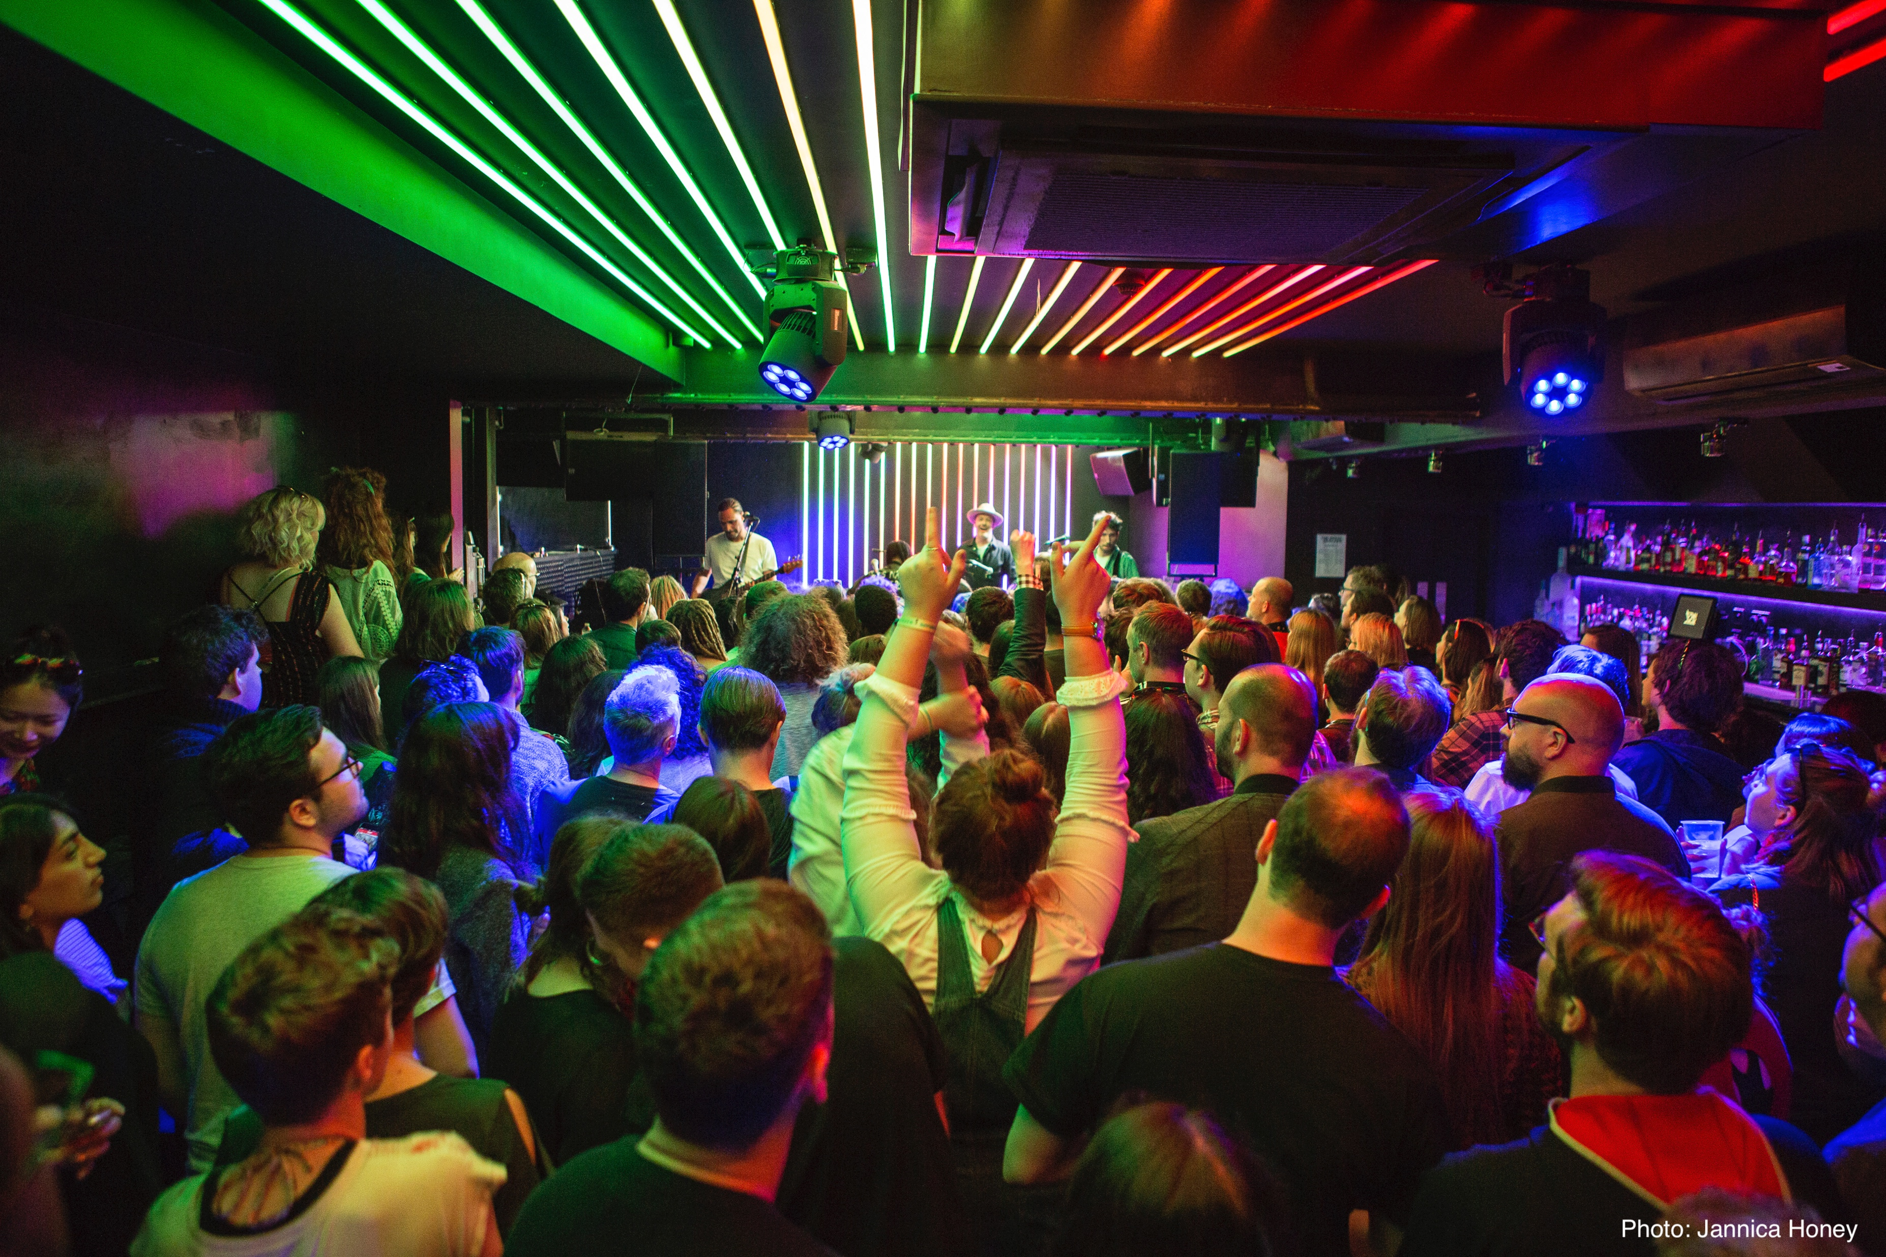
Key Findings
Covid concerns continue: 54% have some concerns about events taking place, with 1 in 5 not wanting to be in crowds
Lockdown impact lingers: 54% less likely to go out, rising to 72% amongst 18-24s and 76% for Londoners
Customers are pausing before purchasing: 16% of consumers are buying later post lockdown
Financial pressures are impacting: 22% report having less disposable income than before lockdown
Some customers are now less frequent gig goers: 22% are going to fewer events overall

Slide 7
Classical Cut
Percentage response v total population
Attitude to attending live music events
Attending fewer events overall (37:22)
Travelling to events feels like a lot of effort (18:10)
Do you have any concerns at all about live music events taking place?
Net have concerns about attending (59:54)
I don’t want to be in crowds (31:25)
I have concerns about Covid/illness in crowds (31:23)

Slide 8
Classical Cut
Percentage response v total population
How do you currently feel about buying tickets for live music events?
I am happily buying tickets for live music events (15:11)
Consider buying for favourite artist, but tickets not a priority (22:14)
Trying to reduce spending to essentials at the moment (29:19)
Tickets are too expensive (39:31)
In 2022, did you buy tickets and then not attend?*
No, if I have tickets, I use them (62:59)
Yes, I bought tickets but then sold them (10:6:1)
Has your approach to buying tickets changed in the last year?*
Buy earlier to guarantee attendance (7:10:1)
Buy later to know I can afford to attend (18:9:4)
Not bought in the last year (34:43:57)
* Where third figure is shown this relates to responses from 55+ age group

Slide 9
Conclusions
While record attendance numbers this summer have shown there is still huge demand for live music, this research highlights continuing pressures
A chunk of our customers are out of the habit of attending gigs while others are looking at attending less frequently due to financial concerns
With the live music industry still rebuilding after lockdown, Government support is required if we are to play our part to driving growth and economic activity across the UK
In particular, reticence amongst our youngest customers, denied the opportunity to develop a gig going habit by lockdown, must be addressed

Slide 10
Thank You

