Slide 1
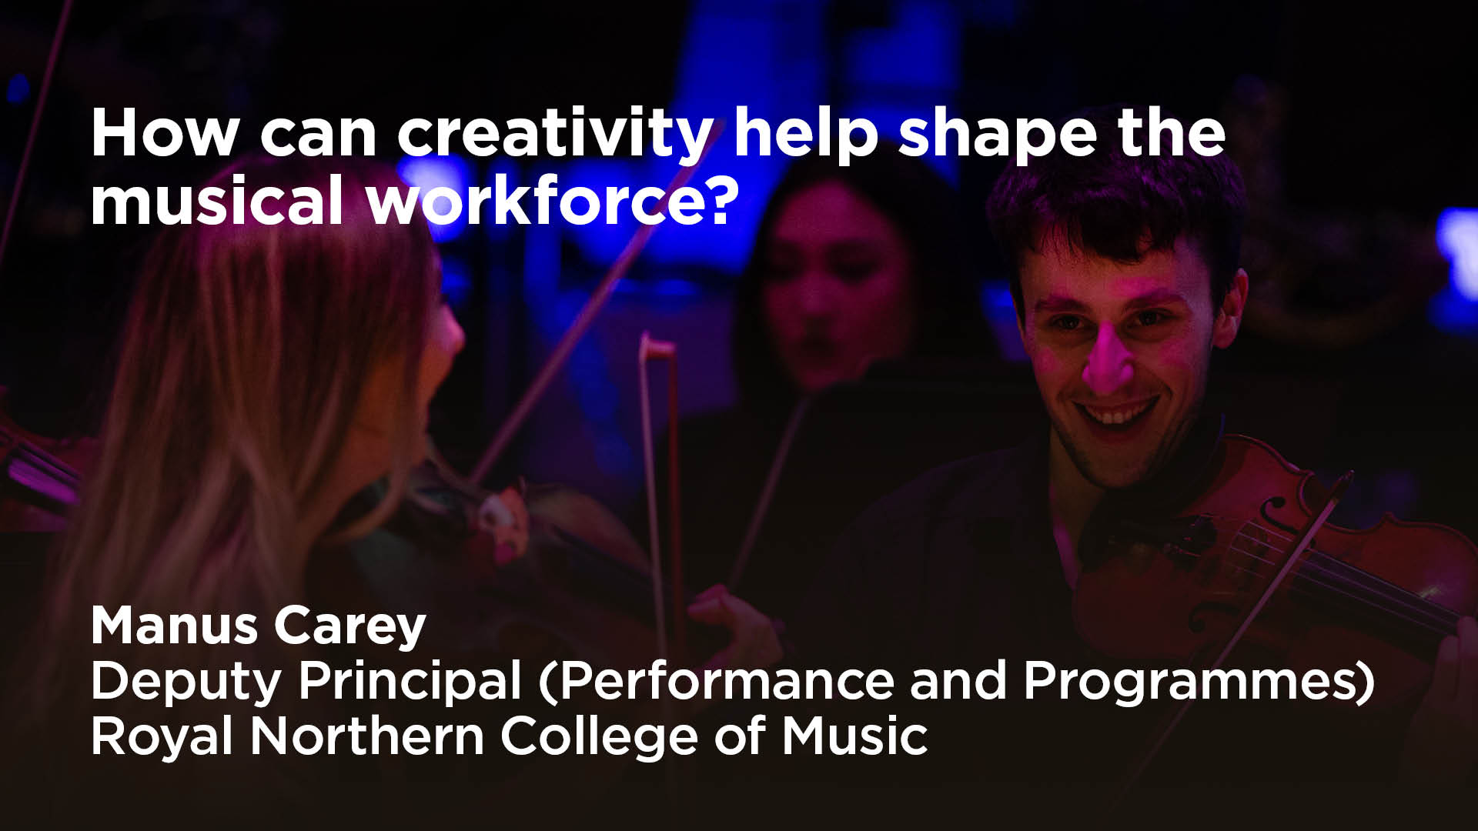

Slide 2


Slide 3
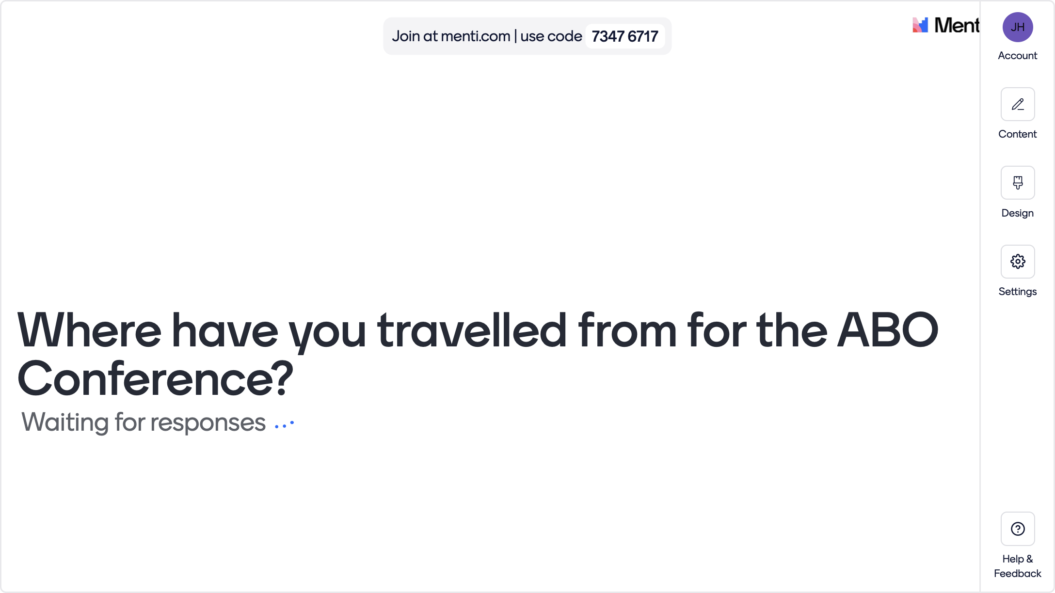

Slide 4
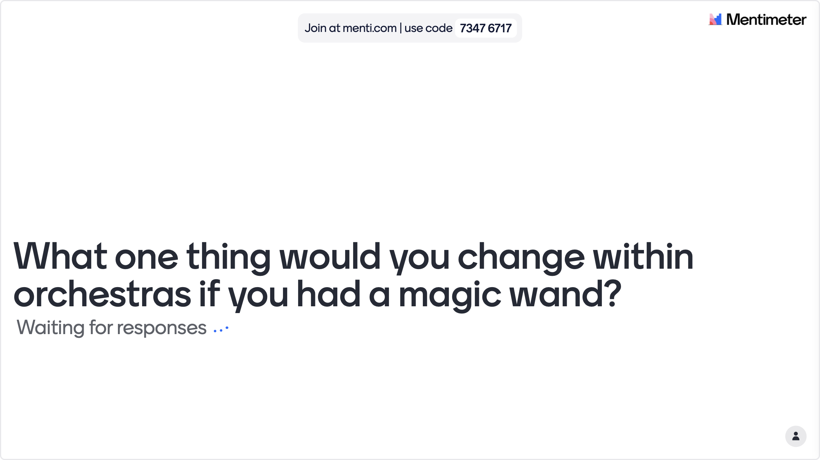


Slide 5
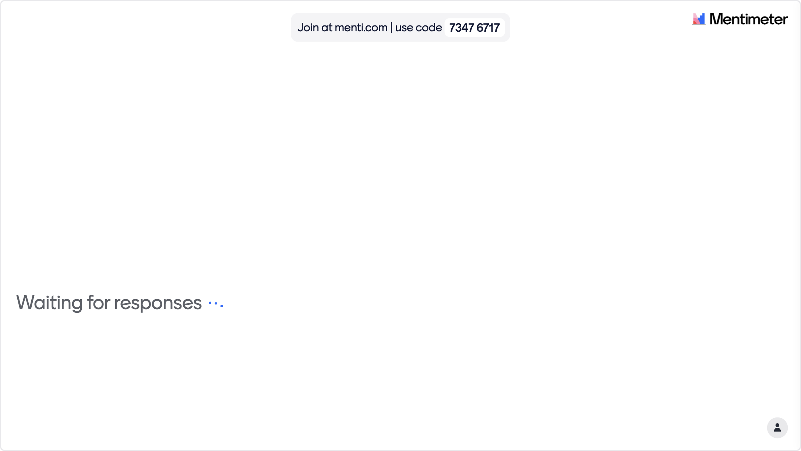

Slide 7
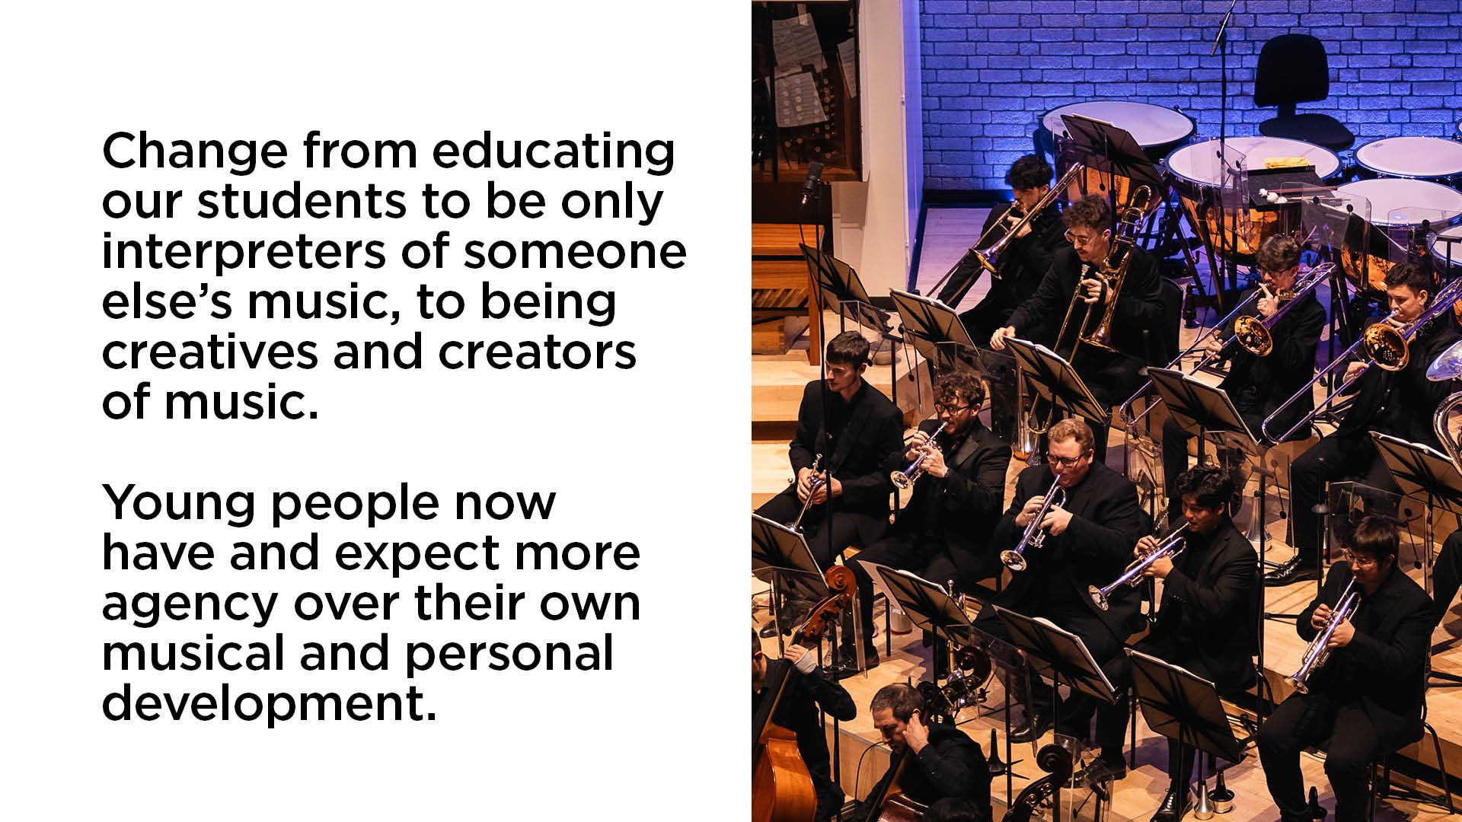

Slide 8
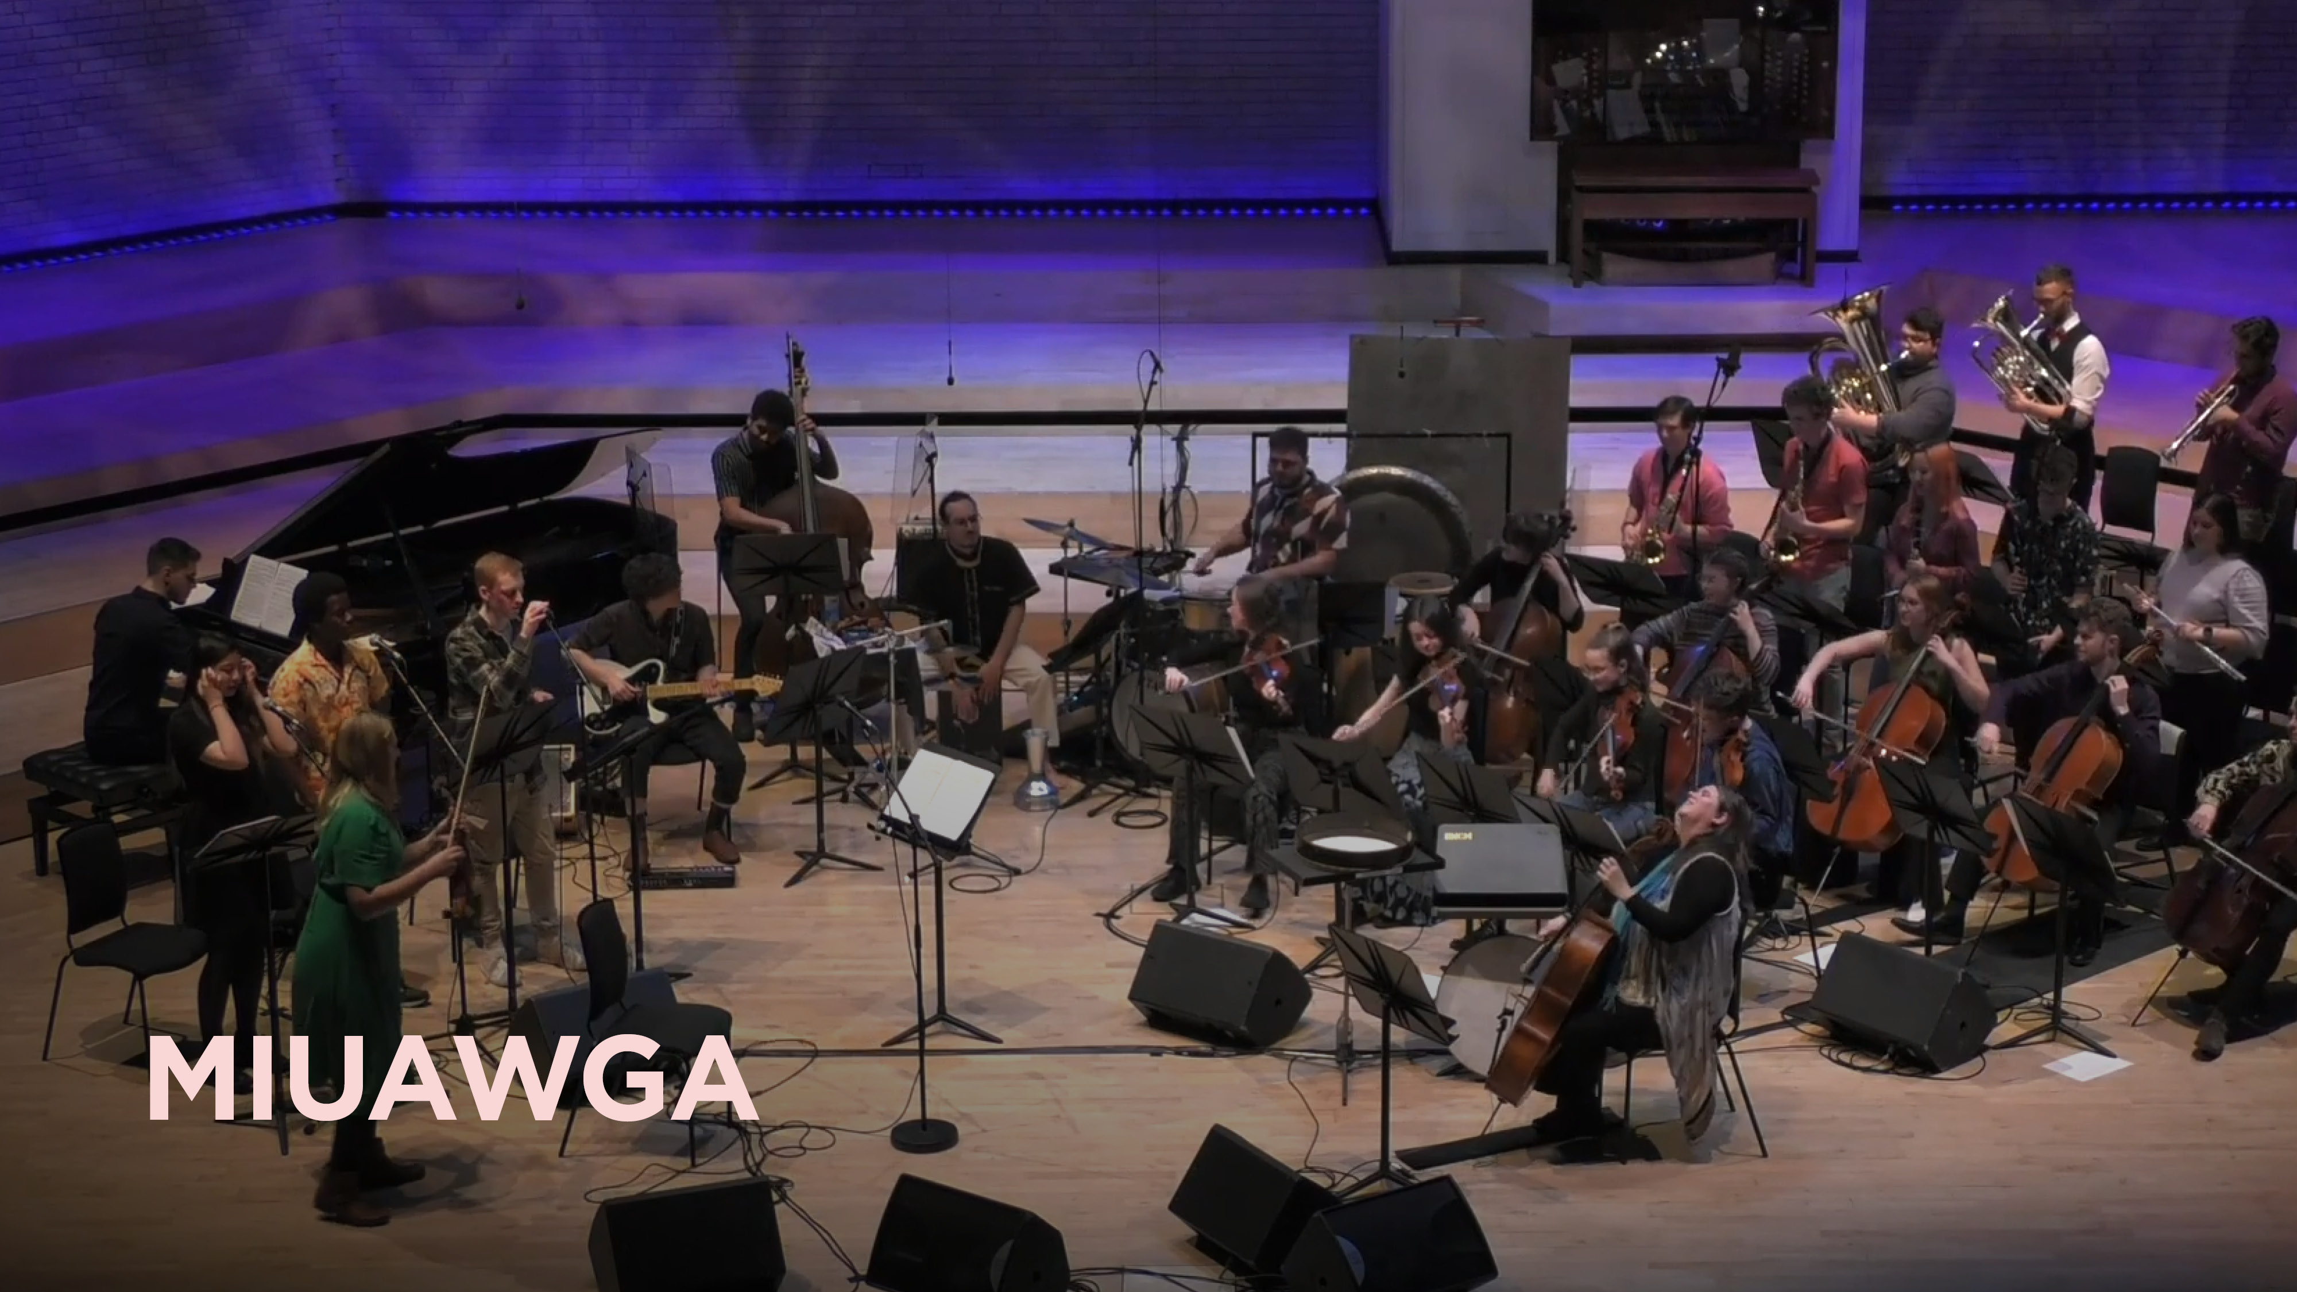

Slide 9
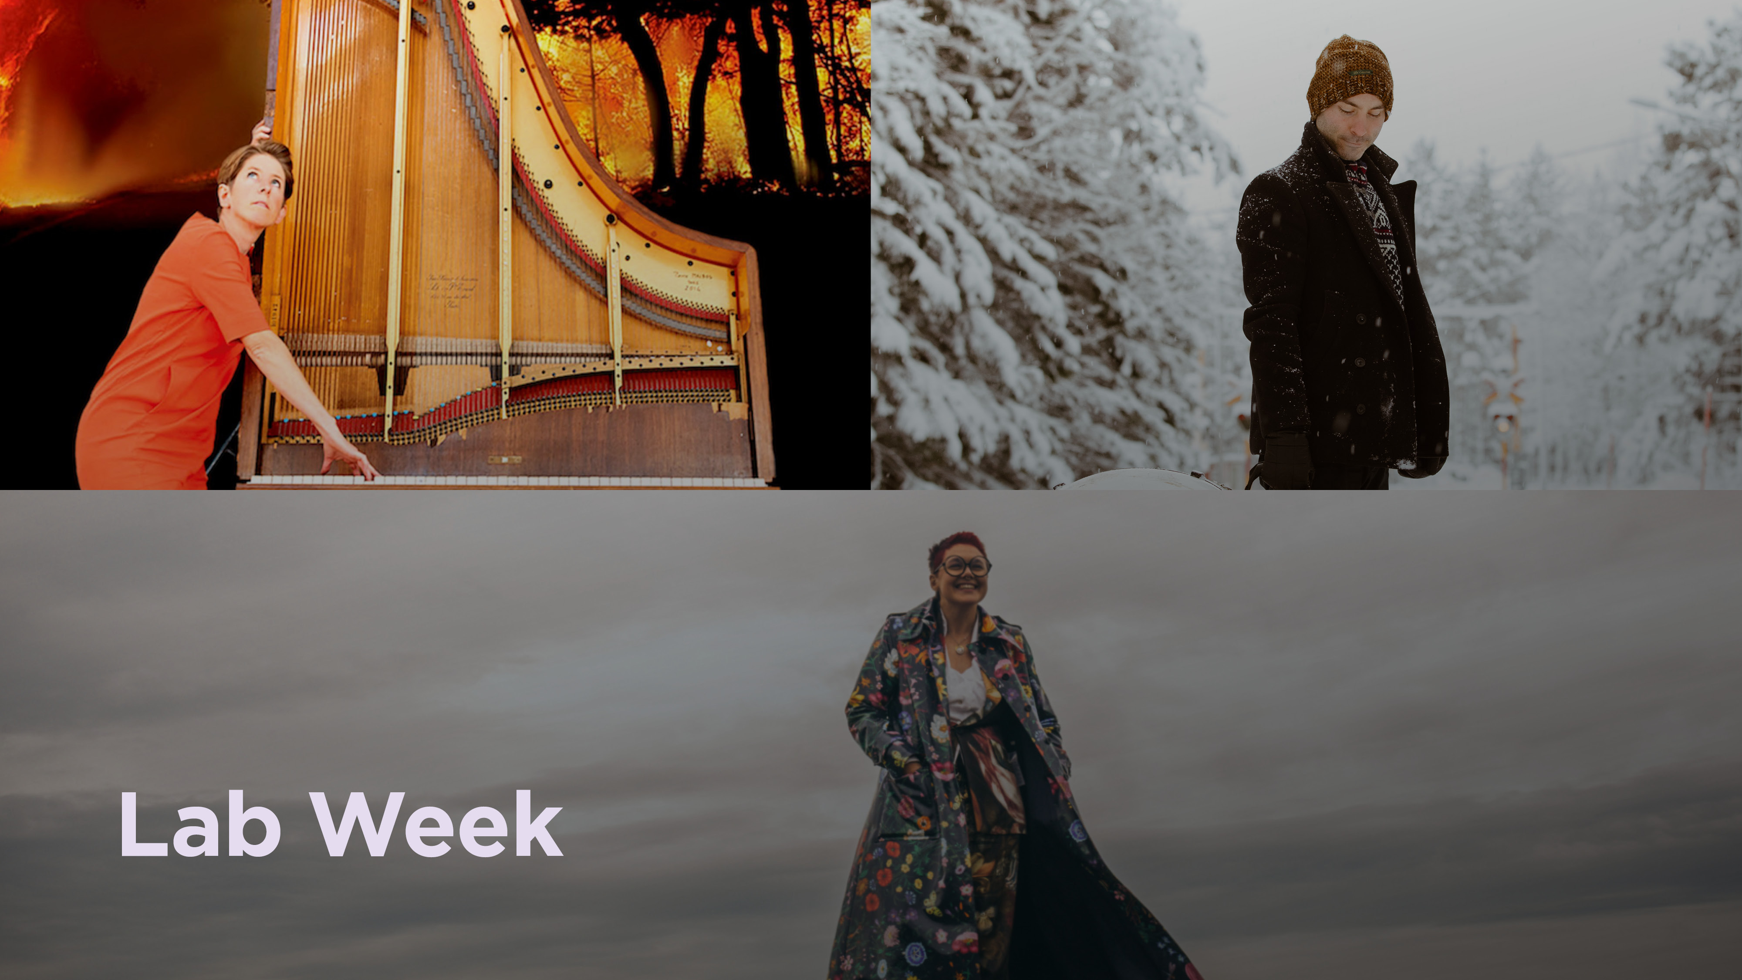

Slide 10
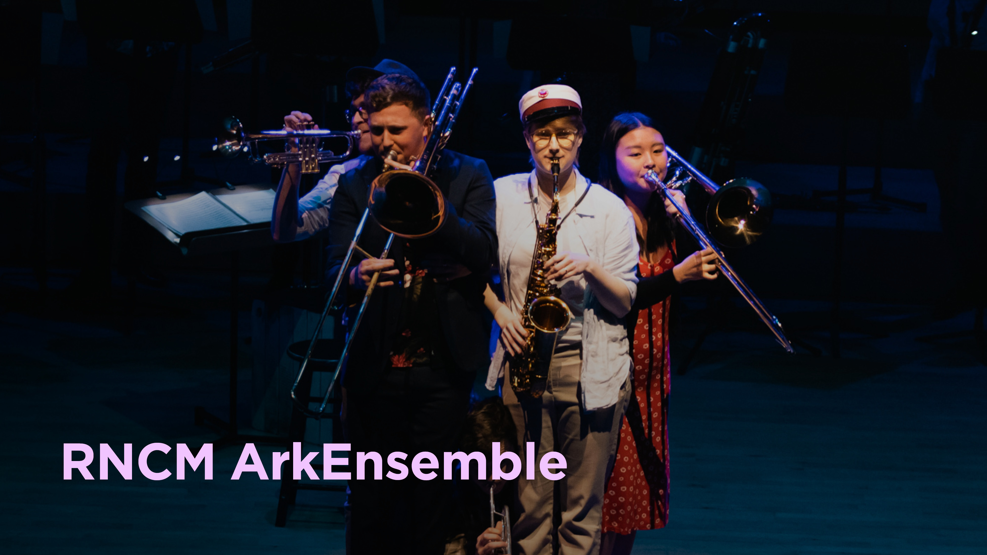

Slide 11
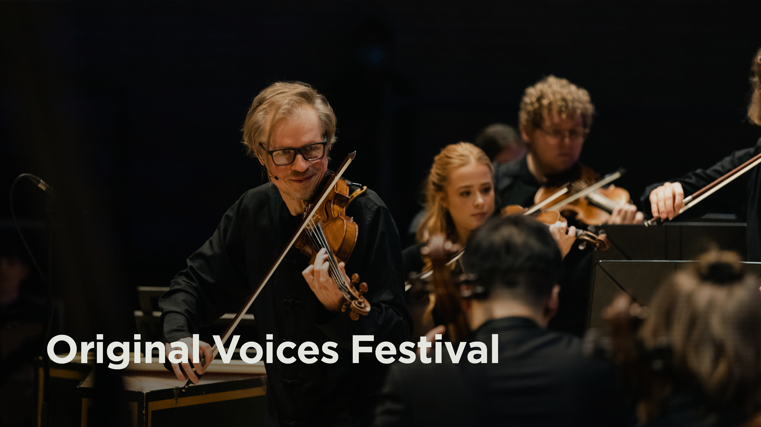

Slide 12
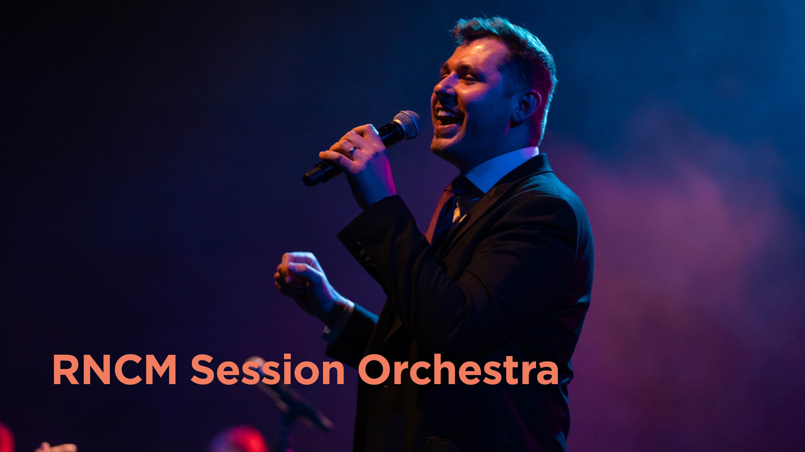

Slide 13
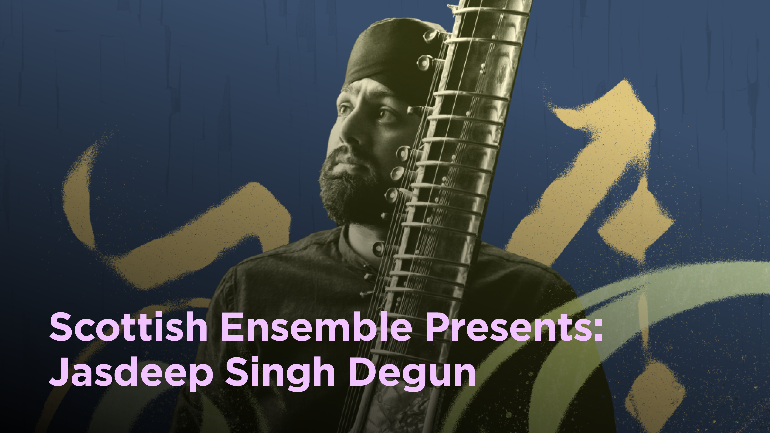

Slide 14
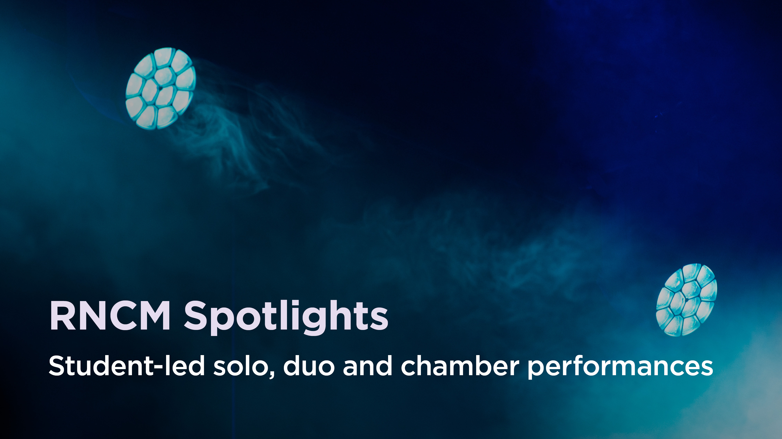

Slide 15
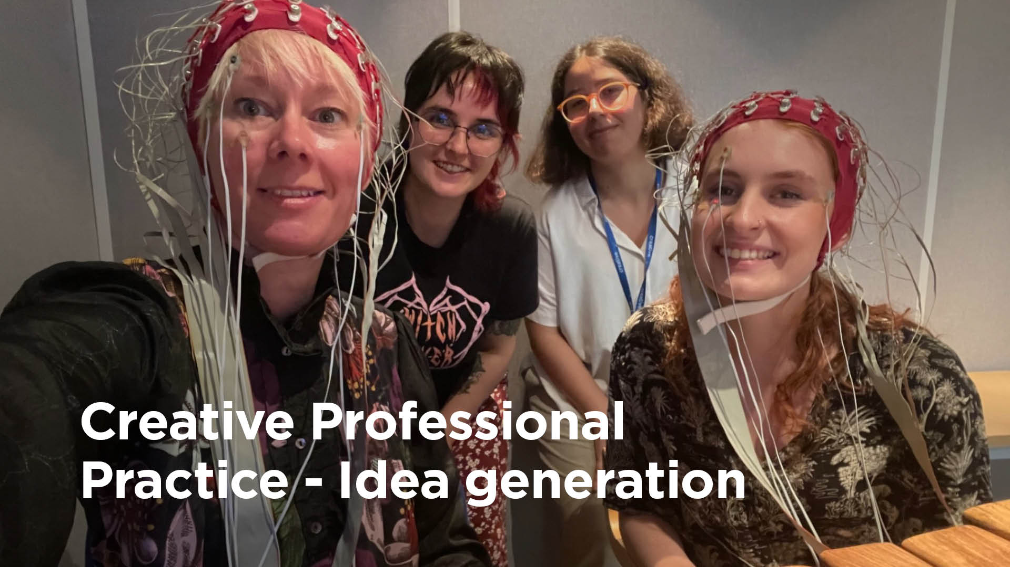

Slide 16
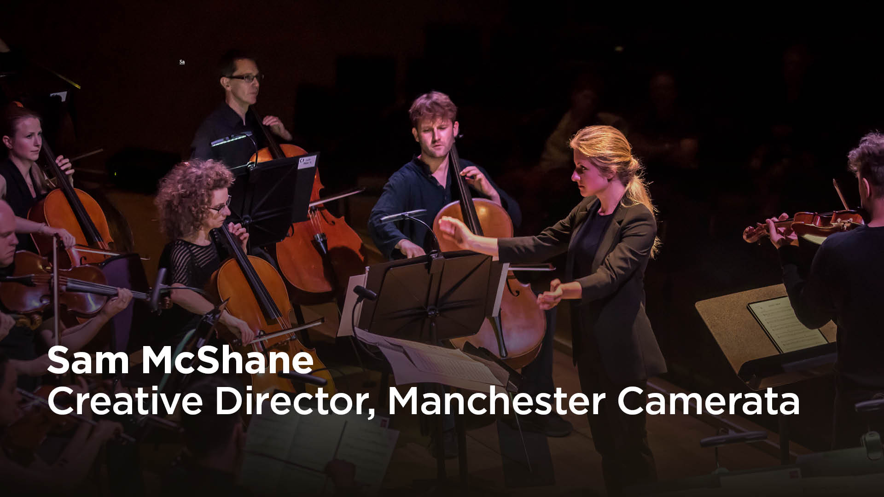
Notes:
Good afternoon everyone – I’m Sam McShane, Creative Director of Manchester Camerata and I’ve had the great privilege of working previously at the Royal Conservatoire of Scotland as well as currently working with the Royal Northern College of Music through my work at Camerata. I’m going to take five minutes of your time to hopefully whet your appetite for our thoughts and discussions in today’s session.

Slide 17
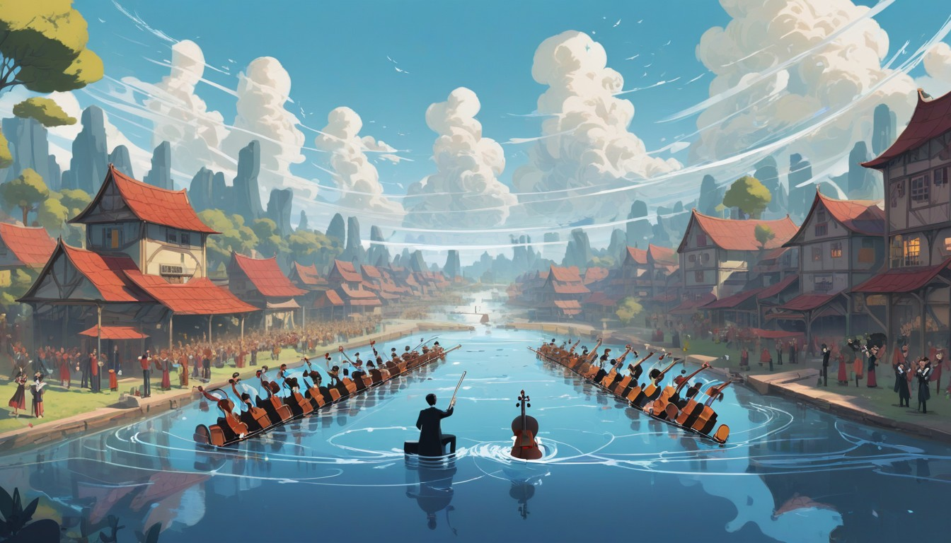

WHERE ARE WE NOW?
TWO VILLAGES WITHOUT A BRIDGE
Notes:
So, where are we now? From my perspective, on our current 100 mile journey, we’re 40 miles in.
Taking inspiration from the image you see here, let's imagine we have two villages - the orchestral village and higher education village, working on opposite sides but separated by water, with no bridge between them. We’re waving over at each other with a desire to get-together to create unity but when we try to build a bridge, we get halfway and then are distracted by our own problems.
Keeping with the same imagery…
The higher education village has a hugely diverse community, working together with new approaches, training for the new world but perhaps struggling to keep the balance of old and new, with many elders within the village unable to see the benefits of a new way of working. This village is so busy with activity that there is often no time for reflection. The purpose of this village is to raise its young people with the knowledge of what is possible out in the world, ready and prepared to work with the opposing village and many others with a diverse range of people and communities. This village's values are important to them – equality, diversity, sustainability and a sense of individualism is evident.
The orchestral village is changing day by day, perhaps not wholly because they desire to but because they can see they need to in order to survive. The elders in the village feel a huge sense of ownership of the tradition and are doubtful of working in any other way. They know deep down that they need to adapt but there are so many systemic challenges to tackle that take priority over everything else. This village isn’t so diverse in terms of its people and any attempt to diversify results in them complaining that the talent and excellence just isn’t there. There are a few groups within the village that are making steps to build the bridge, but not enough to make change quickly enough.
The challenges are clear:
The orchestral village, steeped in tradition and history is run by people who feel ownership over it, who have lived in the village their whole life, who continue with the norm but know if they don’t adapt they will find their population in decline.
The higher education village, whilst it sounds like a brighter place, perhaps doesn’t appreciate how tough times are in the other village and have some relatives of the orchestral village in their midst who bring negativity to a new way of working.
In many ways, both villages are trying to tackle similar problems but aren't speaking about it. Both villages have the potential to make change in the world but are working in silos. The question is, how do we start to build this bridge.

Slide 18




Notes:
There are many examples of programmes within the orchestral world that are trying to bridge the gap – some of these are:
Manchester Camerata’s – 360 Fellows
Royal Liverpool Philharmonic’s – Emerging Musician’s Fellowship
CBSO’s Career Accelerator and Manchester Collective’s Young Artists programme with the Royal Academy of Music – TO NAME A FEW.
These schemes give the opportunity to go beyond side-by-side events – to be involved in Community work, to curate performances, to learn about audiences and marketing and offer a deeper sense of engagement. The organisations have invested in this.
Whilst these exist and the opportunity to engage in a deeper and more meaningful way is there for students, is there a missed opportunity that none of this work, or any other community work is seen on the main stage, as part of our ‘season’. Why is it the case that much of our community and talent development work is shown outside of the season? Don’t our audiences want to see this? Isn’t it ‘serious’ enough? My main question here is, why is the majority of orchestral programming the same as it always has been and if we did adapt this, would it enable some of the qualities that students and graduates are looking for?

Slide 19
What do you want from an orchestral position?
Diversity
More Community Work
Creative Freedom
Stability
Younger Audiences
To feel Welcome
Respect
Agency
Wellbeing
Culture of Positivity
Excellence
Innovation
Transparency
Variety
Flexibility
Rewarding Career
Training
Notes:
A few weeks ago, I asked around 30 students and recent graduates to complete a survey on what they want for their orchestral career. I’ve extracted one question from the survey and given an idea of the types of answers. Culture of the organisation, programming, creative freedom, community engagement, training and wellbeing scored high in the answers as well as financial stability and protection.
Can we provide these things within the structures and models we currently work in or do we need to make substantial change for the future.
One thing is clear, we need to be vulnerable, take off our masks and have open communication before we build the bridge. We don't need grand ideas at this stage, we need to talk and find small and realistic ways to move forward. So whether that is finding out more about your local conservatoire's curriculum or ensuring all of your organisation understand the importance of this work - let’s collectively think about those small steps we can take in order to open up conversation for positive change.

Slide 20
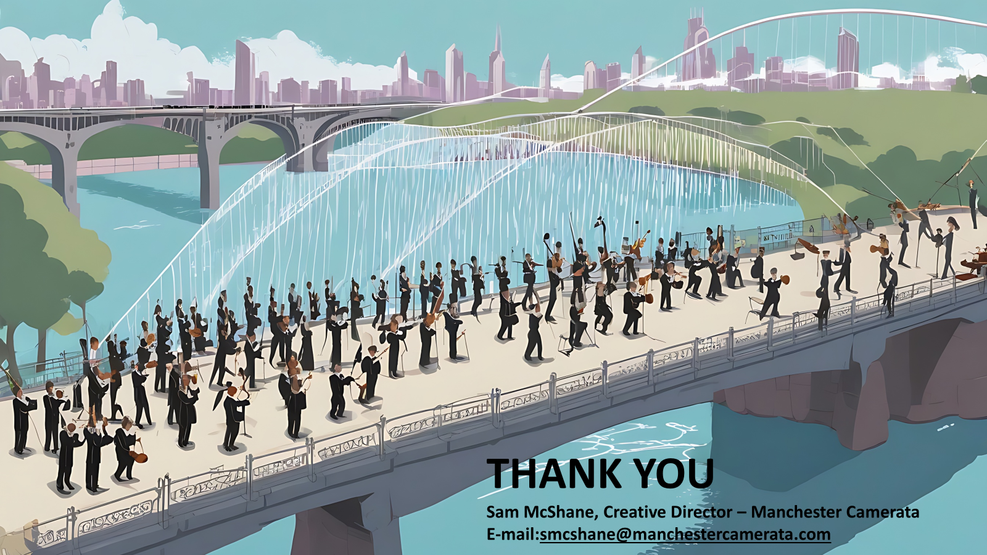
THANK YOU
Sam McShane, Creative Director – Manchester Camerata
E-mail:smcshane@manchestercamerata.com

Slide 21
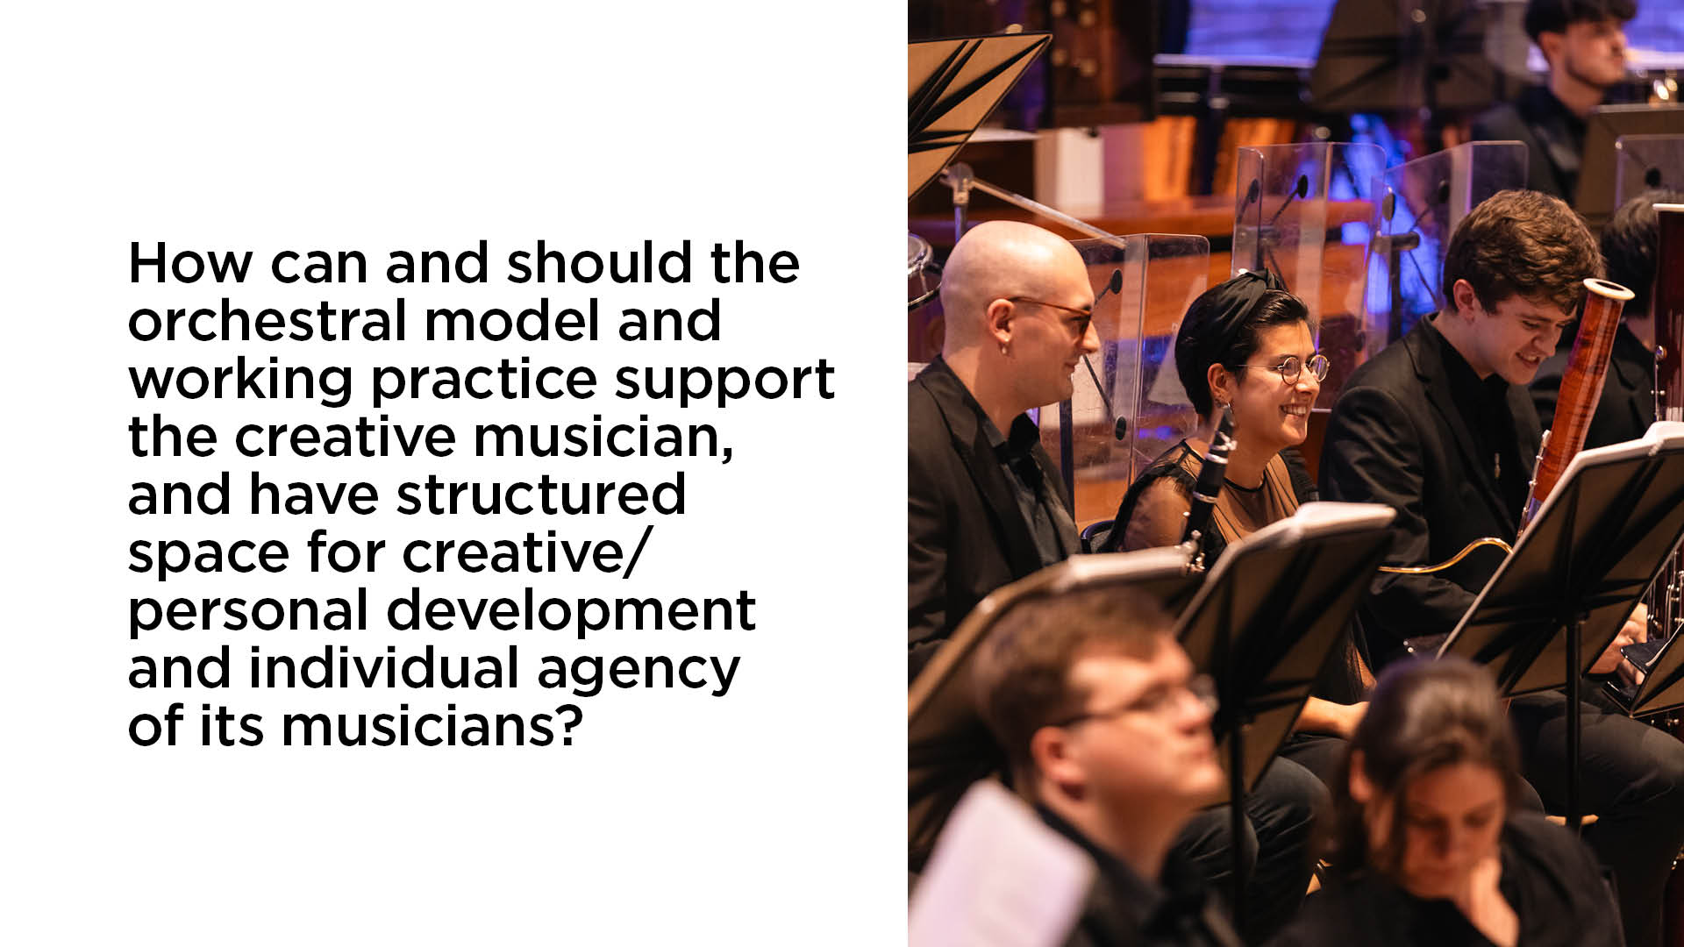

Slide 22
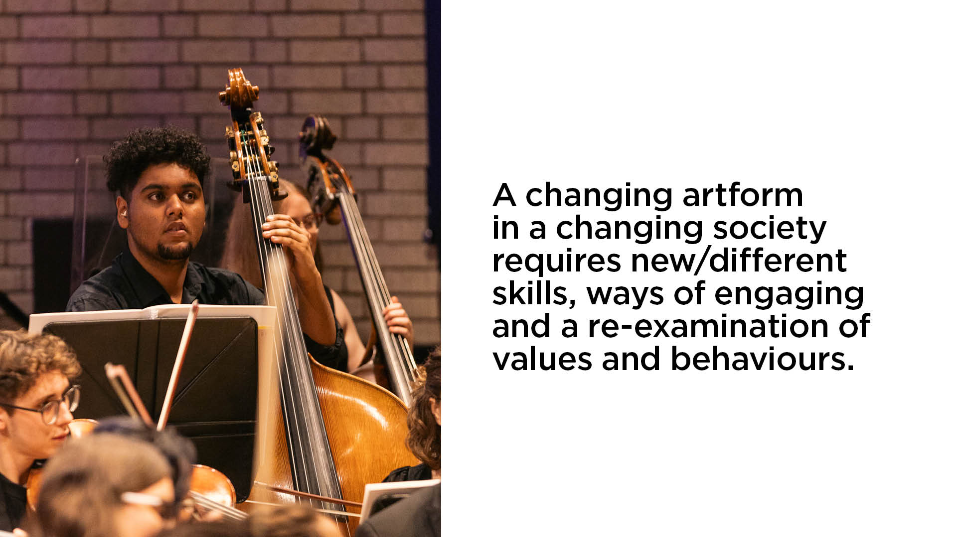

Slide 23
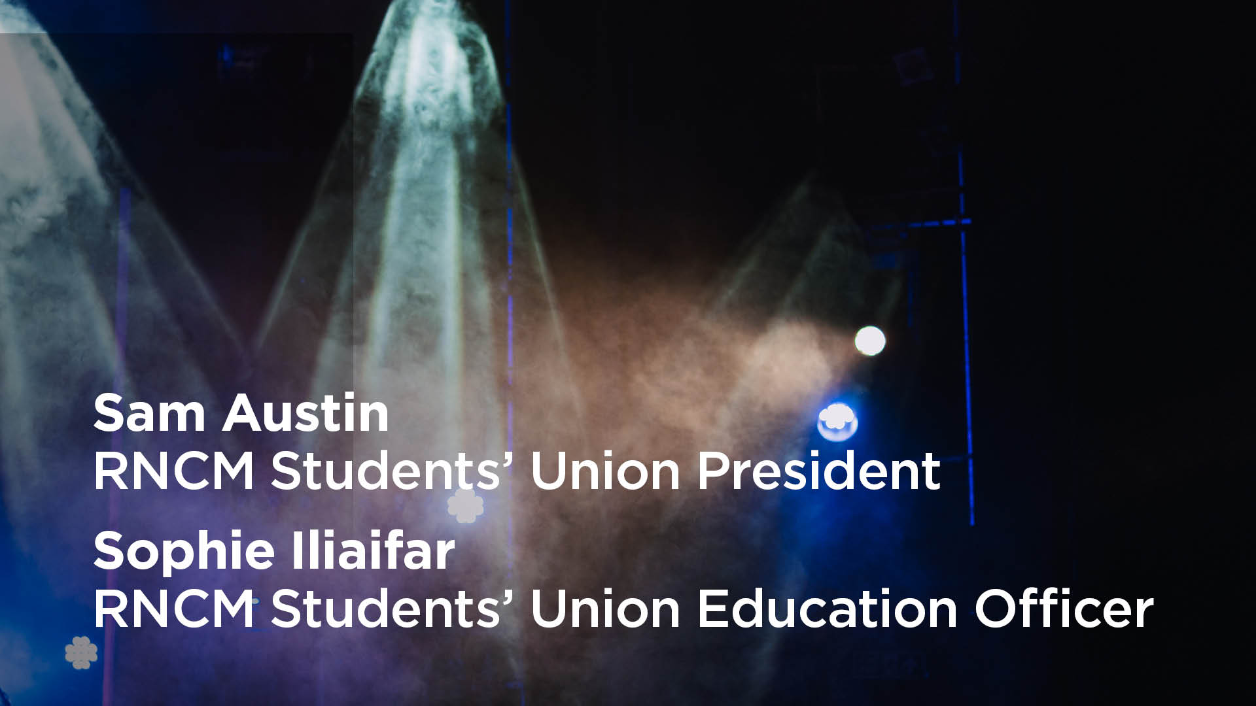

Slide 24
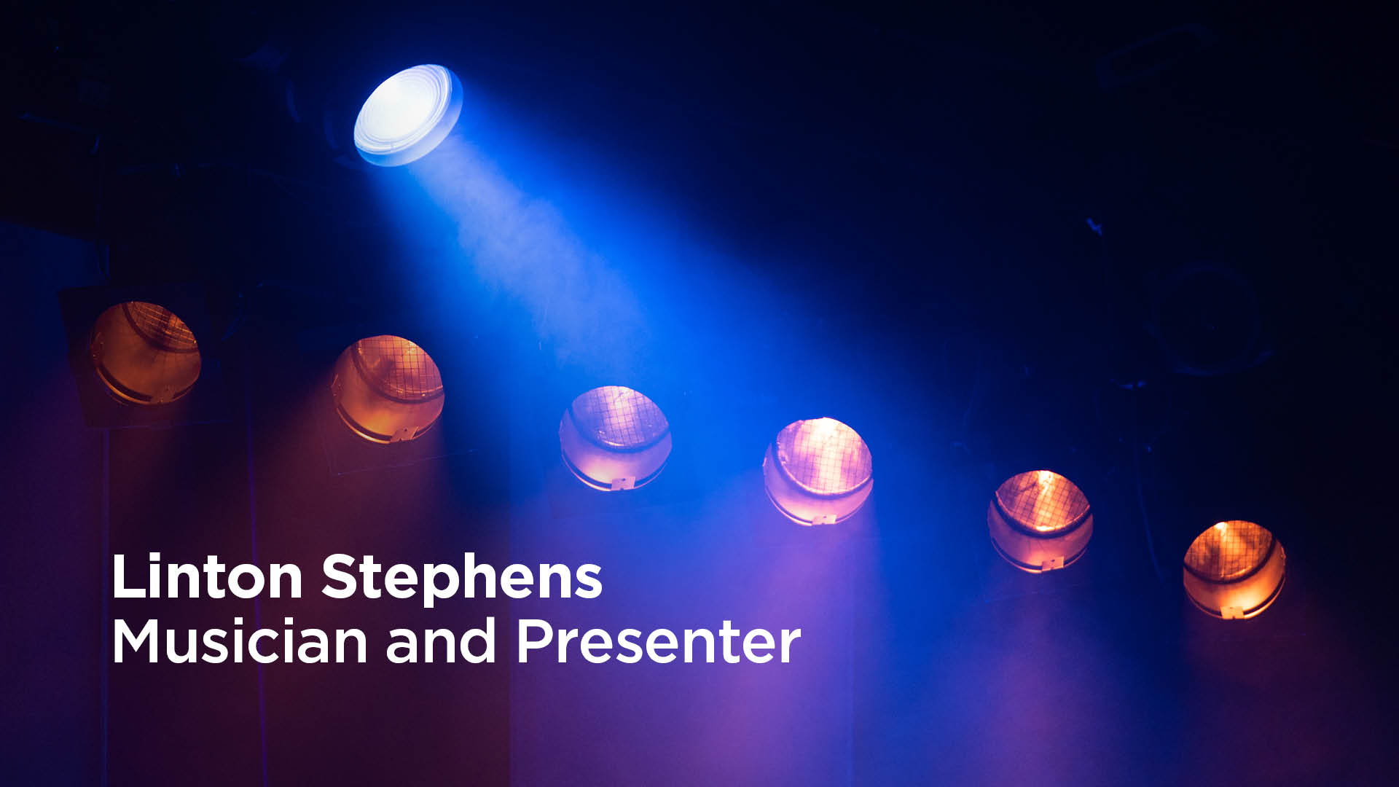

Slide 25
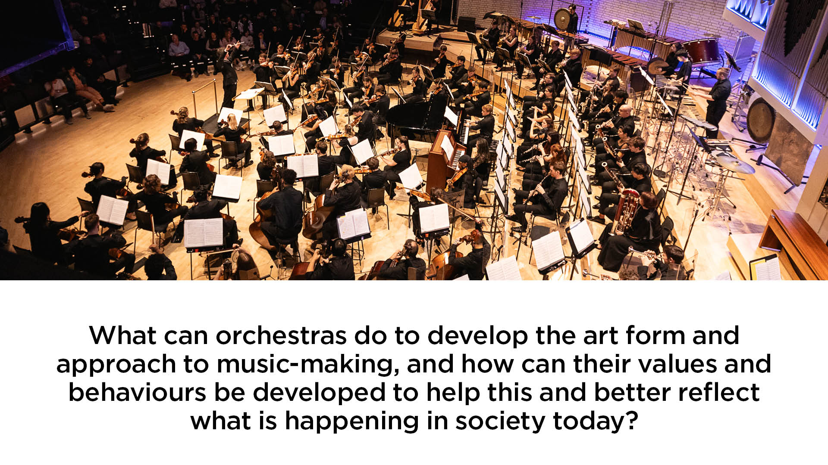

Slide 26


