Slide 1

AI and the music industry

Slide 2
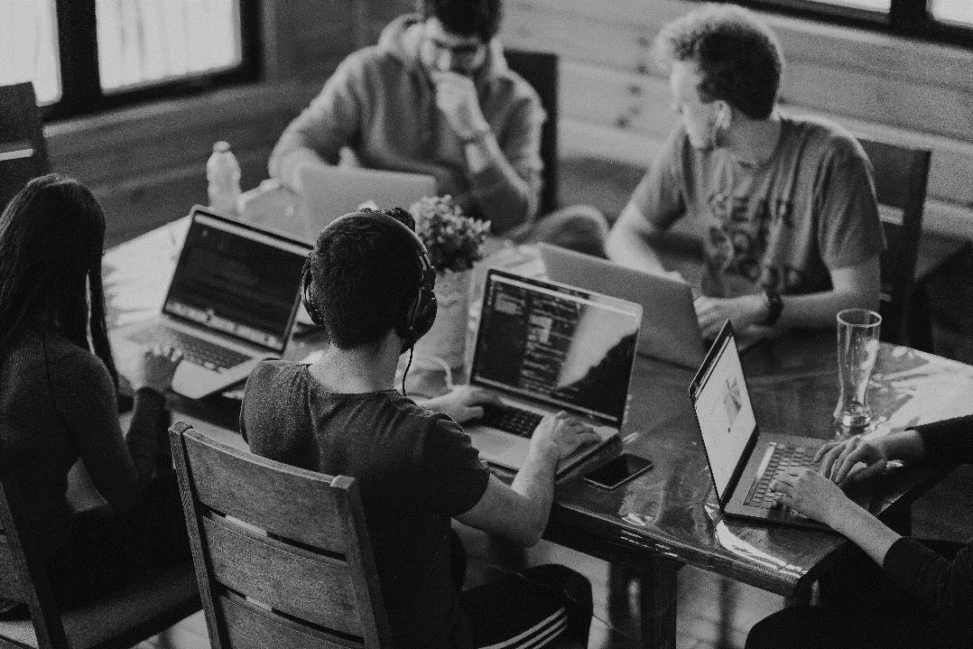
We must ensure that AI continues to enable human creativity rather than erode it.

Slide 3
How The Music Industry Uses AI
An aid to the creative process.
Analytics on audience engagement.
To detect copyright infringement
To predict consumer trends.
To help make more accurate payments.

Slide 4
How Is AI Being Used Against The Music Industry?
Generative AI systems are being developed without regard to the rights of creators and rightsholders.
Music is being used to train generative AI systems without the consent of the rightsholders.
Music is being used to train generative AI systems without payment for the use of the music to be used for this purpose.
Technology exits that can replicate the voice and image of artists and the UK has no legal framework against this. One recent example saw AI used to clone the voices of Drake and The Weeknd for a new song after the software was “trained” on the musicians’ voices.

Slide 5
Parliamentary Activity
June 2022
Publication of IPO Artificial Intelligence and Intellectual Property: copyright and patents report.
February 2023
Sarah Olney MP held a Westminster Hall debate on the potential impact of artificial intelligence on intellectual property rights for creative workers, at which Minister for IP George Freeman said that the proposals would not be taken forward and that further more in-depth discussion would take place.
Summer 2023
IPO Roundtables with tech and creatives.
July 2023
Publication of Culture, Media and Sport Committee Connected Tech: AI and Creative Technology report.

Slide 6
August 2023
Publication of Science, Technology and Innovation Committee The Governance of Artificial Intelligence
September 2023
Publication of Competitions and Markets Authority AI Foundation Models: initial review.
November 2023
AI Safety Summit & DCMS Roundtable.

Slide 7
UK Music Activity
June 2022
Responded to the IPO report & CEO writes op ed for The Times newsletter.
February 2023
Briefed into the Westminster Hall debate.
April 2023
Joined the Human Artistry Campaign.
May 2023
CEO gave evidence at Science, Innovation and Technology committee inquiry into AI.

Slide 8
July 2023
Published members position paper on AI & wrote to DCMS Secretary Lucy Frazer.
Summer 2023
Participated in IPO roundtables.
September 2023
UK Music and members met with a key official of Prime Minister Rishi Sunak & we Launched Manifesto for Music, with policy asks previously seen.
October 2023
AI was discussed at UK Music party conference events.

Slide 9
November 2023
Wrote to the Prime Minister ahead of the AI Safety Summit

Slide 10
Policy Asks
Commit to respecting creators’ and rightsholders’ choice by ruling out any new copyright exceptions or extensions to existing ones. In early 2023, the Government rowed back on plans to allow AI developers to use copyright protected works without the permission of creators and rightsholders. These failed plans highlight the need for policymakers to engage more effectively with the creative industries on AI-related issues and to ensure damaging copyright exceptions remain off the table.
Require those using music as part of the AI training process to maintain records of trained and ingested works. Maintaining records of music ingested by AI applications is vital, especially when determining the consent of the original creators and rightsholders. There is currently no legal requirement to disclose the material AI systems are trained on. Requirements for record keeping and disclosure are included in regulatory AI proposals across the world, notably in the EU and China. The UK must avoid being an outlier on this issue.

Slide 11
Ensure AI-generated music is identifiable, either through labelling or within the metadata, to distinguish it from human created works. Labelling AI generated products allows human creators to be properly recognised for their intellectual contributions and helps protect them from unauthorised exploitation. Labelling also protects consumers from misleading representations of what is or is not AI-generated.
Introduce personality/image rights into the UK legal framework. AI can mimic human creativity, as evidenced by recent examples of music that unlawfully replicated the voices of Drake and Eminem. This technology can easily be abused for misappropriation or false endorsement, potentially inflicting damage on the reputation of artists, songwriters and rightsholders. The absence of a specific personality right in UK law means there are currently limited protections for creators in this space.

Slide 12
2024 Activity
Jan | Session one of APPG on Music mini inquiry into AI and the music industry.
Feb | Session two of APPG on Music mini inquiry into AI and the music industry.
March | Polling Publication of report Proposed update published to CMA to AI Foundations Review.
Other | Possible work with MP to get Private Members Bill in Lords or Commons.

