Slide 1

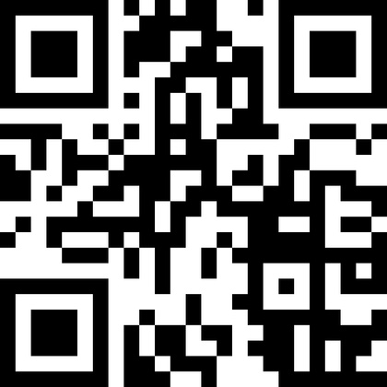




Download our app for all the info.
Scan the QR code and enter event code:
abo2024
Join the conversation!
Use the hashtag #abo24

Slide 2
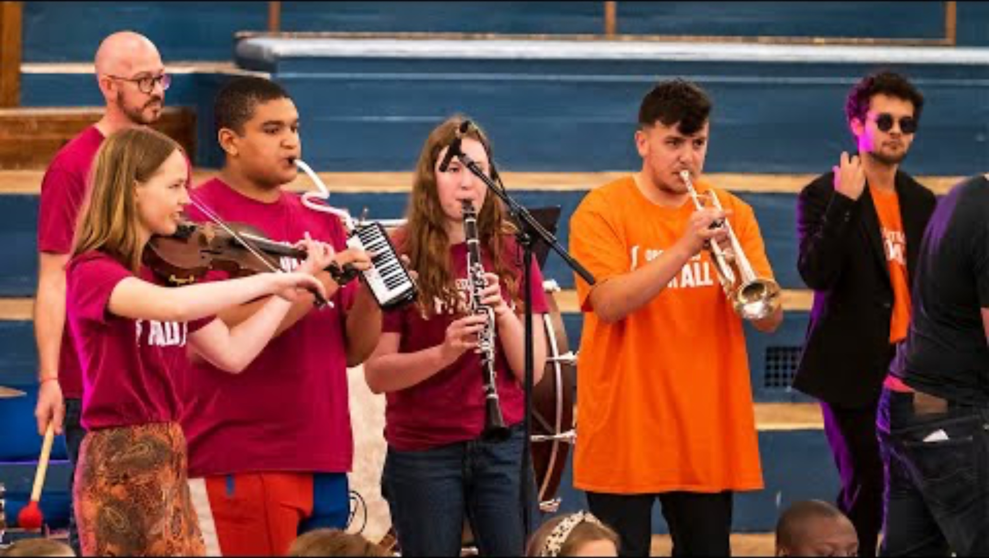
Who we are:

Slide 3
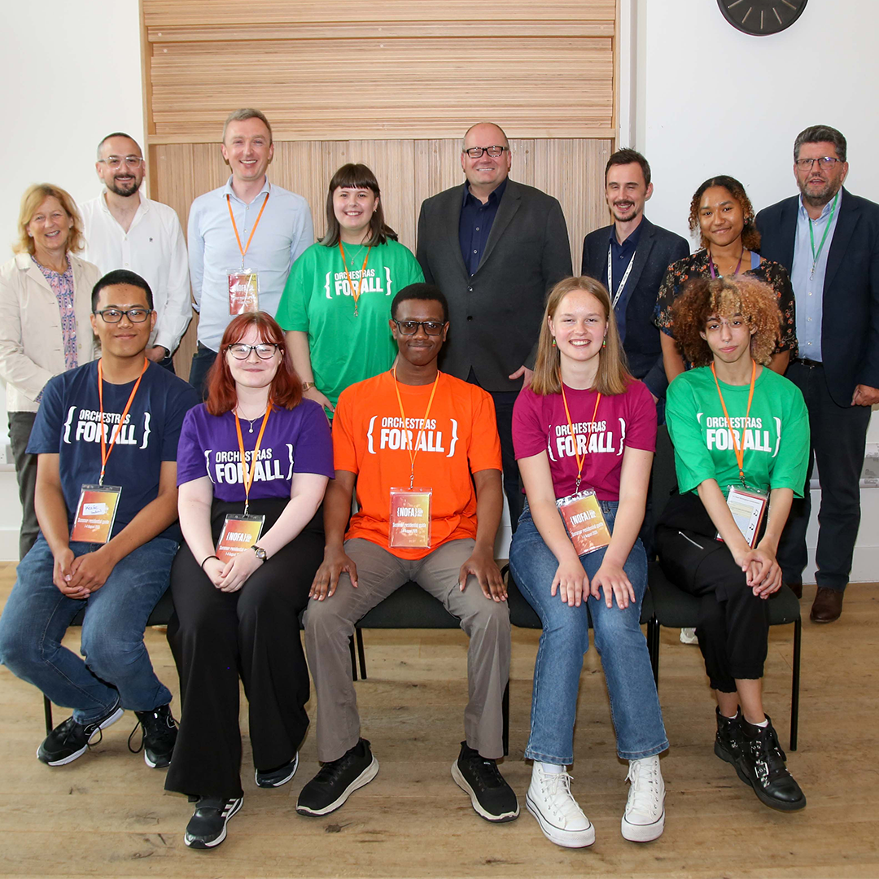
Youth Leadership in OFA:
Trustees
  We are proud to have NOFA alumni, Beth, Joelle and Chloe, sit on our Board of Trustees.
Youth Board
  OFA’s Youth Board is made up of current NOFA members and OFA alumni, aged 114-23. They meet regularly to connect, share their ideas and discuss important strategic questions faced by the charity.
Ambassadors
  Last year, we recruited 10 inspiring NOFA alumni, who joined our team as Ambassadors.
Young Leaders
  During NOFA activity, NOFA members aged 16+ have the opportunity to take on leadership roles. Last year, each of our Young Leaders led and managed our famed recital evening, encouraging members to sign up.
Youth Leadership Coordinator
  Last year we appointed Elen, a NOFA alum, to our full-time OFA team as our first Youth Leadership Coordinator.

Slide 4
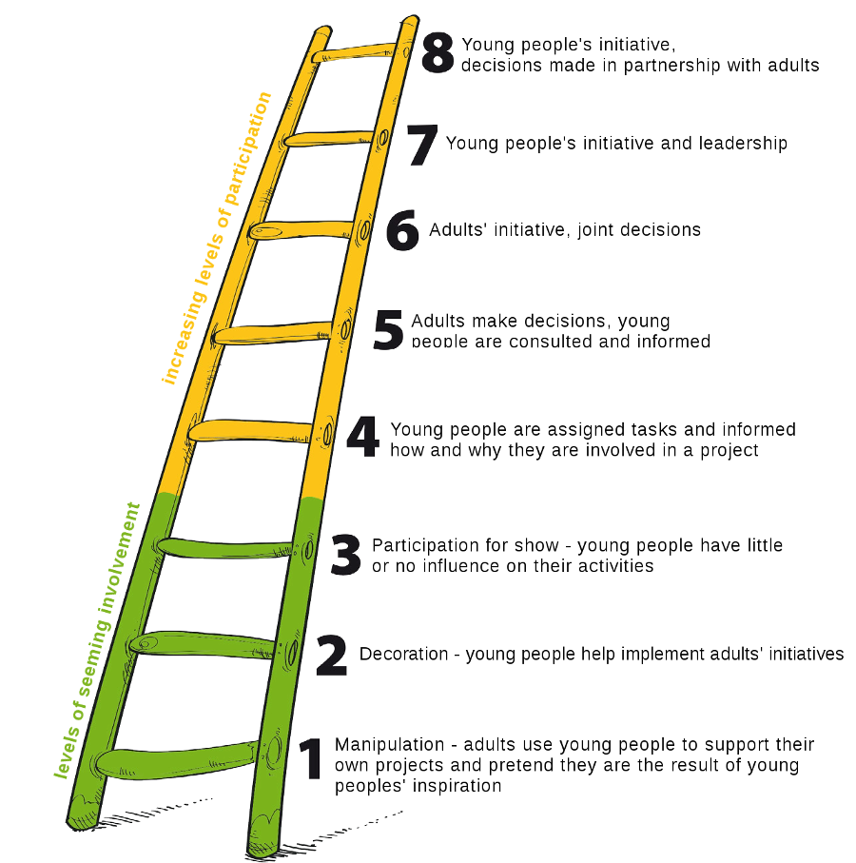
Hart’s ladder of participation:

Slide 5
“Nothing about us, without us.”

