Slide 1
Equality, Inclusion, & System Change
Ewan Hilton
CEO – Platfform

Slide 2
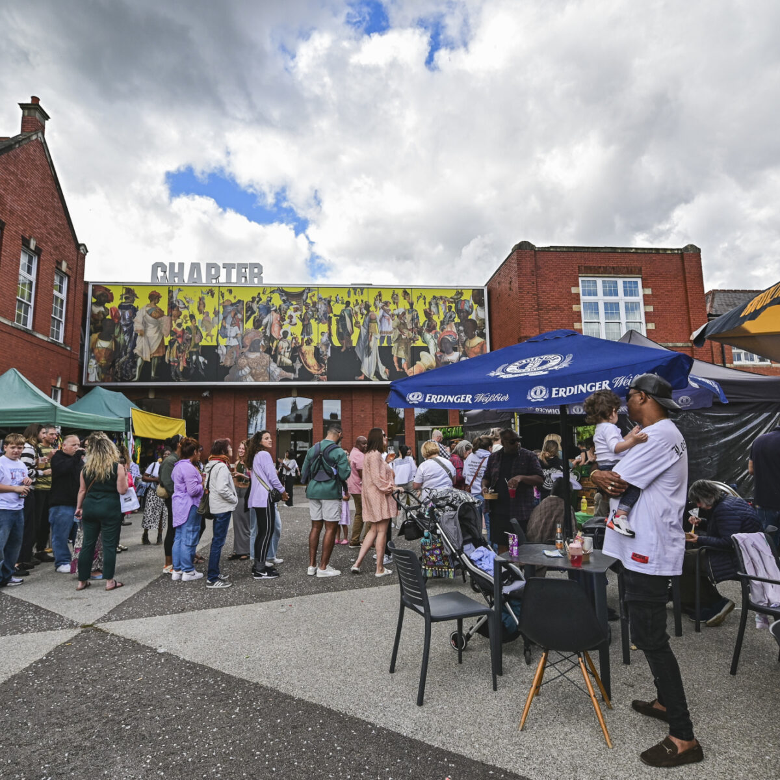

Slide 3
Overview
What do we have in common
A bit about me
Platfform and our journey – with a little bit of Chapter woven in
Some time for you to reflect
Sum up
Questions

Slide 4
What do we have in common
Many of us will be charities, with charitable purpose
Many of us will be in receipt of public money with increasing expectations that we are better and EDI
Yet – we continue to lack diversity in who we employ. Particularly in governance and leadership positions
And in who we reach.
Many of our organisations and institutions, are part of the problem – historic structural barriers to progression and access
There is a growing recognition that we can’t just stay the same, we know we need, and we want to change
But we don’t necessarily know how.

Slide 5
Platfform - Our Purpose
To change the dominant narrative around mental health
  By advocating for the role that trauma, life experiences and socio-economic circumstances have on our mental health + ability to heal.
  By making the evidence for this accessible to help shift public perceptions.
To make our 'helping systems' work better for people
  By changing how we provide services to people in distress.
  Focus first on the mental health, housing, homelessness, and young people's systems we interact with.

Slide 6

OUR MENTAL HEALTH IS LARGELY DETERMINED BY THE CONDITIONS IN WHICH WE ARE BORN, GROW, WORK, LIVE, AND AGE ALONG WITH THE WIDER SET OF FORCES SHAPING THE CONDITIONS
OF OUR DAILY LIVES.9 WORLD HEALTH ORGANIZATION

Slide 7
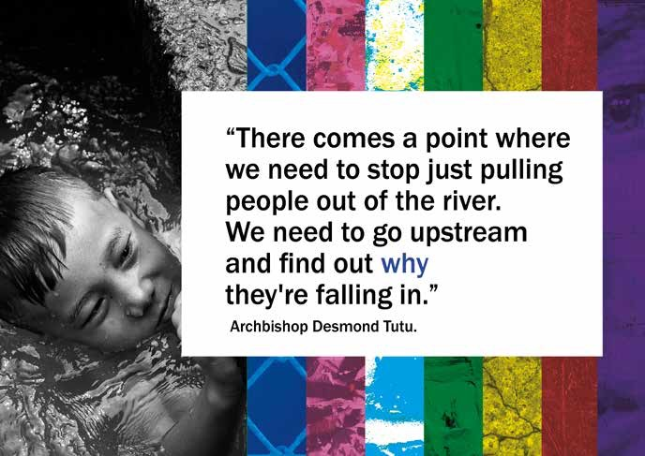

Slide 8
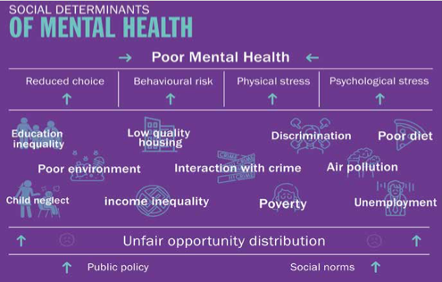
Compton & Shim

Slide 9


Slide 10
Platfform
for mental health and socical change

Slide 11
Reflections
What are your reflections on what you have heard?
How well do you think your organization’s purpose drives you towards increased equality and inclusion?
What more could you and / or your organisation be doing?

Slide 12
What I have learnt
The power of purpose
The litmus test – if it doesn’t contribute to purpose don’t do it
Be brave and be honest
Connect connect connect
Experiment, make mistakes and continually learn
It is all about leadership, organisational culture, power structures and values

Slide 13
Any Questions?

Slide 14
Get in touch
Ewan Hilton
@EwanHilton
ewanhilton@platfform.org
www.platfform.org

